Slide 1
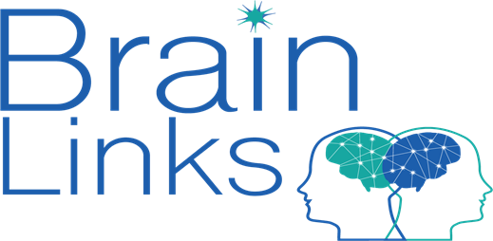
What Foster Parents Need to Know about Concussion
Department of Children’s Services Forster Parent Conference
Jennifer Rayman, EdS, CRC, CBIS
Wendy Ellmo, MS, CCC-SLP, BCNCDS
Notes:
Thank you all for your interest in this topic and for letting have some time with you today to talk about Concussion, Traumatic Brain Injury and Abusive Head Trauma.

Slide 2
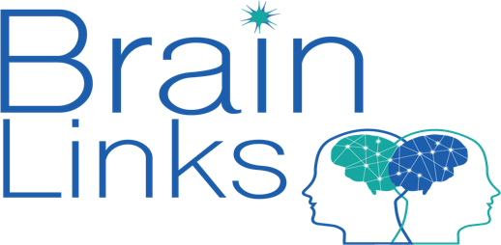
Brain Links is supported by the Administration for Community Living (ACL) of the U.S. Department of Health and Human Services under Grant No. 90TBSG0024-01-00 and in part by the TN Department of Health, Traumatic Brain Injury Program.
Notes:
To tell you just a little about our grant, we are funded by a federal grant with the Administration for Community Living and in part by the TN Dept. of Health.
Brain Links is a program of the TN Disability Coalition.

Slide 3
Brain Links
Statewide team of brain injury specialists
Who we are
We equip professionals to better serve people with TBI with current research-based training and tools.
What we do
Family-friendly educational materials
Resources for return to school and work settings
Toolkits for healthcare providers and school nurses
Notes:
Here’s a little more about us: Brain Links is a statewide team of brain injury specialists. There are four of us total. I’m in East TN, we have Wendy and Paula in Middle and Carrie in West TN.
We equip professionals to better serve people with TBI with current research-based training and tools.
One thing I like best about us - We work had to make sure that we offer family friendly materials that are interesting and easy to use.
Our resources are made to serve people all ages – from 0-5 to school age, to adult and older adults.
Our toolkits are a collection of some of our newer resources – we designed them for healthcare providers and school nurses.
Source:
Report to Congress: Traumatic Brain Injury in the United ...www.cdc.gov › traumaticbraininjury › pubs › tbi_report_to_congress

Slide 4
Agenda
Six types of concussion and ways to treat them
Danger signs of concussion
Helpful resources in the community and online
Notes:
"Traumatic brain injury (TBI) is a leading cause of death and disability among children and young adults in the United States. Each year an estimated 1.5 million Americans sustain a TBI.”
It’s likely that you are joining because you have someone you know who has or may have sustained a brain injury.
************If you’ll take a moment, please go to the green check mark and let me know if you have someone you care for or work to support who has a TBI.
With our time today, we’ll talk about a new model for treatment of TBI/Concussion, what to look for and where to go for help.

Slide 5
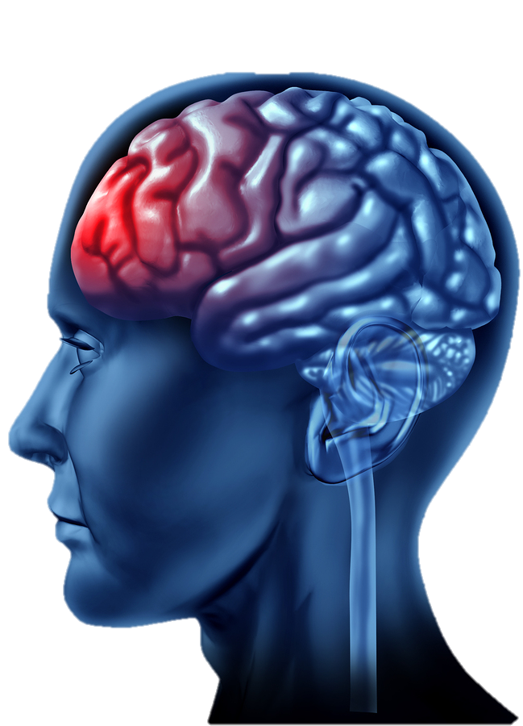
What is TBI?
A Traumatic Brain Injury is caused by a bump, blow or jolt to the head or body, or a penetrating head injury that disrupts the normal function of the brain.
Notes:
One of the most important things to remember about a TBI is that your head doesn’t have to hit something. You can experience a concussion or more severe brain injury when you experience a hard jolt, like in a car crash – like whiplash. You don’t have to lose consciousness. Only 1 out of 10 people actually lose consciousness.
There is so much to consider when you talk about injuring your brain. The injury and the changes that occur are unique to the individual. As you think about things today, maybe you’ll have questions about someone you know. We are starting this series for DCS because there are many topics to cover. Your brain controls everything you do, think, say, feel, remember and learn. Your brain controls your breathing, your heart. Every part of your life is controlled by your brain and if you sustain an injury, it’s likely that you’re going to need some supports.

Slide 6
TBI Can Happen in Many Ways
Falls
Car Crashes
ATVs
Whiplash
Sports Injuries
Being Shaken Violently
Domestic Violence
Cycling
Jumping on the bed/playing
Assault/Self-harm related TBI
Notes:
TBI can happen when you’re least expecting it. You don’t have be doing something dangerous to get hurt. It may be more common when driving or playing sports, but sometimes a common daily activity like stepping down from a bus is how people are hurt and have long lasting symptoms.
Falls are most common in the youngest and oldest but in some states – falls are highest for all ages, followed by motor vehicle related accidents, etc.
Sadly, some injuries are caused by violence - harming ones self or another person. This may be a little difficult to think about but some injuries could be prevented.

Slide 7
Can also Include:
Repeatedly smacking someone in the back of the head
Throwing someone against a wall
Punching them in the face
Falling off a bed
Whiplash from a car accident or being pushed
Strangulation
Being physically bullied at school
Notes:
When we think about TBI, we probably first think of car crashes and sports injuries. You may not think of an injury like whiplash from a car accident that seemed minor. You may not think of being pushed or hit or hurt while being bullied as a cause to sustain a brain injury, but it can be. A hard hit to the head or body can cause a brain injury. Stopping from breathing can cut off oxygen to the brain and cause an injury. Any injury to the brain is serious.

Slide 8
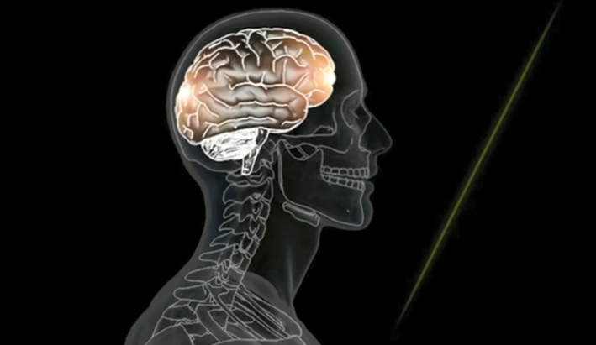
Concussion is a Type of TBI
Functional Injury vs. Structural Injury
Chemical Cascade
CT Findings
https://www.youtube.com/watch?v=Sno_0Jd8GuA
Notes:
https://www.youtube.com/watch?v=Sno_0Jd8GuA
If you have had a concussion or know someone who has, concussion is a type of brain injury.
With concussion, it’s more apparent as a functional injury – that means it shows up more in change of your ability to do things and less as a structural injury – where you might see the injury from the outside or on a brain scan.
We were talking about whiplash and how being pushed or shaken or a seemingly minor car accident can cause TBI.
Look at this image and think about the lit up spots in the front and back of the brain. This is an example of a coup contrecoup injury. Think of the person driving and they are hit from behind and slam on their breaks and the car stops suddenly. Their head may jerk forward, the brain moves forward, too, inside the skull. That’s injury #1 – the coup- in front – just over the eyes. Then all in the same split second, they are bouncing back against the seat. The brain moves, too, and then is injured a second time in the back – that’s the contra coup. This could happen from side to side, at multiple sites. It depends on how you are moving. Your head doesn’t have to come into contact with anything for the injury to occur. And it is likely invisible from the outside, so it will probably not been seen in a CT scan.
The chemical cascade is when chemicals at a cellular level rush out from parts of the brain to other parts and cause the injury (like tearing, swelling) and symptoms.
Computed Tomography.

Slide 9
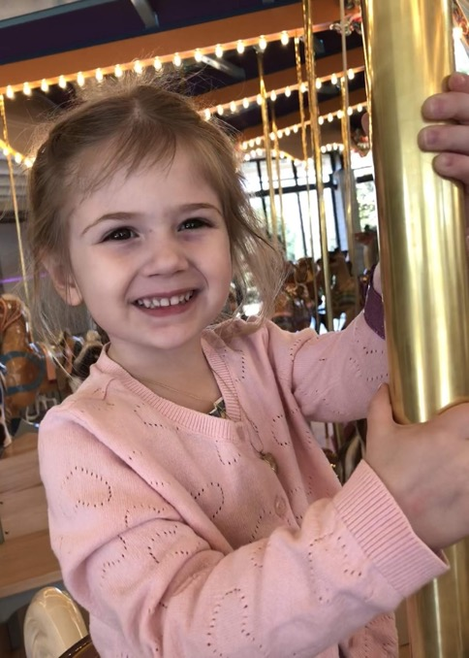
Common Symptoms following Concussion
Cognitive/Communication
Feeling dazed or in fog
Word finding problems
Slowed information processing
Physical
Headaches
Changes in vision
Sleep disturbance
Fatigue
Balance/Dizziness
Sensitivity to light/sounds
Emotional/Behavioral
Irritability
Quick to anger
Decreased motivation
Cries easily
Notes:
As we just said, everything you think or do, your personality and emotions – EVERYTHING – is controlled by the brain. So the list of possible symptoms is HUGE!
Some symptoms you can’t see from the outside, but those can be just as serious as those you can see. In children, you might see a child who is more irritable, cries more, seems like they are not motivated or can’t get started on tasks.
Headaches and fatigue aren’t always easy to observe, especially in younger children, but they can make it hard to learn in a classroom. Think about getting a poor night’s sleep and having any of these other physical symptoms and trying to listen to instructions or follow directions.
Easier to observe: Balance, Motor Coordination, Word retrieval, Forgetfulness, Irritability, Sleep Disturbance.
Less noticeable: Headaches, Changes in vision, Feeling Confused, Depression

Slide 10
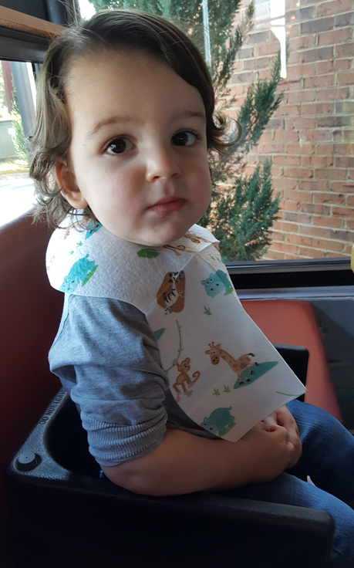
Common Symptoms Following Concussion for the Younger Child
Same as Older Child or Adult, but also
Appetite Changes
Behavioral Dysregulation
Decreased Engagement
Disrupted Sleep
Continence Issues
Increased Dependence
Stomachaches
Suskauer et al, 2018
Notes:
With younger children, they may not be able to tell you what they’re feeling or what is wrong. So you may have to look more carefully to notice changes – changes in sleep, appetite, continence issues.
There was a study in 2018 about concussion symptoms in younger children, that focused on reports from the main caretaker (parent or guardian in same home). There was a significant finding in all of these types of symptoms.
With Behavior dysregulation – they reported tantrums, hitting, biting, more crying that before injury.
With Decreased Engagement – may overlap with feeling fatigued or slowed down.
These two are very important, what we tend to see is decreased engagement at time of injury, sitting on couch, quiet, don’t want to do anything. That makes sense because they were just injured. Then, they’re more active again, back to regular life. Then we see this time of dysregulations where they’re acting out, having tantrums, pushing other children, getting in to trouble. Because they were so “good” before the injury, then after for some time, it’s missed that it is was due to the injury. So we have to watch for this pattern of behavior and change – after the injury a little down the road or it’s missed.
Additional young child symptoms from: Suskauer, S.J., rane,S., Reesman, K., and Slomine, B.S. Caregiver-report of symptoms following traumatic brain injury in a small clinical sample of preschool-aged children. J. of Pediatric Rehabilitation Medicine: An Interdisciplinary Approach 11 (2018) 7-14.

Slide 11
Missing the Very Young:
What to look for
Touching or holding their head
Startling to light or noise
Forgetting routines
Changes in any skill they already had
More clingy, emotional or withdrawn
Not eating their favorite foods
Waking at night
More tantrums or disruptive
Stomach issues
* These behaviors would also be relevant for someone who communicates without words
Notes:
You can look for these changes, like touching or holding their head, reacting differently – startling to light or noise. Less interest in favorite foods, waking up during the night, stomach issues.
We’re talking about children, but keep in mind that these behaviors would also help you to look for signs of concussion symptoms in someone who does not speak or communicates without words.
************Do you care for someone who may not be able to verbally tell you what they’re experiencing?

Slide 12
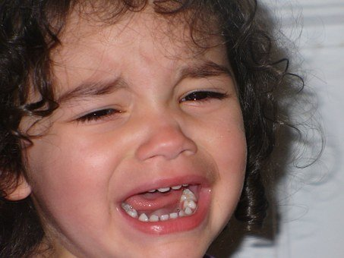
Missing the Very Young:
Pain Indicators
Signs of Pain:
Excessive crying
Anxious or agitated
Increased muscle tightness
Facial changes (tense or stressed)
A lot of physical movement
Changes in breathing
* These behaviors would also be relevant for someone who communicates without words.
Notes:
Signs of pain in the very young could include being agitated, tense or stressed facial changes, changes in breathing.

Slide 13
Danger Signs
One pupil larger than the other.
Drowsiness or inability to wake up.
A headache that gets worse and does not go away.
Slurred speech, weakness, numbness, or decreased coordination.
Repeated vomiting or nausea; seizures.
Unusual behavior, increased confusion, restlessness, or agitation.
Loss of consciousness.
Emergency
CDC.gov
Notes:
These are danger signs, Although you might have heard about checking pupils or keeping someone awake with a head injury, they’re not usually associated with concussion.
One pupil larger, drowsiness, loss of consciousness – these are all danger signs to seek medical attention immediately.
*Once they have been assessed, no need to wake them every hour like we did in the past.

Slide 14
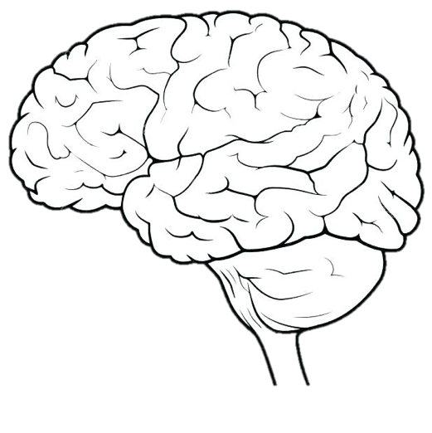
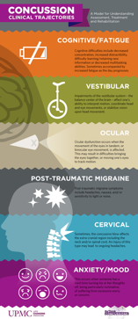
6 Types of Concussion
Vestibular
Mood/
Anxiety
Ocular
Concussion
Cognitive/
Fatigue
Cervical
Post-Traumatic
Migraine
Courtesy of UPMC Sports Medicine Concussion Program
Notes:
At the University of Pittsburg Medical Center, they have been following a newer method of treatment for concussion. Instead of treating all concussions the same – with rest and time, they’ve focused on the individual’s symptoms and an active treatment plan to address those symptoms.
Symptoms will be broad and generalized during the first week following concussion and will often include symptoms like headache and fatigue.
After the first week, if symptoms persist, they will tend to fall into one of the 6 clinical trajectories.
There could be more than one trajectory type present. Someone may have mood/anxiety related symptoms and fatigue for example.
Which types and the outcomes depends on several factors:
Direction of force
Location of impact
Amount of force involved
Pre-injury risk factors (migraine, prior concussions, attention & learning issues, age – younger children take longer to recover) and more.
From 6 types of concussion back page:

Slide 15
Targeted & Active Treatments
Vestibular Rehabilitation
Exercise
Vestibular
Medication
Exercise
CBT
Psychotherapy
Mood/
Anxiety
Vision
Therapy/
Orthoptics
Ocular
Manual Therapy
Exercise
Injection
Acupuncture
Biofeedback
Medication
Surgery
Concussion
Structured Rest
Exercise
Medication
Cognitive/
Fatigue
Cervical
Post-Traumatic
Migraine
Behavior Regulation
Exercise
Medication
CBT Cognitive Behavioral Therapy
Education/Trigger Modification
Courtesy of UPMC Sports Medicine Concussion Program
Notes:
Research is showing that specialized treatment – focused on specific symptoms – helps the brain recover from injury.
Notice how exercise is included (except vision) in treatment. It’s important to note that a short period of rest 2-3 days is still part of healing and recovery. The exercise component of treatment is not meant to bring about or worsen symptoms. With a professional’s help to gradually increases the activity, the person may exercise until the begin to have a symptom, then back off and try again later. It’s not for a someone to “push though” the symptom and keep going, but to gradually work up to doing more. The main goal is to return to some level of normal activity and routine, even if it’s only a little at the beginning.

Slide 16
Dispelling the Myths
TRUTHS:
Don’t need to hit your head to have an injury
Don’t need to have a loss of consciousness to have an injury – even a serious one
A clear CT scan does not mean no concussion
Having “only” a concussion does not mean no long-term consequences
Notes:
A clear CT scan does not mean there is no concussion: Remember that because it’s a functional injury, it is unlikely to show on CT, or to even have a CT scan unless there is a possible skull fracture.
A concussion can cause long-term symptoms. Let’s try to get away from downplaying concussion as a minor injury.
A new study, though, showed microbleeds with some concussions on MRI. Not that we would do an MRI at this point, because we can diagnose concussion based on symptoms and we don’t really know the functional implications of the microbleeds. Soon, though, they will be able to diagnose concussion by a saliva test! And they will be able to predict which symptoms will predominate and how long they will last.
Ref Dr. Amen for no long term consequences?

Slide 17
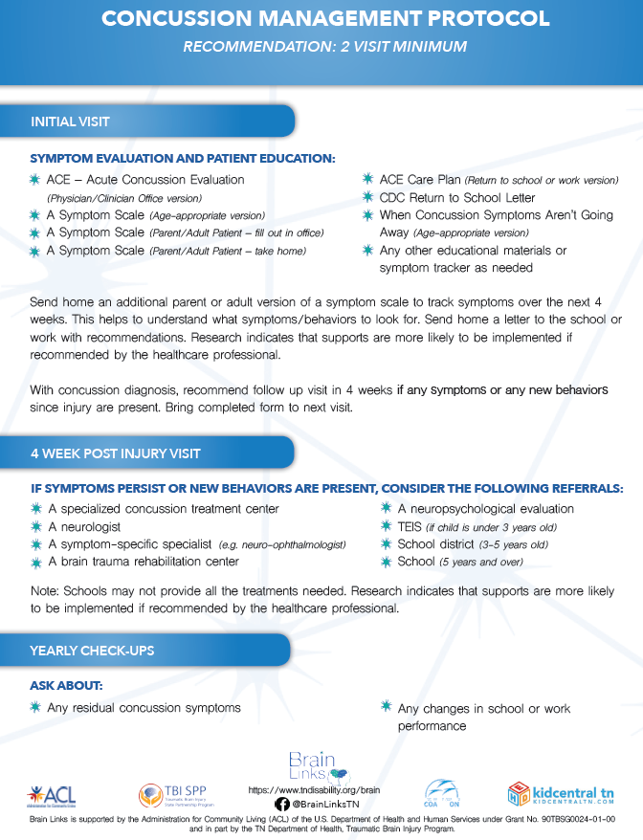
Concussion Protocol
Asking Healthcare Providers to
Think of Concussion as a 2-visit diagnosis
1st visit: Symptoms Evaluation and Patient Education. Give parent/patient a symptom list to take home and observe.
Return in 4 weeks if symptoms exist/persist
Referral for treatment
Check in at yearly check-ups specifically
about the concussion
Notes:
In our toolkit for healthcare providers, we have the Concussion Protocol. We are no longer waiting for symptoms to go away on their own. We are being more proactive because active treatment works and we know if we do nothing, many kids will go on to have significant issues.
The protocol is simple. All patients with concussion get two doctor visits.
The first for symptom evaluation and patient education. We have a lot of great information for the office and for the patient.
The patient/family gets a symptom list to take home and observe. You make the 2nd appt. before you leave the doctor’s office.
4 weeks later, if symptoms have continued, you go back and may need a referral to a specialist. If no symptoms, cancel the appointment.
Check in every year about the concussion as it could cause changes that show up with new learning.

Slide 18
?
How do you determine if a Concussion /TBI exists when the child already has another issue?
For instance a child with ADHD or Autism
ADHD
TBI
Medical
Notes:
What if your child already has another issue and it’s hard to tell if they’ve had a concussion? For example, ADHD, Developmental or Intellectual Disability, or are Medically Fragile. They may communicate without words and can’t tell you. What do you do?
Medically Fragile – need to address from Anna’s notes.

Slide 19
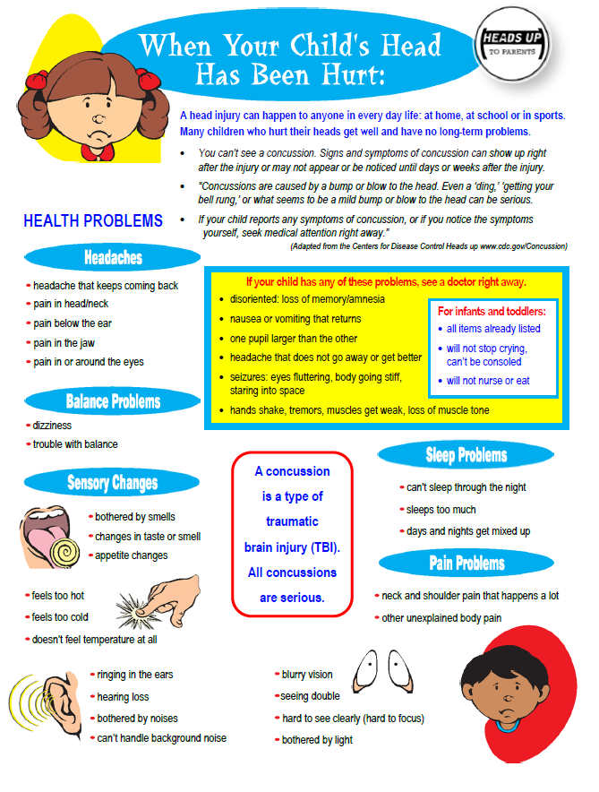
Think about their history.
If there was an injury, were there signs of a TBI?
Notes:
First thing we would do is to ask – are there any signs of concussion?
Do they have a history of injury? Go back to the concussion signs and symptoms tool. Did you see signs of the injury, bruising? Were they in pain? IF you saw signs of the concussion, maybe it was.
Looking for any change in that person and it will help us to figure out what to do.
Have they ever fallen off from the bed, fallen down stairs, bike or car accident?
Were there symptoms – like headaches or crying without being able to console them?
If a medically fragile child, did they fall out of their chair? Because it doesn’t take such a severe injury to cause symptoms.

Slide 20
Worsening of Pre-existing Behaviors
It was always there, but now it’s worse.
Used to focus for an hour before breaking, now breaks after 30 minutes.
Balance was not great, but is falling more now.
Behavioral outbursts were once a day, now they are 3 times a day.
Notes:
“He always had ADD.”
Were there changes since the injury? Read this one.
Look at what they’re doing. Here is where knowing that person and having a good baseline of how they do things can help.
This is when you need to make the call to go to the doctor. If you see any signs of concussion, get them to the doctor for referrals.
You can still get treatment at any time. It’s never too late to make a difference.
Maybe what you’ve been doing will help or maybe another type of therapy, vestibular for balance, oculomotor for vision for example.

Slide 21
Returning to School
Return them gradually, as the student can tolerate more
Few hours, half day
Allow to rest in a quiet area as needed
In the classroom
In the building (nurse’s office)
At home
Notes:
When the child returns to school, they may need to take it slowly. That can mean staying home at first for rest. Then as they can tolerate more, they could go for part of the day, or half-days. It may need to be the part of the day they need most – like socialization or a favorite class. Maybe they feel better first thing in the morning, while some may need extra time to sleep and afternoon is better.
Rest for down time can help – it can be in steps – maybe in the classroom at their desk the can put down their head for a few minutes. They could leave to have quiet or rest in the nurse’s office or may need to go home.

Slide 22
Making the Transition to Preschool
Allow a comfort item from home
Don’t push participation
Don’t expect them to remember rules and normal routines immediately
Notes:
For a younger child, It may help to have something from home make this transition back to preschool easier (stuffed animal, blanket). These comfort items can SLOWLY be transitioned away as the child is ready.
Don’t push participation – the child may need more time and patience to get back into the routine. They need time to readjust, especially, after a long absence from school. For a small child a few days and a weekend, can feel like a long time.
Remembering Rules and routines may be hard. Offer patient and gentle reminders even if they knew all of the rules before the injury. Look for cues that this child is beginning to remember, and praise them on this.

Slide 23
Return to Sport/Physical Activity
No remaining symptoms
Warn parents/other caregivers of the dangers of returning to sport while symptoms persist – risk of (Second Impact Syndrome)
Gradually increase participation/exertion each day, as long as no symptoms arise
TN Dept. of Health RTL/RTP Guideline
Notes:
The TN Dept. of Health RTL/RTP Guideline was created to help professionals and families when a child has sustained a concussion. The child cannot return to a sport or physical activity with symptoms.
Second Impact Syndrome is one risk, especially in children and young adults with a growing and developing brain. This occurs when a second injury occurs before the first has healed and causes a catastrophic reaction in the brain and can be fatal. This type of injury is why we have sports concussion laws in all of the states to protect athletes.
Returning to participation can be done gradually as long as no symptoms arise.
Source:
https://www.tn.gov/content/dam/tn/health/documents/Returning_to_Learn_Guidelines.pdf
https://www.tn.gov/content/dam/tn/health/documents/Returning_to_Learn_Guidelines.pdf
Differentiate if needed:
6 types – prescribed exercise treatment in a concussion treatment program with a physician’s input.
Once you are released from the treatment center program – you would be are okayed to go back to your return to play under the guidance of Athletic Trainer or Coach.
TSSAA letter – possible resource down the line.

Slide 24
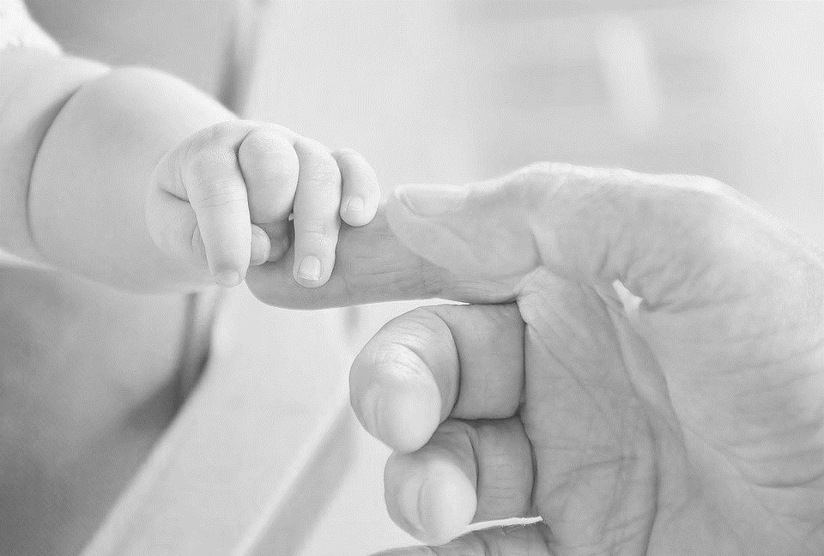
Abusive Head Trauma aka Shaken Baby Syndrome
Ages 0-5
From Shaking
Injury to the Brain
Notes:
Abusive Head Trauma is the primary cause of death and disability in infants and young children from child abuse. Shaken Baby Syndrome is a type of abusive head trauma when a child is shaken hard by the shoulders arms or legs.
The brain injury occurs when the axons – tiny connection that send messages in the brain - are torn. Then swelling causes further damage, that can be lifelong or can be fatal.

Slide 25
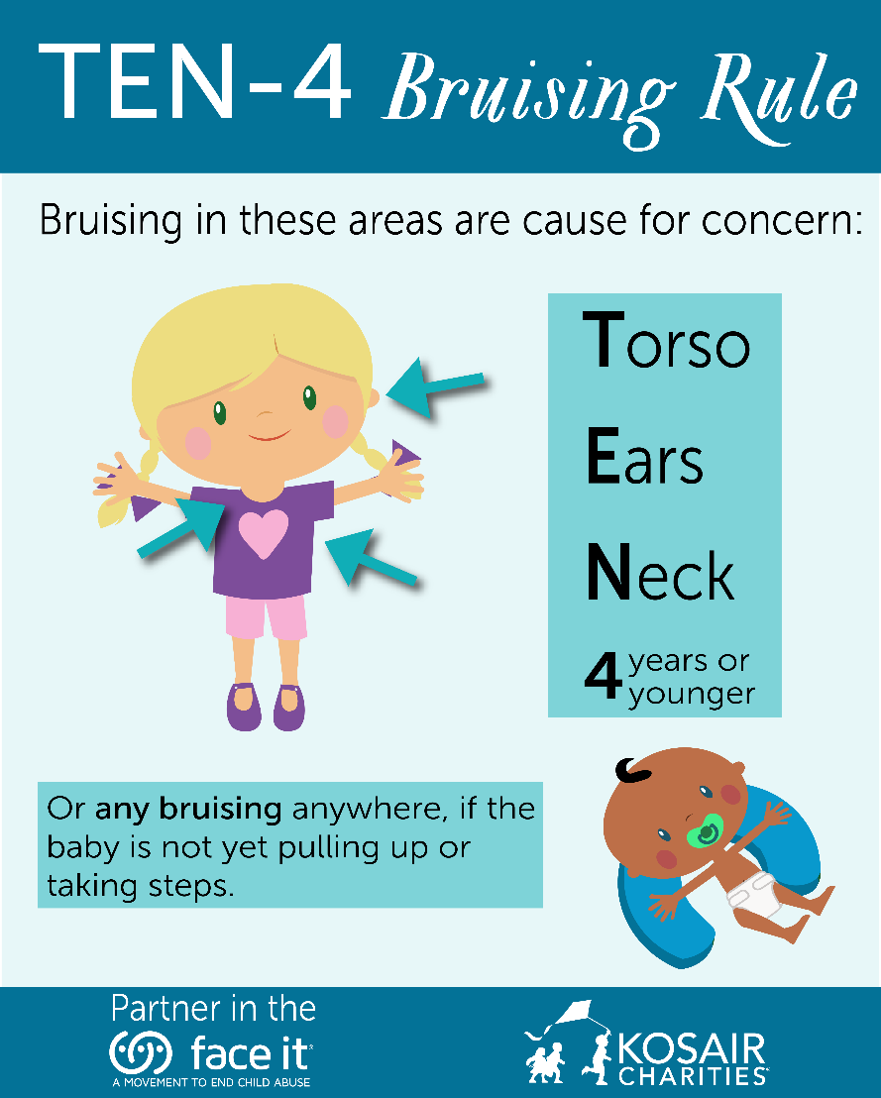
Early Symptoms Abusive Head Trauma
Bruises on arms and chest
Larger than usual head or forehead
Bulging or tight fontanels
Different –sized pupils
Retinal bleeds (85%)
Not able to focus
Favoring one arm or leg
Stop smiling/talking/walking
https://faceitabuse.org/ten4rule/
Notes:
How many of you have heard of the Ten-4 Bruising rule?
Bruising in infants should alert the physician to the possibility of abuse. Particular attention should be given to “TEN-4” bruising (bruising of the Torso, Ears, and Neck in children younger than 4 years
or any bruising in an infant younger than 4 months).
These are Early symptoms:
Large head or forehead – Head could be larger due to swelling
Bulging or tight fontanels (where the bones of an infant’s skull have not yet grown together)- occurs when fluid builds up in the brain or the brain swells, causing increased pressure inside the skull. When the infant is crying, lying down, or vomiting, the fontanelles may look like they are bulging.
Different sized pupils –
The inability to use an arm or leg could be from injury to the limb but could be from the bleeding on the brain
Retinal bleed – you may be able to see a bleed in the white part of the eye (Sclera)
Oral injuries in infants, such as frenulum tears, (the little stretchy tissue connecting between your lips and gums) may also accompany or precede AHT and should prompt consideration of abuse.

Slide 26
Early Symptoms Abusive Head Trauma
Less interested in eating
Vomiting
Tremors or shakes
Trouble sucking
Irritability
Difficulty staying awake
Seizures
Abnormal breathing
Report Child Abuse:
877-237-0004
Reports also can be made online on DCS secure site.
Direct link: https://apps.tn.gov/carat/
In Case of Emergency and Life-Threatening
Situation Call 9-1-1
For more information:
https://www.tn.gov/dcs/program-areas/child-safety/reporting/child-abuse.html
Notes:
More symptoms include vomiting, seizures, less interested in eating, trouble sucking, trouble staying awake.
If some suspects abuse or neglect related to shaken baby syndrome, they should make a referral to the Child Abuse Hotline. If it’s life threatening they should contact 911 immediately.
Under the exclamation point is he DCS webpage that will give you more information including frequently asked questions and what you need to know.
https://www.tn.gov/dcs/program-areas/child-safety/reporting/child-abuse.html

Slide 27
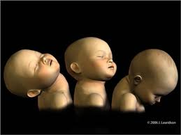
Injuries You Can’t See Abusive Head Trauma
Fractured ribs or other bones
Spinal cord injury
Neck injury
Bleeding on the brain
Notes:
Infant’s heads are large and heavy, and the neck muscles are still too weak to support a large head – That’s why we have to support it for them when holding a baby.
A child’s brain has a higher water content than adults, so the brain is more susceptible to shaking injuries
As you see in the image, the neck is hyper extended and this allows the brain to really shake and is injured by the skull.
Something you might notice - Children may not be able to hold something trying not to move an arm due to rib pain or not breathing correctly due to rib bruising or pain.
The infant or child may present with mild flu-like signs and symptoms
or extreme illness which includes apnea, severe respiratory distress, bradycardia, bulging fontanel, decreased consciousness, seizures, and cardiovascular collapse.
You will see evidence of active and/or bleeding on the brain – Dangerous. More likely from a brain bleed, there is not a lot of space for that bleed so you will see life threatening changes – breathing, sleep patterns, mental status change.
Midline shift – mental status/concussion danger signs.
•https://www.ncbi.nlm.nih.gov/books/NBK499836/

Slide 28
Later Symptoms Abusive Head Trauma
Learning Disabilities
Behavior Disorders
Vision Problems or Blindness
Hearing Issues
Speech and Language Issues
Seizures
Cerebral Palsy
Hydrocephalus
Can be Fatal
More than ½ of the children
0-4 injured by Abusive Head Trauma will die before they turn 21
Children who are severely injured have a 55% reduction in health-related quality of life
Notes:
Over half of children injured by abusive head trauma by age 4 will die before turning 21. Those who survive have a 55% reduction in health-related quality of life.
Symptoms include:
Blindness – possible optic nerve, or pressure, occipital lobe damage, retinal damage
Hydrocephalus aka “water (hydro) on the brain (cephalus means head)”- an accumulation of cerebrospinal fluid (CSF) occurs within the brain. This typically causes increased pressure inside the skull. Symptoms for Infants - a rapid increase in head circumference, eyes that are fixed downward.
Cerebral Palsy –is a problem that affects muscle tone, movement, and motor skills Most common motor disability of children. CP often is caused by brain damage that happens before or during a baby's birth, or during the first 3-to-5 years of a child's life.
Cerebral – brain Palsy – problems using muscles.
May have someone with a dx that aht could be the cause.
Congenital cp has nothing to do with trauma - 28 Days after birth – brain infection or injury
https://kidshealth.org/en/parents/cerebral-palsy.html
Adults- cognitive issues

Slide 29
Need for Ongoing Monitoring
Even if “cleared” earlier, children may need supports later.
Recommendation
Alert caregiver to what the child should be doing next developmentally and warn caregiver about things to things to watch for over time.
Example: Early Intervention System
Child passes the first developmental screening – but might fail the next one.
May need a referral back to TEIS if delays or issues arise
Notes:
For example:
Admitted to Hospitals, released w/rehab or services
Treated and released, no recommendations Regardless of the age of the child, where they were seen, or where they get “cleared,” don’t think it’s in the past. TBI needs to be addressed and monitored long-term.
One year – Studies show more likely to have a decreased IQ at 12 months. Samant, et all 2008

Slide 30
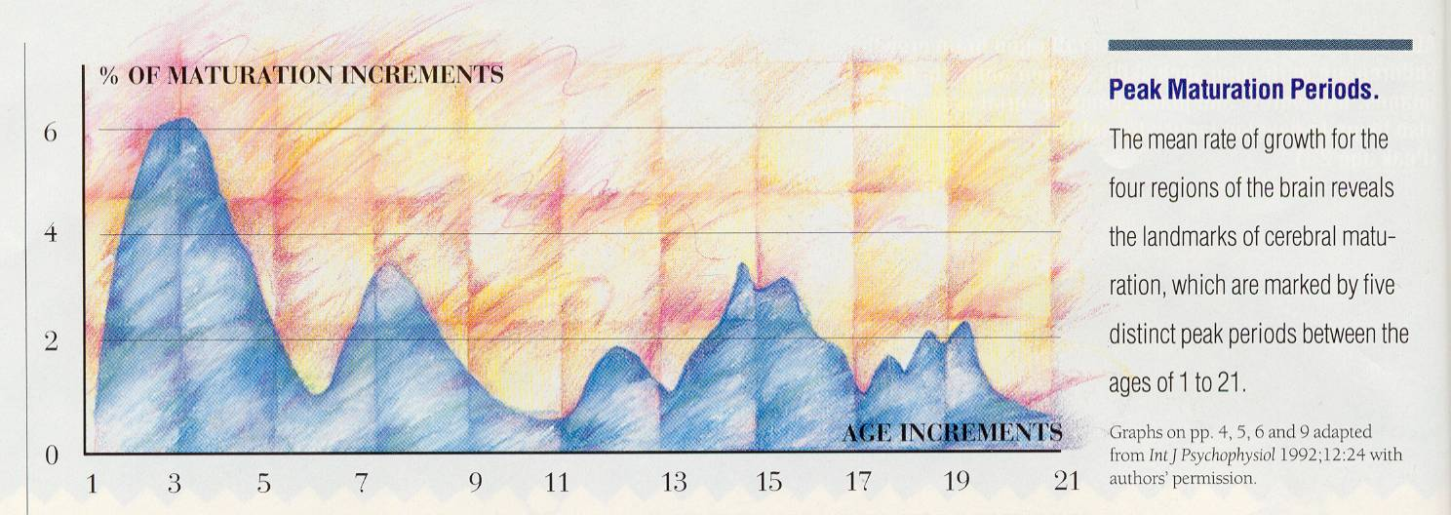
Need for Ongoing Monitoring Rates of Development for the Four Regions of the Brain
5 Distinct Periods of Maturation
P-O parietal/ occipital
C central (limbic & brainstem)
T temporal
F-T frontal/ temporal
% of maturation increments
6
P-O
C
T
F-T
4
P-O
C
F-T
T C
2
F-T
P-O
0
age increments
1 3 5 7 9 11 13 15 17 19 21
Notes:
This chart gives you a glimpse of how many times there is a major peak in brain development from birth to early twenties.
From 0-5 years is a critical stage of development for children. They’re learning how to walk, talk, become independent and are also learning who to trust in their lives.
From 14-18, they’re learning how to transition into an adult. They’re learning who they are as a person.
If there is an injury at any of these ages, new learning from that point on can be delayed or maybe not happen at all. So if that young adult’s injury causes changes and they never achieves that development of “who they are” – (with a frontal lobe injury, could be more impulsive, less confident in themselves, they’re more likely to not have positive relationships, maybe less likely to hold a steady job.)
*Source of chart - Lash & Associates Publishing booklet: Brain Development in Children and Adolescents. https://lapublishing.com/brain-development-in-children-adolescents/

Slide 31
Children & Families Need Help Transitioning to School
“If, as a part of their medical care,
we provide systematic transition services,
they are more likely to receive the supports the student needs at school.”
Haarbauer-Krupa, King, et al., 2019
Notes:
Timing is critical as part of the child’s medical care to have supports during transition because of the possible behavioral and/or educational challenges. The school is more likely to take the advice of a physician when services are needed.
Because of their stage of development, young children are at highest risk for long-term behavior and learning challenges following a TBI
Longitudinal outcome studies in young children report cognitive and language deficits that influence school readiness and later school achievement
more severely injured children demonstrating greater risk for long-term neuropsychological impairment - These children enter school with potential for reduced capacity for learning and at great risk for development of secondary social and behavioral issues because of TBI-related cognitive changes

Slide 32
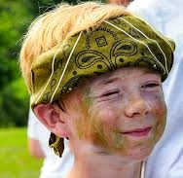
When there is no transition and follow up
Zack Age: 4 years
In a car accident
Loss of consciousness
Initial Glasgow Coma Scale = 8
(agitated, non-verbal, moves all extremities)
Multiple skull and facial fractures
Brain shifted to the left
(Not a concussion)
Recovers “beautifully”
Zack Age: 5 years
By October, “failing kindergarten”
Hitting other children
Wandering around the classroom
Disruptive
Impulsive
Not identified as having had a TBI
“Just a boy being a boy”
Notes:
Zack was injured at 4 years old in January. Car accident, loss of consciousness, skull and facial fractures, swelling in the brain caused a shift – this was not a concussion. Despite all of us this telling us his injury was very serious, he recovered PHYSICALLY quickly as most children do. Most of his injuries were invisible and other than a scar on his forehead that could be missed, he “looked” good – a beautiful boy.
Explain recovers “beautifully” – invisible injury
When he began Kindergarten, his teacher didn’t know about his injury and he had recovered so well, it was not apparent. What she did begin to notice was his disruptive behavior. By October, he was hitting children, walking around the classroom when he was supposed to be seated. His Mom was told he was “failing Kindergarten.” Because he was not identified as having sustained this very serious injury, they didn’t know what might be causing it – and thought he was a boy just being a boy. This is when his mother reached out to us and we provided training for his school and follow up with his teacher. It was the first time most of the staff that saw him every day learned that he had survived the injury only earlier that year.
Let’s first look at just one year after the injury. This is, unfortunately, an all too typical case for us. Zack…

Slide 33
Families
Where there was family dysfunction/poor coping, the child had greater dysfunction
Schwartz, 2003; Anderson, Catroppa, Dudgeon, et al., 2006; Taylor, Swartwout et al., 2008
Families reported needing information, emotional support and access to community-based services
Jones, 2017
Notes:
It makes perfect sense, but studies have found there where there was already family dysfunction, the child also had greater dysfunction after TBI.
Families need that connection to information, support and services.

Slide 34
Long-Term Consequences of TBI

Slide 35
Need for Ongoing Monitoring/Treatment
All ages: More likely to
Have another injury
Become obese
Be incarcerated
Abuse substances
Become depressed
Be socially isolated
Notes:
For obesity, TN is one of 12 states with food insecurity and at the same time we have one of the highest rates of obesity & diabetes…
Having food insecurity and TBI both decrease school performance and cognitive development in children.

Slide 36
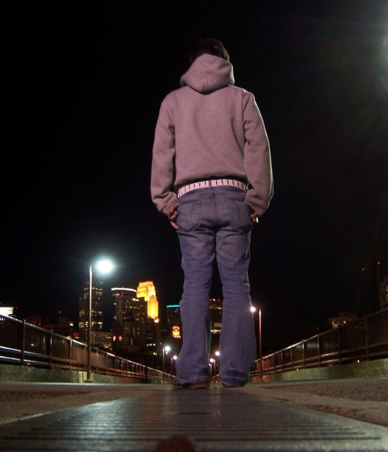
Juvenile Justice System
Within 5 years post injury, nearly 1/3 report some involvement with criminal justice system
(Farrer & Hedges, 2011)
Of those in the Juvenile Justice System, 41% have had a TBI.
In the adult Justice System, 50-80% have had a TBI.
Notes:
Of those injured, nearly 1/3 report some involvement with the criminal justice system within 5 years post TBI.
Within the Justice System, 41% of Juveniles and 50-80% of adults have sustained a TBI.
-Juveniles in adult prisons were 50 more likely to report being attacked with a weapon by staff and one in ten juveniles report being “beaten up” by staff.
If you’re dealing with a juvenile getting out of the system, they need to be monitored and observed for TBI.
Incarceration - Tennessee has an incarceration rate of 853 per 100,000 all age people (including prisons, jails, immigration detention, and juvenile justice facilities)
According to the CDC - 25-87% of inmates report having experienced a head injury or TBI. https://www.cdc.gov/traumaticbraininjury/pdf/Prisoner_TBI_Prof-a.pdf
Children and teenagers who have been convicted of a crime are more likely to have had a pre-crime TBI and/or some other kind of physical abuse.
close to http://www.justicepolicy.org/images/upload/97-02_REP_RiskJuvenilesFace_JJ.pdfone in ten juveniles report being “beaten up” by staff.
The juveniles in adult prison were also 50 percent more likely to report being attacked with a weapon
…(at end) “In fact, more than half of those individuals with TBI who reported an incarceration history were found to belong to FOUR or more vulnerable groups.”
https://www.freeimages.com/photo/contemplate-1225745

Slide 37
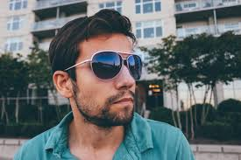
Nathan
Age: 10 months
Falls down a flight of steps
Crying, no loss of consciousness
Seen at hospital, “no concussion”
No recommendations
Bruising around his right eye for weeks
Age: 24 years
Is currently in prison
Is an addict (“tried everything”)
Can’t/won’t hold a job
Very smart but struggled in school
Few friends
Borderline personality disorder
Often, the parent or guardian may say, “He won’t get help.”
Notes:
This is a perfect example of why we need transitional services in medical care.
Nathan was injured as a baby, the injury was undiagnosed and he didn’t get follow up care.
Now, he’s in prison, had a drug addiction and struggles with employment, school and relationships. It could have been better for him.
Is he treating symptoms with drugs and alcohol? Having trouble with impulse control?
Now let’s look at a typical outcome years later.
Have to identify early. This injury occurred 23 years ago, the knowledge on TBI/Concussion wasn’t what we have now.
Nathan is more likely to become an abuser as a result of his TBI.

Slide 38
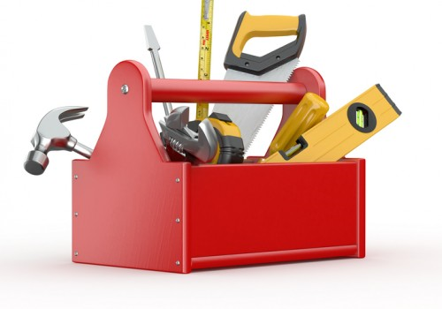
Tools
!
Notes:
If there are any problems identified, we have some tools you can use.

Slide 39
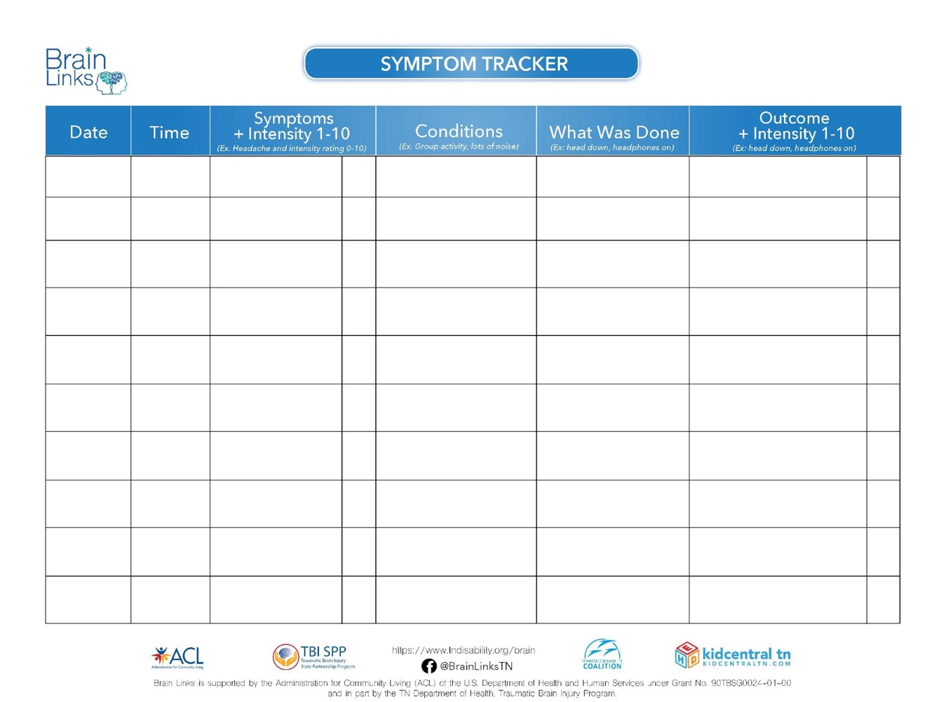
Symptom Tracker
Simple
Quick
List symptom
Occurs during what
What was done
Outcomes
Over time, maybe only a few entries, you learn triggers and how to address them.
Notes:
This is a great for tracking one symptom or a couple to look more carefully at any contributing factors. More so, it gives you something to take back to the doctor and get their help in finding the triggers. You also don’t need to remember the details.
Used to help the family and the school track symptoms. This is particularly good for 1-2 symptoms, like a headache. Then this information can be used to make changes in school or home and should also be taken back to the doctor so they can assess how treatments are working and help determine the need for changes.

Slide 40
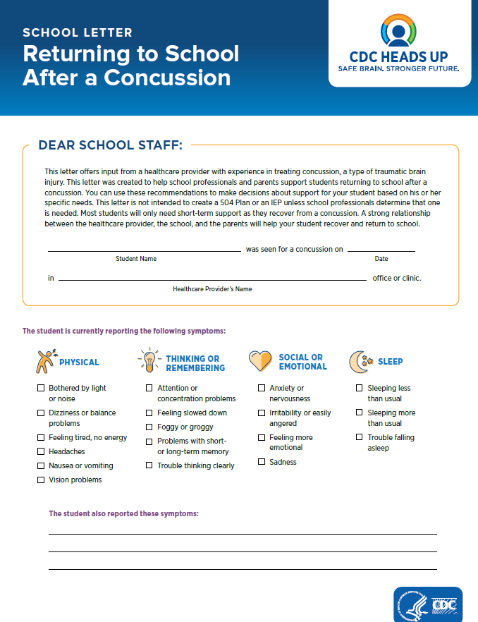
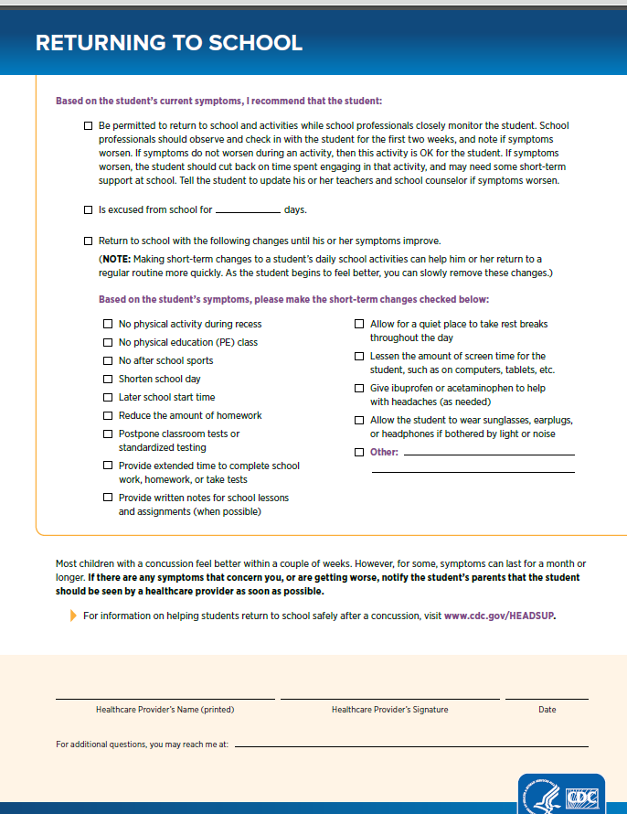
!
!
Notes:
This is the CDC’s Returning to School After a Concussion Letter. We are working with doctors across TN to get it consistently used because research says that if accommodations are given to the school, they are more likely to use them.

Slide 41
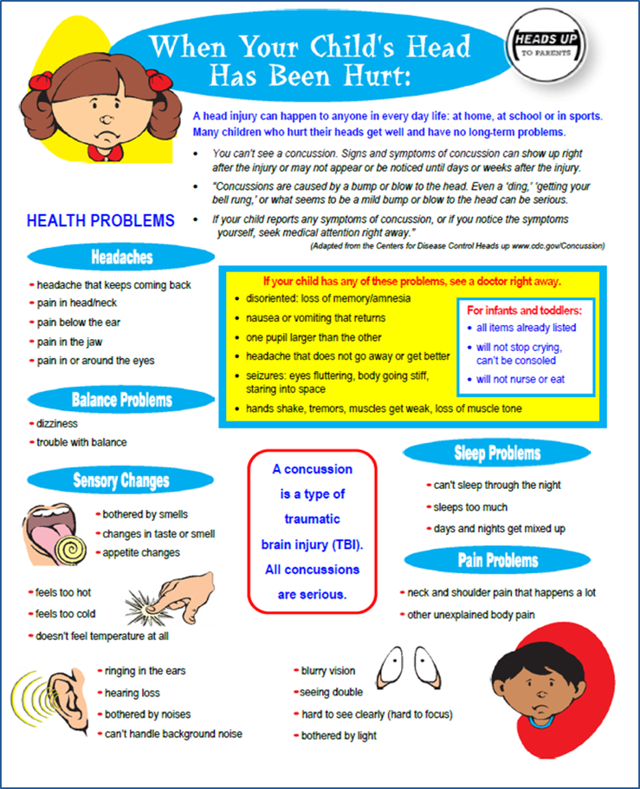
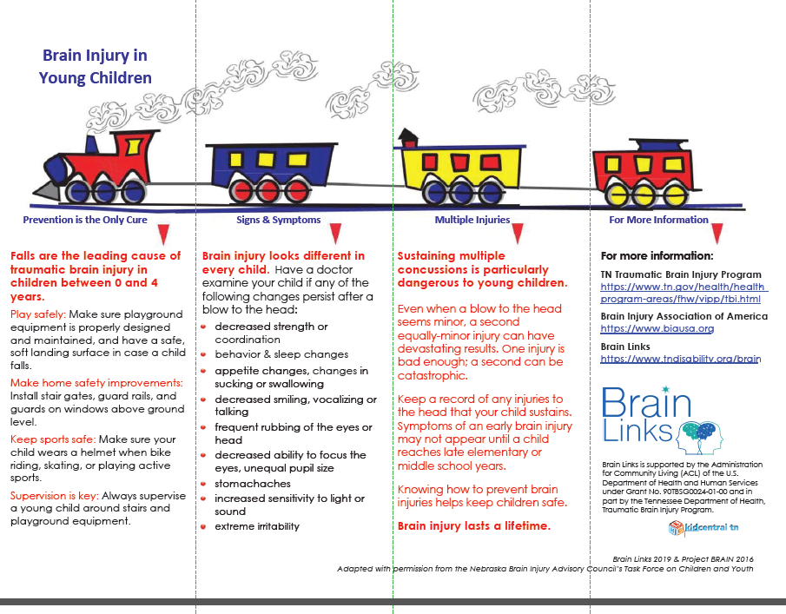
Signs & Symptoms Tools
Adult version and Spanish available
!
!
Notes:
You’re looking at our signs and symptoms tools for children and on the right, the one for the young child – under 4 years.
If a child has hurt their head, or if a concussion has been diagnosed, this tool can really help the family know what to watch for. We hope they get this from their hospital or doctor in TN, but you can always share this with anyone – family, school, doctor – to help them identify symptoms and know of resources.

Slide 42
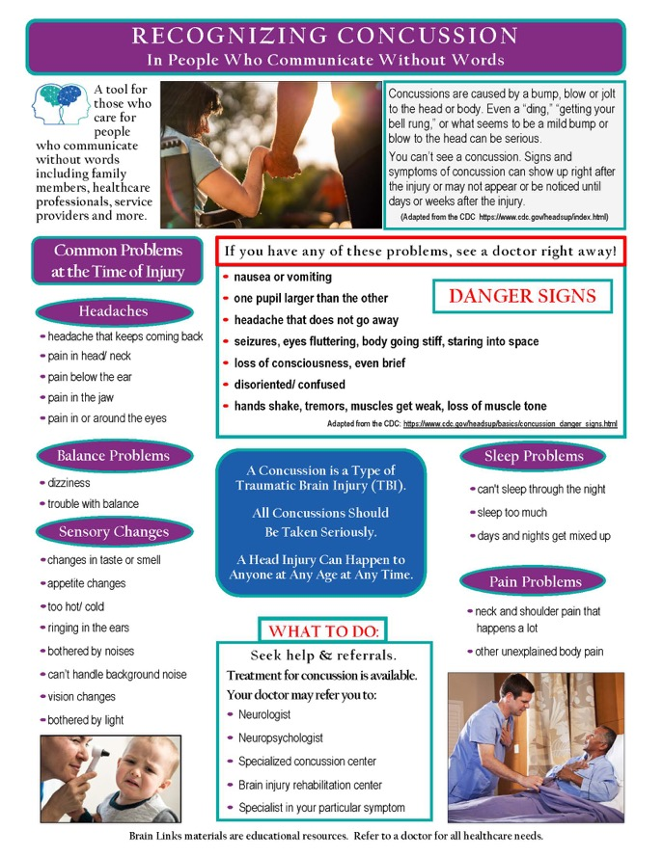
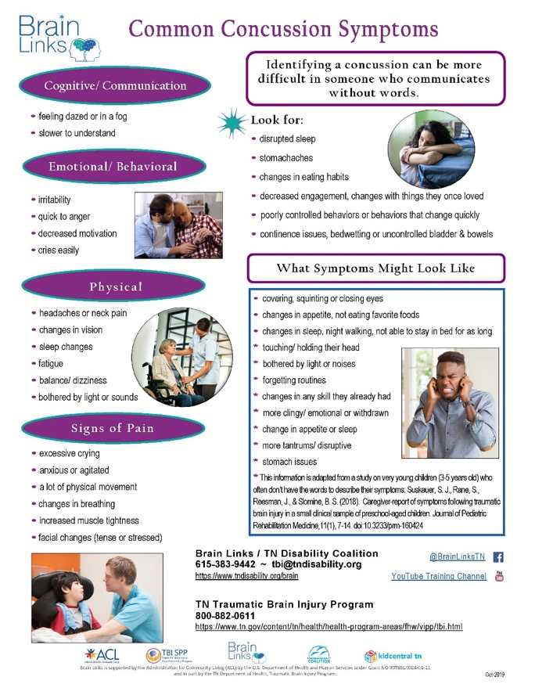
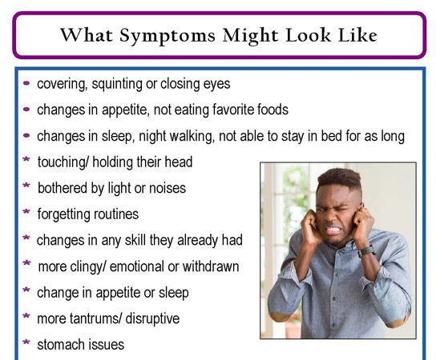
Signs & Symptoms – WOW (Without Words)
Notes:
This is another version of that tool for identifying concussion symptoms in someone who communicates without words, someone who isn’t able to verbally tell you what they’re experiencing. This is good to share with families to have before there is a concussion, so they know what to look for following a fall or other injury. Please also share this with doctors. ☺

Slide 43
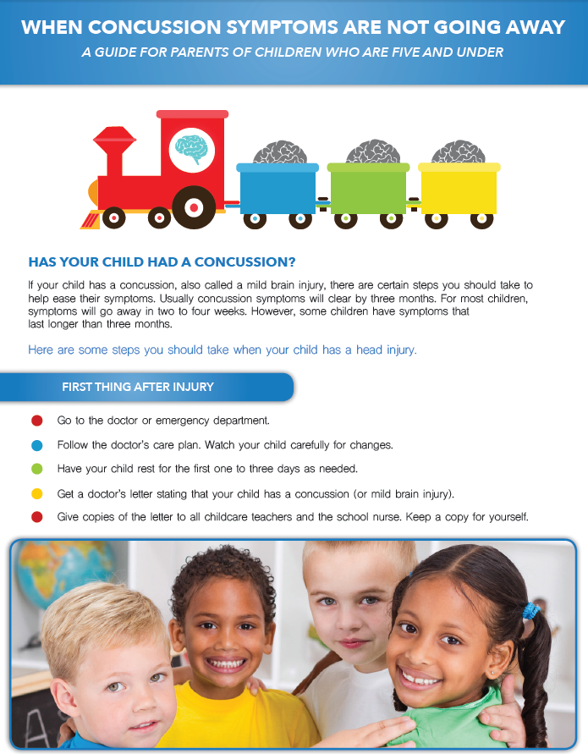
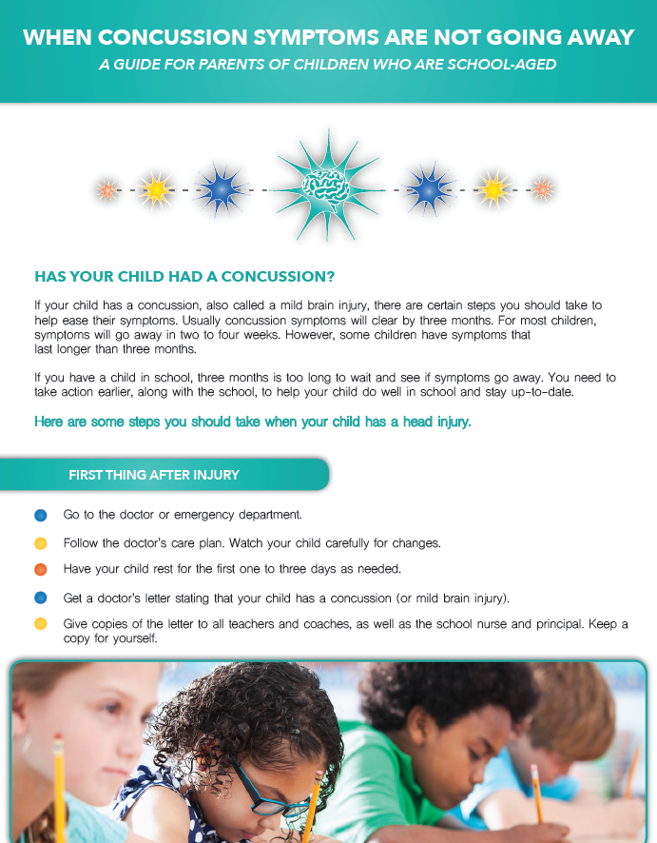
When Concussion Symptoms Aren’t Going Away
Adult version and Spanish Available
Notes:
These two handouts follow the Signs and Symptoms tools for children if needed as the title says - When Concussion Symptoms Are Not Going Away.
We have two - one is for ages 0-5 (with the trains) and both help families understand what to do immediately after an injury. Both tell them what resources to access and what they should be looking for first thing after the injury, weeks, months later, but also downstream. The one is for school-aged kids and goes through how to interact with the school and what the school will need. It helps them to understand school concepts like a 504 Plan and an IEP. Please also share both of these with the doctors, along with our website where they can access and download all of these documents.

Slide 44
What to Watch for Over Time
Headaches
Changes in sleep
Fatigue
Vision issues
Balance, coordination
Dizziness
Changes in personality
Changes in work performance
Not feeling like themselves
Trouble with attention and thinking
Short term memory problems
Difficulty handling stress
Grades dropping, falling behind in class performance
Notes:
Here is a little closer look at what’s included in our both the Signs and Symptoms handouts and our When Concussion Symptoms aren’t going away.
We suggest circling those you have noticed and sharing this with your doctor.
Socially – tend to become isolated.
Mood – tend to become depressed.
Behavior – tends to be a big issue. Help them to process situations, plan for problems and brainstorm other responses to avoid unwanted behaviors. Reinforce positive behavior.
Help other people stay involved – help them understand brain injury and this person’s strengths, weaknesses and strategies.
Reputation – be careful what you say. Be sure to stress positive behavior and put challenging behaviors in as positive a way as possible.

Slide 45
Over Time – What You Can Do
Ask “What happened to you, not What is wrong with you?”
Watch them socially
Watch mood (depression, anxiety, mood swings)
Behavior issues
Help other people to stay involved
Watch them physically-greater chance of another injury
Be patient and consistent
Notes:
Especially for a child, don’t expect them to deal with the symptoms like you might expect from an adult.
Be patient. Think and ask What happened to you, not what is wrong with you.

Slide 46
If You See Any Problems
Refer back to the doctor
Remind doctor of the Concussion/TBI/AHT
Tell doctor all changes that you are seeing
Give doctor the Symptom Tracker/CDC Return to School Letter
Don’t hesitate to suggest what referrals you think may be needed
Take appropriate steps within the school
!
!
Notes:
If you see any problems, tell the doctor what you’re seeing. Make sure doctor completes the CDC Return to School letter and give it to the school. For some symptoms, referrals might be a Physical Therapist, or an Occupational Therapist or maybe a vision specialist or counselor.

Slide 47
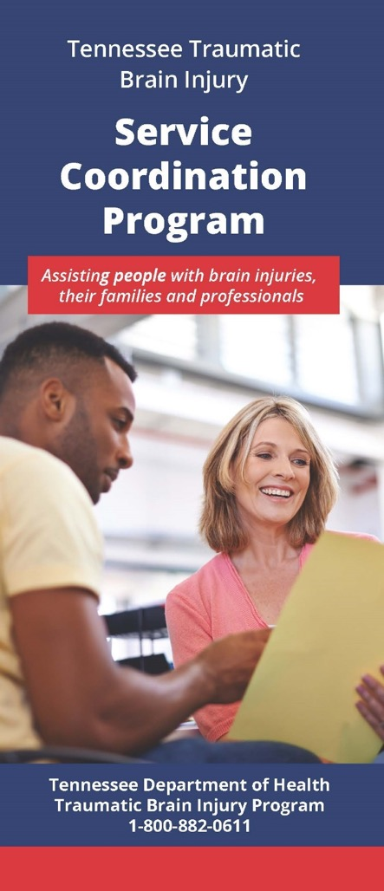
Service Coordination
Free Service
The service coordinator works with survivors and their families to assess their current resources and needs. The service coordinator:
develops a comprehensive plan of care
provides referrals to available resources
coordinates services for individual client advocacy
assists in applying for the Family Support Fund
CURRENTLY OFFERING VIRTUAL SUPPORT GROUPS
http://www.braininjurytn.org/service-coordination.html
Notes:
Also on the TN Dept of Health’s TBI Program’s website – you can find how to talk with your local TBI service coordinator. There are 8 SCs across the state and they work directly with the individual and or their family to connect to brain injury related services. They also host the local support groups. Now, they have the virtual support groups online. Those have been a great way for people to join conveniently from their phone or computer and meet other people. The meeting have different topics and speakers. That’s just a few of the great resources we can share with you today, but please check out our website or follow Brain Links on social media for more.

Slide 48
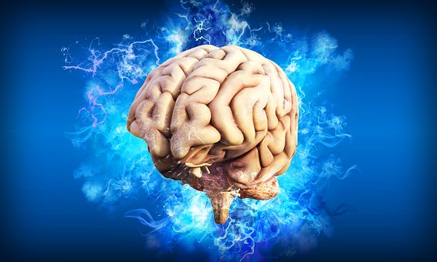
Attention
Judgment
Memory
Cognition
Flexibility
Organization
Awareness
Reasoning
Problem Solving
Notes:
Understanding cognition will help you to better understand anyone in your life, including yourself.

Slide 49
Understanding Cognition
Attention – not a unitary skill
Visual
Verbal
Task-specific
How long (duration)
How much (density)
How hard (complexity)
What environment
Distractions/no distractions
What type of distraction
Breaking it down:
Sustained Attention
Divided Attention
Alternating Attention

Slide 50
Special Case of ADHD & TBI
Children with TBI and attention problems are often referred for treatment of the ADHD problem.
Cognitive Problems Following TBI
That’s fine, but need to look at whole picture.
ADHD

Slide 51
Dig Deeper into Problem Areas
Charlie is “Forgetting”
Memory
Attention
Depression
Lack of organization
Initiation
Something else?
Notes:
Why might he be exhibiting this behavior that looks like forgetting?
Memory
Attention
Depression
Lack of organization
Initiation
Etc.

Slide 52
Testing Options
School Psychologist or Learning Specialist
Academic Testing
IQ Testing
May add other tests
Neuropsychological Testing:
Gold Standard for TBI Testing
Brain-Behavior Relationships
Academic Testing
IQ Testing
Specific Domains of Cognitive Function
Attention
Memory
Executive Functioning
Visual-spatial Function
Information Processing
Notes:
Advocate for Neuropsyche testing when needed.

Slide 53
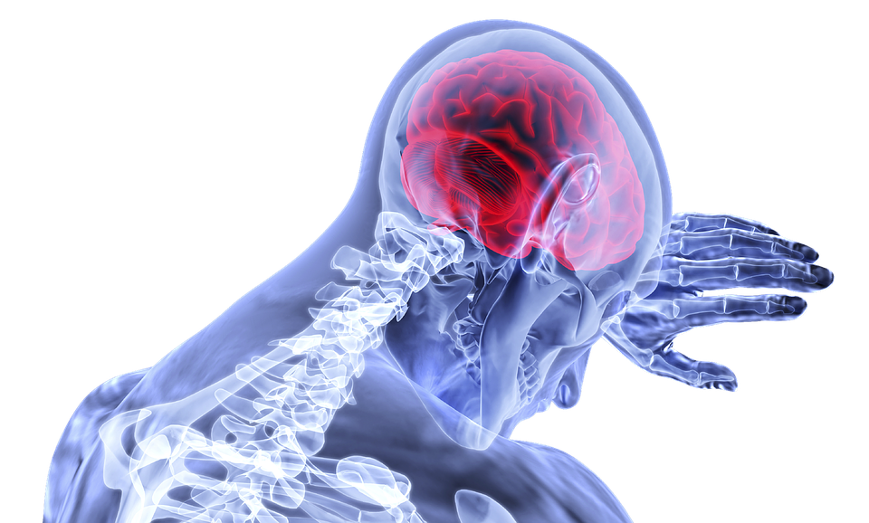
Need to understand this so we:
The Brain is causing the behavior
Help and don’t punish
Help them to understand and control the behavior
Change the behavior and we change the brain
Change the brain and we change the behavior

Slide 54
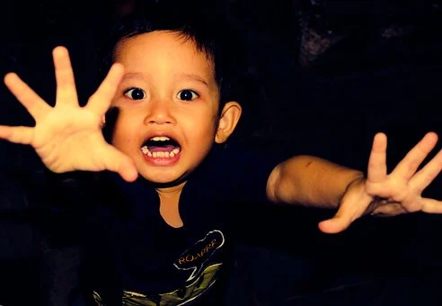
Behavioral Issues
Behavior is Communication
What are they Communicating?
Confusion
Frustration
Anger
Pain
“I feel stupid”, etc.
With help, they may be able to put words to what they are feeling, want or need.

Slide 55
Behavioral Issues
Always look at communication and cognitive demands of the situation
Understand their communication strengths and weaknesses
Speech & Language Evaluation
Understand their cognitive strengths and weaknesses
Neuropsychological Evaluation
Brainstorming Solutions Tool
Help identify triggers

Slide 56
Communication Demands: Kelly
First grader Kelly had a near-drowning accident 3 months ago. As a result, early on she had expressive and receptive aphasia. She progressed nicely in rehab and returned home. In simple conversation, you would never know that Kelly had aphasia after the accident.
Behavior: When Kelly returned to school, she would often push other kids and would refuse to participate in group activities.
The SLP was brought in and it was determined that Kelly continued to have difficulty with language, especially expressing herself. Kelly learned simple phrases that helped her manage the situations, including:
“I’m frustrated.”
“I’m angry.”
“I need a minute.”

Slide 57
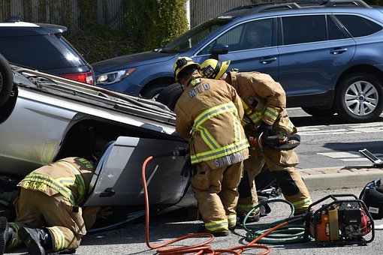
Cognitive Demands: Zack
Five year old Zack was in a major car accident. The SUV he was in rolled twice. He was in the hospital for 5 nights, then released.
He recovered remarkably well and everyone thought the accident was behind them. He went to kindergarten 5 months later, that following August.
Behavior: By October, he was wandering around the classroom and pushed other children. Zack often got in trouble at lunch, in PE classes and at recess. Teacher said she often knew he was going to have a bad day as soon as he walked in the door.
He was referred for cognitive testing and it was revealed that Zack had issues with:
Impulse control
Attention
New learning
Frustration tolerance
Problem solving
Social skills

Slide 58
Zack’s Interventions
Zack gets in trouble in less structured environments:
Control/Structure the environment
Help him decide what he’s going to do before going outside
Provide more supervision
Reduce distractions at lunch – sit with back to most of lunchroom
Give him a job – gather the balls, line leader, etc.
Wanders the classroom
Positive reinforcement for staying in seat
Can’t wander, but can go sit in bean bag chair

Slide 59
Communication Demands: Kelly
First grader Kelly had a near-drowning accident 3 months ago. As a result, early on she had expressive and receptive aphasia. She progressed nicely in rehab and returned home. In simple conversation, you would never know that Kelly had aphasia after the accident.
Behavior: When Kelly returned to school, she would often push other kids and would refuse to participate in group activities.
The SLP was brought in and it was determined that Kelly continued to have difficulty with language, especially expressing herself. Kelly learned simple phrases that helped her manage the situations, including:
“I’m frustrated.”
“I’m angry.”
“I need a minute.”

Slide 60
Zack’s Interventions
Zack gets in trouble in less structured environments:
Control/Structure the environment
Help him decide what he’s going to do before going outside
Provide more supervision
Reduce distractions at lunch – sit with back to most of lunchroom
Give him a job – gather the balls, line leader, etc.
Wanders the classroom
Positive reinforcement for staying in seat
Can’t wander, but can go sit in bean bag chair

Slide 61
Zack’s Interventions
Teacher knows he’s going to have a bad day
What does she see? Teach Zack the signs.
What does he feel on those days?
What can he do differently on those days?
Increase his awareness: “I’ve noticed that…and it seems to help if….”

Slide 62
Zack’s Interventions
Results of Cognitive Testing
Impulse control/Frustration tolerance
Take a deep breath
Slow down
Stop, think, then go
New learning
Help the attention, help the new learning
Repetition of information
Different modalities
Spaced rehearsal (specific form of repetition)

Slide 63
Zack’s Interventions
Results of Cognitive Testing
Problem solving
Break things into steps
Give him visuals
Show him first (model)
Support where needed
Social Skills
Social skills group
Peer buddy
Group work
Play dates
Big brother/big sister
Sports, clubs, etc.
Behavior therapy with someone who understands TBI.

Slide 64
Support the communication and cognition…
And you change the behavior
Notes:
…and then it’s all rainbows and butterflies. ; ) Need to step back and not think about how the behavior is impacting you, but it’s about the why. Get my reaction out of it.

Slide 65
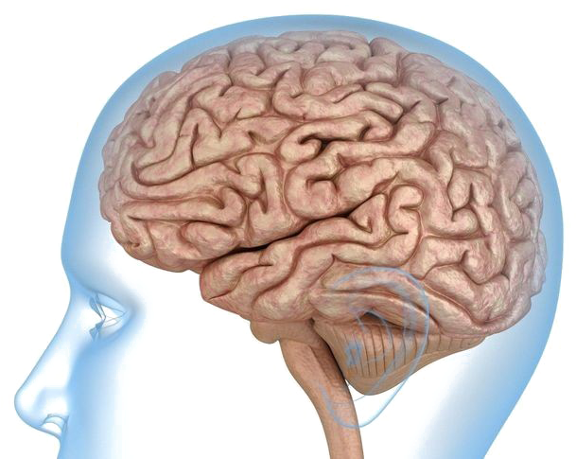
BRAIN HEALTH Scavenger Hunt!
Notes:
As we begin, I’d like you to think about your brain. Or the brain of someone you love or serve. Now think about how you would like it to look as it ages. This, here, is a nice, healthy brain.
SCAVENGER HUNT TIME (for live sessions, ask people to find one thing that is part of their efforts to build a healthy brain

Slide 66
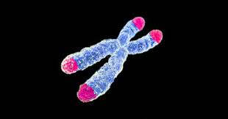
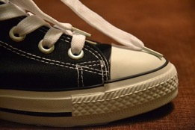
Things that impact our brains
ACEs (Adverse Childhood Experiences)
Brain Changes
The way the brain processes memory & emotion, and how we deal with stress
Produce brain chemicals that lead to inflammation & weaker connections in the brain
Change our telomeres – leads to faster cell aging, more diseases and shorter lives
Notes:
Some of these things are things we have done to our brains. And other things are just the result of living our lives…what has happened to us in our life.

Slide 67
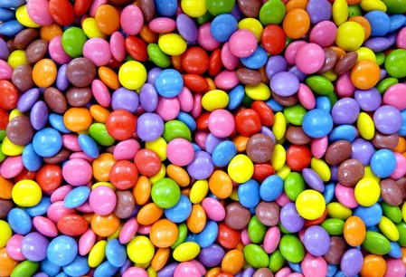
Things that impact our brains
Inflammation
Sedentary Lifestyle
Genetics
Toxins
Mental Health
Infections

Slide 68
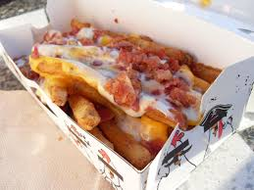
Things that impact our brains
Neurohormone Deficiencies
Obesity
Diabetes
Poor Sleep
Lack of New Learning
Notes:
Some of these things are things we have done to our brains. And other things are just the result of living our lives…what has happened to us in our life.

Slide 69
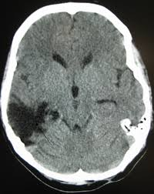
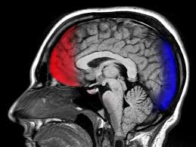
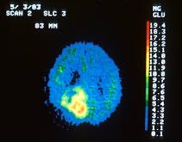
Brain Injuries
Traumatic brain injury
Stroke
Tumor, etc
Notes:
Even concussions can be seen years later on a special type of scan called a SPECT – if we don’t work to change it.

Slide 70
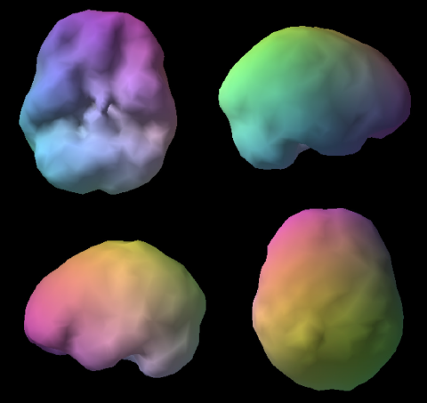
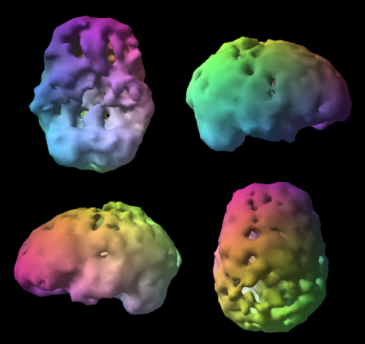
Healthy Brain
Brain on Alcohol & Drugs
Amenclinics.com

Slide 71
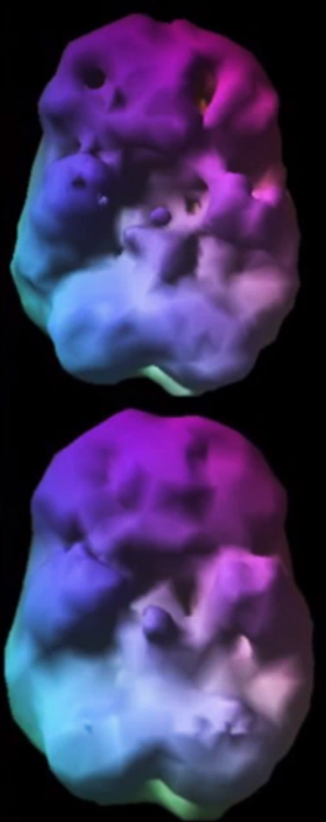
We CAN change our brains!
What we’re seeing in this brain
Multiple concussions
Damage to the anterior temporal poles
Asymmetry – left side worse
Bad temper
But! …
He changed
his brain!
Notes:
Someone with multiple concussions. Anterior temporal poles both damages. Assymetry – left side worse. Bad temper. Made changes and brain improved.

Slide 72
Cultivate Resilience
A commitment to find meaning
A belief in your capacity to create a positive outcome
The willingness to grow
The CHOICE to laugh and be grateful
Bonanno
Notes:
So how do we cultivate resilience? Resiliency experts, including psychology professor George Bonanno of Columbia University say that we can become resilient by….
A commitment to find meaning
A belief in your capacity to create a positive outcome
The willingness to grow
The CHOICE to laugh and be grateful

Slide 73
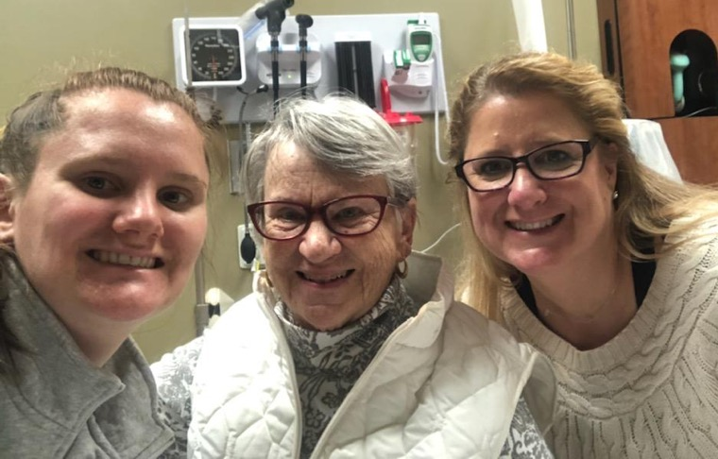
An Approach to Resilience
2 Questions to ask Yourself:
“What could possibly be right about this?”
“What in your life or yourself can you be grateful for right now?”
MJ Ryan, How to Survive Change You Didn’t Ask For
Notes:
MJ Ryan wrote a great book called How To Survive Change You Didn’t Ask For. And in it, she says that she asks 2 questions while in the middle of a challenge or change.
“What could possibly be right about this?” I get that this can be hard to do…. This helps us to find meaning and to grow. Positive psychologists call it “creative construing”, the ability to assign meaning to what we are going through that pulls us into the future in a positive way.
“What in your life or in yourself can you be grateful for right now?” There IS something. Even if it is that right now your family member is alive.
I get that this can be a very hard mind set. Think about someone who you know who is negative or a worrier. It is so easy for them to continue to be negative or to worry. They have literally trained their brain to think that way. So the next time a situation arises, their brain is ready to fire that way. So we may need to make a conscious effort to think this way (positively) for a while, but it can become easier. Let’s talk more about gratitude now.

Slide 74
Be Grateful
Gratitude Study:
Group 1: Journal what they were grateful for
Group 2: Journal things that annoyed or bothered
Group 3: Journal what happened to them
- Emmons & Mc Collough, J. of Personality & Social Psychology
Notes:
So the second question just asked, ”What is there you can be grateful for.?” So that’s the next thing to do…be grateful.
There is some evidence that there’s increased depression in folks with TBI as they age, so that’s something we want to be mindful of and head off at the pass.
Emmons & Mc Collough did a study where they asked one group of people to write down what they were grateful for each day, another group to write down things that bothered or annoyed them and another to just write down what happened. What they found was that…(next slide)

Slide 75
Outcomes of the Gratitude Study
Greater levels of well-being and optimism
Also
Exercised more
Slept better
Woke up more refreshed
Lower blood pressure
Less inflammation
Better immune function
More likely to help someone else with a problem
Lower levels of cortisol (stress hormone)
Notes:
The ones who wrote down something they were grateful for showed positive results and the more they wrote, the stronger the effect.
They had greater levels of well-being and more optimism about the days and weeks ahead. And there were other benefits to their psychological AND physical health:
Exercised more,
slept better,
woke up more refreshed,
more likely to help someone else with a problem,
lower blood pressure,
less inflammation,
better immune function, and
lower levels of the stress hormone cortisol.

Slide 76
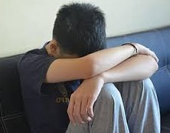
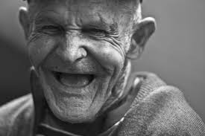
Happy if only vs. Happy in spite of
“I’ll be happy if only…”
-Younger people
“I’ll be happy in spite of…”
-Older people
Carl Pillemer of Cornell
Notes:
Carl Pillemer is a gerontologist. He studies older people and he saw a difference in the way that older people looked at life versus younger people. Older people had the life experience to know that things happen in life and they are not always good things. They tend to develop the ability to be happy even though things are not perfect. They CHOOSE to be “happy in spite of.” While younger people tend to be hold off their happiness and want to pin it on some future accomplishment or attainment. “I’ll be happy when I get that raise.” “I’ll be happy when I finish that test.” So what is our “to-do” now? We can choose to be happy NOW and not wait for something to happen in the future. We can CHOOSE to be happy now, even though things might not be perfect in our lives at the moment.

Slide 77
Preserve Mental Health
Kill the ANTs
Automatic Negative Thoughts
4 Questions
“Is it true?”
“Can I absolutely know it’s true with 100% certainty?”
“How do I feel when I believe the thought?”
“Who would I be or how would I feel if I didn’t have the thought?”
“Don’t believe every stupid thought you have.”
Dr Daniel Amen, Amen Clinics

Slide 78
“If you have fear of some pain or suffering, you should examine whether there is anything you can do about it.
If you can, there is no need to worry about it. If you cannot do anything, then there is also no need to worry about it.”
-Dalai Lama
Notes:
The Dalai Lama says, “If you have fear of some pain or suffering, you should examine whether there is anything you can do about it. If you can, there is no need to worry about it. If you cannot do anything, then there is also no need to worry about it.”
So there is really no need –ever- to worry. Worry only produces negative effects on the mind and body.
Other things that help decrease stress: meditation (20 mins), yoga (20 mins), physical activity (30 mins), 8 hrs of sleep, and relaxation techniques, especially those that focus on breathing.
Let’s take a look at the next thing.

Slide 79
Relaxed Breathing
Headache Relief Guide
https://www.youtube.com/watch?v=YKxV07cisPA&feature=youtu.be
Notes:
https://www.youtube.com/watch?v=YKxV07cisPA&feature=youtu.be

Slide 80
Find Purpose & Joy
Notes:
Our next to-do is to find purpose and joy. Both are important. Both are good for brain health. Purpose without joy can eventually lose it’s sense of purposefulness and joy without purpose loses it’s joy. You don’t have to get both out of the same thing, but you need both in your life. For example, for me, working in an oncology unit, may give me a tremendous sense of purpose, but I don’t know if I would find joy there. On the other hand, working in brain trauma gave me a tremendous sense of purpose and joy. Other people would say to me, “I don’t know how you work there, it must be so sad.” But for me, I always saw the hope and I was fascinated by the brain and all that it did. And I loved being able to use my knowledge and experience to help make a difference in people’s lives.

Slide 81
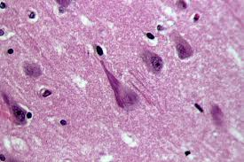
Purpose & Alzheimer’s Disease
Having a sense of purpose determined whether symptoms of Alzheimer’s Disease showed up or not
THE PURPOSE OF A LIFE IS
A LIFE OF PURPOSE.
ROBERT BYRNE
Commons.Wikimedia.org
Notes:
Researchers have long seen that people who have a sense of purpose live longer, fuller and healthier lives than those who don’t. Ex: Toby
Patricia Boyle and her team took an interesting look into the relationship between a sense of purpose and Alzheimer’s disease. They knew from previous studies that people who had a sense of purpose had less memory loss. So they took a look at the brains of people who died. They were looking for the plaques and neurofibrillary tangles that are an indicator of Alzheimer’s disease. What they found was that (from 246 brains) purpose didn’t stop these plaques and tangles from developing in the brain, but it did stop whether they showed symptoms of the disease or not. Their memories were much better. They showed little or no decline.
Boyles interpretation of this was that “having a purpose creates a reserve that enables some brains to form other pathways to transmit signals and nutrients and remain functional. The stronger the purpose, the more protective it is.” (MJ Ryan, Happiness is a Choice you make.)

Slide 82
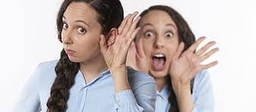
Be Social
Relationships
Decrease risk of dementia
Improve physical health (helps the immune system)
Increase capillary formation and new neuronal growth in the brain
Decrease depression and
Decrease stress
Get Hearing Aids when needed!
(We know who you are)

Slide 83
Learn
Notes:
Having extra cognitive reserve helps us to age well. Learning at any point in our lives helps us build cognitive reserve.
There was a study where older adults were given 10 hours of cognitive training. TEN YEARS later, their memory testing was better and their self-reports of functioning were better. A variety of studies have shown that memory and overall cognition can be improved with cognitive training, even in older adults with MCI (mild cognitive impairment).
No matter what your age, this is important. We used to think that brains only declined with age and only young people could grow new neurons or have what we call plasticity, but improved fMRI scanning has shown that brains continue to develop new neurons throughout our lives and that with “brain exercise” we can continue to increase the number of brain cells.
So we need to keep learning and doing NEW things. This doesn’t just mean be busy. For example, if you’ve knit your whole life and it’s simple for you, it won’t grow new cells, because your brain doesn’t need them to knit. That doesn’t mean give up knitting, but also start something new.

Slide 84
Exercise!

Slide 85
Exercise
Helps depression
Helps with focus
Decreases stress
Lowers blood pressure
Helps control blood sugar levels
Helps maintain healthy weight
Boosts immunity
…and more
Notes:
Exercise also alleviates depression – and there is some evidence to suggest that folks with BI have more depression, as we said, as they age, so we always want to do anything that will help with that.
Exercise elevates mood, helps with sleep, decreases stress and is good for the heart…and the brain!

Slide 86
Exercise & Memory
Notes:
The hippocampus is the part of the brain that is very much involved with memory. Long term, mild exercise enhances the hippocampus and protects it against disease processes. The exercise has to be somewhat aerobic (stretching and weight training don’t do it). Aerobic exercise actually REVERSES age-related shrinkage in the memory centers of the brain.
And a lack of exercise negatively impacts the brain.

Slide 87
Eat Well
Eat Well.
Start Now.
Notes:
Eating well can reverse heart disease & diabetes.

Slide 88
Eat Well
Eating to ward off Alzheimer’s
Currently thought to be incurable, but preventable
Through dietary and lifestyle changes
Guidelines for the Prevention of Alzheimer’s Disease
“Vegetables, legumes (beans, peas, lentils), fruits, and whole grains should replace meats and dairy products as primary staples of the diet.” - J. of Neurobiology of Aging, 2014

Slide 89
Eating to Ward off Stroke
Fiber
Soluble: beans, oats, nuts, berries
Insoluble: whole grains (brown rice, whole wheat)
Potassium
Best sources: greens, beans, sweet potatoes
Citrus
Decreases blood pressure, increases blood flow
Antioxidants
Plant foods 64Xs more antioxidants than animal foods
Notes:
Some specific things to ward off stroke:
Fiber: 97% of us don’t get enough! It doesn’t take much of an improvement to get positive results and reduce the risk of stroke. So start eating more fiber rich foods like beans, oats, nuts, berries and whole grains.
Potassium: Less than 2% of us get enough! We all think bananas when we think of potassium, but they actually come out # 1,622 on a list of potassium-rich foods, right below Reeses Pieces! Better sources are greens, beans and sweet potatoes.
Citrus: Contains hesperidin which increases blood flow throughout the body – including the brain. It also decreases blood pressure.
Antioxidants: Slow the aging of cells and repairs damage caused by free radicals. We are beginning to see that antioxidant supplements don’t help. We need to get them from food. On average, plant foods contain 64 times more antioxidants than animal foods. Spices come up high, so eat a lot of them as well. Antioxidants also help to prevent damage to the sensitive cell walls of the small blood vessels in the brain, they decrease artery stiffness, prevent clots from forming, decrease blood pressure and decrease inflammation.

Slide 90
Green Tea Fun Fact:
Neuroprotective
Neurorestorative
Notes:
Not only will green tea help to heal the brain once it is damaged, but it is also neuroprotective. If you have green tea in your system when you are injured, it will help to protect the brain from damage.

Slide 91
Fun Fact:
Wild Maine Blueberries
Good for
Health of Blood Vessels
Blood Vessel Regeneration
Reducing Inflammation
Lowering Blood Pressure
Enhancing Mood
Notes:
two polyphenol fractions found in wild blueberries, anthocyanins and phenolic acids
Get ORGANIC if not getting the wild Maine ones – non-organic blueberries contain the highest levels of pesticides. Easy to find frozen. Great in smoothies, healthy baked goods, etc.

Slide 92
Notes:
In fact, if you want to read more, there’s a great book called How Not to Die by Dr. Michael Greger. In it, he covers all the evidence out there about nutrition and how it helps us to “not die” from the 15 leading things that kill Americans, like heart disease, diabetes and high blood pressure. Lucky for us, he also covers Brain Diseases which comes up #3 on the list.
The bottom line for ALL of the categories is whole foods, plant-based. Be careful, because a lot of the diets out there pick and choose their studies, don’t use studies at all, or focus on what they think Americans can do food-wise and not what they should. And many are aimed at short term weight loss, and don’t look at long term effects on the body. One example of this is high protein and low carbs.
Studies have shown that some foods impact certain cognitive domains, and others impact others, so it’s important to get a variety of plant foods.

Slide 93
Remove Toxins
Food
Go organic
Grow your own
Reduce alcohol
Drink filtered water
Don’t eat processed foods
Watch artificial colors and sweeteners
Go vegetarian or vegan
Image: producebluebook.com List: ewg.org
Notes:
This could have gone under the last section on food, but I thought I’d further highlight the toxins in food.

Slide 94
Remove Toxins
Products
housecleaning
personal hygiene - www.safecosmetics.org, Think Dirty App
Environment
mold, smoke, paint fumes
Notes:
The dietary part of the 2014 “Dietary and Lifestyle Guidelines for the Prevention of Alzheimer’s Disease” that were published in the Journal of Neurobiology of Aging was “Vegetables, legumes (beans, peas, lentils), fruits, and whole grains should replace meats and dairy products as primary staples of the diet.”

Slide 95
Sleep
For children’s needs at each age:
webmd.com/parenting/guide/sleep-children#1
Your brain cleans itself of toxins and plaques during the night.
If not cleaned, it causes brain fog, memory issues and can lead to dementia.
Strategies
Treat sleep apnea
Get 7-8 hours of sleep a night
Reduce/manage stress
Reduce use of electronic devices at night
Stick to a regular schedule
Reduce caffeine, especially at night
Drink chamomile tea
Kill the ANTs
Fix what keeps YOU up at night
Notes:
One theory about why people with dementia sleep so much is because their brain is trying to clean all of the plaques and other gunk.
Chronic insomnia leads to many other things like stroke, pain, cardiovascular disease, anxiety, cancer, death from any cause.
Sleep Apnea: “Untreated sleep apnea triples your risk of dementia and depression makes it hard to lose weight. It looks like Alzheimer’s disease on SPECT sans, with decreased blood flow to the parietal and temporal lobes.” Amen, Memory Rescue p245
Fix what keeps you up at night. You probably have an idea of what it is. Take care of it. Try some things or seek help. For me, for an overactive mind, it’s often enough to say, “don’t worry, it’ll be there in the morning.” For chronic pain and related restless leg, nightly stretching has been a life-saver or should I say sleep saver and has had many benefits that flow over to the daytime.

Slide 96
Post in the chat the Change YOU will make
Notes:
For live sessions.

Slide 97
Thank you!
www.tndisability.org/brain
*** More web-based training available https://bit.ly/2W5GCIK
Brain Links is supported by the Administration for Community Living (ACL) of the U.S. Department of Health and Human Services under Grant No. 90TBSG0024-01-00 and in part by the TN Department of Health, Traumatic Brain Injury Program.
Tennessee Disability Coalition
955 Woodland Street | Nashville | TN |37206 | 615-383-9442 www.tndisability.org/brain
Notes:
You can download our toolkit and many of our resources from our website.

