Slide 1




Supporting Children with Cognitive Changes and Their Families
Department of Child Services – Brain Links Webinar
Wendy Ellmo, M.S., CCC-SLP, BCNCDS
Brain Injury Specialist, Brain Links
Notes:
This is part of a series on TBI. This is #2. You can get a lot out of this one without having participated in #1, but we do recommend you go back and listen to #1 after this one. There are currently 2 more scheduled on TBI topics.

Slide 2




Brain Links is supported by the Administration for Community Living (ACL) of the U.S. Department of Health and Human Services under Grant No. 90TBSG0024-01-00 and in part by the TN Department of Health, Traumatic Brain Injury Program.

Slide 3

Brain Links
Who we are
Statewide team of brain injury specialists
We equip professionals to better serve people with TBI with current research-based training and tools.
What we do
Family-friendly educational materials
Resources for return to school and work settings
Toolkits for healthcare providers and school nurses
DCS-specific resources on our YouTube training channel
Notes:
Who we are, what we do
Add youtube training channel for DCS – releasing more videos following each webinar.

Slide 4

Agenda
What Cognition is
The Cognitive Domains
Treatment & Referrals
Suggestions for interacting with Schools
How Acute Childhood Experiences (ACEs) change the brain
Tools & Resources

Slide 5
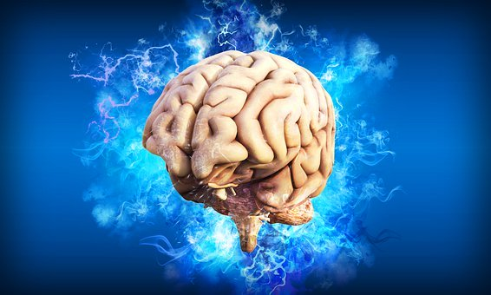
Attention
Judgment
Memory
Cognition
Flexibility
Organization
Awareness
Reasoning
Problem Solving
Notes:
Understanding cognition will help you to better understand anyone in your life, including yourself.

Slide 6


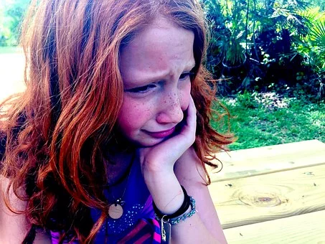

Father
Keeps missing appointments
Comes unprepared
Seems to want to do right thing
Why does this keep happening?
What can you or he do?
Little Girl
Pushed downstairs by brother
Used to love school
Doing poorly in school
Says she’s “stupid”
Having headaches
What do you recommend?
Brother
Says “she made him mad”
Other aggressive acts
Angry
Impulsive
What’s causing his behavior?
What do you do?

Slide 7
Understanding Cognition
Attention – not a unitary skill
  Visual
  Verbal
  Task-specific
  How long (duration)
  How much (density)
  How hard (complexity)
  What environment
      Distractions/no distractions
      What type of distraction
Breaking it down:
Sustained Attention
Divided Attention
Alternating Attention

Slide 8

Special Case of ADHD & TBI
Children with TBI and attention problems are often referred for treatment of the ADHD problem.
Cognitive Problems Following TBI
That’s fine, but need to look at whole picture.
ADHD

Slide 9
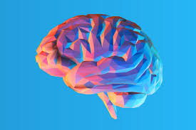
Memory
Short-term
Long-term
Working Memory
Write things down
Repeat information
Use lists, planners, pictures, cue cards, timers
Cue where needed
Use spaced rehearsal – reviewing the same info several times over time
Create procedures and routines
Use their strengths – visual or verbal
Pause for processing before moving to the next step
New learning
Episodic
Procedural
Declarative
Semantic
Verbal Memory
Visual Memory
Notes:
Long-term – did it get into storage
Working memory – Pulling in info changing and updating
Episodic- Episode on a show – Visual/what happened
Procdedural – riding a bike – doing something w/o having to think
Declarative – Facts and events
Semantic – meaning based
Knowing all of this will help work off of those strengths.

Slide 10

Executive Functions
The brain skills you need to achieve a goal.
Includes higher order skills of
  Initiation, planning, organization
  Impulse control, self-monitoring
  The flexibility to change strategies as needed
Notes:
We think of that as the Governor, teacher, supervisor – Higher level skills

Slide 11

Awareness
Hierarchy of Self-Awareness
Stop, Think and Plan, then Evaluate later
Ask leading questions: Will anything be difficult, do you have anything that could help you, Will you need my help…
Make a plan with strategies in place for any anticipated problems
Then during Evaluation: how did it go, could anything or anyone have helped to make it go better, what would you do differently next time…
Give feedback gently, always with a way to make it better
Intellectual
Anticipatory
Emergent
(No Awareness)
Crosson et al, 1989
Notes:
Develops with age – so it’s an issue with all kids
But a bigger issue for kids with brain injury
Some key areas that are often impacted after TBI (this and the following slides)
lack of self-awareness may result in a failure to employ appropriate compensatory strategies and may produce behavior that is dangerous or ineffective.^{10,} ¹¹ The lack of self-awareness regarding high-risk behavior is recognized as a common impediment to successful rehabilitation of persons with brain injury. https://www.archives-pmr.org/article/S0003-9993(01)95199-8/fulltext
https://www.neurorestorative.com/assets/sites/7/NeuroInstitute_October1.pdf
Intellectual Awareness Deficits • Trouble with understanding at the lowest level that difficulties exist with performing a particular activity • Likely also have challenges with abstract reasoning and memory • Not able to generalize knowledge from one situation to another • AKA Deficits in Self-Knowledge
Training Intellectual Awareness • Concrete language • Education about personal brain injury • Strengths and Weaknesses Lists • Cued external compensatory strategies • High rate of repetitions
Emergent Awareness Deficits • Difficulty recognizing a problem while it is actually happening • Trouble monitoring the connection between actions and environment • Deficits at this level are the MOST FRUSTRATING to caregivers and clinicians,
Anticipatory Awareness: Unable to realize in advance that a particular deficit might cause a problem in the future • Cannot predict that a learned compensatory strategy could help AVOID a problem
Patient is able to anticipate when an impairment will affect performance and implement strategies. • Emergent Awareness: Patient recognizes when an impairment affects their ability as it occurs. • Intellectual Awareness: Patient may be aware a problem has occurred, but is unable to identify. https://www.neurorestorative.com/assets/sites/7/NeuroInstitute_October1.pdf
Sometimes people don’t remember that they’ve had that injury and that they can’t do something. Use Cody
Intellectual – Know that you have a problem
Emergent – I don’t know that I don’t have a problem until it’s here
Anticipatory – can I anticipate it “think ahead”
Awareness- Do you have the ability to understand that you have a deificit, anticipate when it might happen and then plan for it. Or do you not know.
***We have to be self-aware also! Your body language, expressions, our body language can set people off. We are not often aware of our own faults or deficits. ***
Go into mumbling example –
Develops with age – so it’s an issue with all kids
But a bigger issue for kids with brain injury
Some key areas that are often impacted after TBI (this and the following slides)
lack of self-awareness may result in a failure to employ appropriate compensatory strategies and may produce behavior that is dangerous or ineffective.^{10,} ¹¹ The lack of self-awareness regarding high-risk behavior is recognized as a common impediment to successful rehabilitation of persons with brain injury. https://www.archives-pmr.org/article/S0003-9993(01)95199-8/fulltext
https://www.neurorestorative.com/assets/sites/7/NeuroInstitute_October1.pdf

Slide 12
Father
Little Girl
Brother
Not aware he’s forgetting
Not aware there’s a pattern of forgetting
Doesn’t know why she’s not doing well in school
Doesn’t know what to try to help herself
What she thinks she knows is that she’s stupid
Not aware he’s about to get angry/violent
Doesn’t know what to try instead of violence
Not aware there’s a pattern
“She made me mad”

Slide 13

Metacognition
The Greatest Gift
Helping someone to become aware of the way they think:
Strengths
Weaknesses
Strategies/Tools
Notes:
Want to raise awareness but not pummel them with what they can’t do. When they become aware of an issue, you want to leave them with a strategy to make it better.
This is also important to help raise metacognitive awareness for any child.
Understanding where else it can work – generalization.

Slide 14

Initiation
Planning
Organization
Completion
Initiation
  Make a schedule with clear start times
  Use a timer or Alexa
  Get agreement to remind them when to start
  Follow a routine
Planning
  Use a planner or wall calendar
  Write down steps with a check-off
  Routinely consult the plan
  Use drawings or pictures if helpful
Notes:
Initiation – this is you ability to get going on things. To start something. People can test great, look great, know what they need to do but they wont do it until that drive is good enough (Eating drinking, going to the bathroom
Planning – Can be about the same. Maybe they can’t plan for what’s coming next or an assignment that they have to do. Maybe they can’t complete it because they can’t make that plan of what has to go in what order.
Was it because he couldn’t get started? He couldn’t make a plan? He couldn’t organize the pieces? He couldn’t stick with it to complete it?
Really important to dig deeper to understand why so the child is not simply punished all the time and so that you know what strategies to implement. Child might not know why. They can’t break it down. May not be able to articulate why. May give you a quick answer just to stop the interaction or not feel stupid – “I didn’t want to.”

Slide 15
Initiation
Planning
Organization
Completion
Organization
  See above
  Everything has a place and is put back in it’s place
  Color coding
  Categories
  Pictures to show what goes where
  Write all the steps down, then put in right order
Completion
  Check off all steps
  Photo of what done looks like
  Cues to keep going
Charlie’s daily tasks didn’t get done… Why?
Notes:
Charlie may not be able to tell you why he didn’t get things done…
Was it because he couldn’t get started? He couldn’t make a plan? He couldn’t organize the pieces? He couldn’t stick with it to complete it?
Really important to dig deeper to understand why so the child is not simply punished all the time and so that you know what strategies to implement. Child might not know why. They can’t break it down. May not be able to articulate why. May give you a quick answer just to stop the interaction or not feel stupid – “I didn’t want to.”

Slide 16

Flexibility
Reasoning
Problem Solving
Extreme “Stuckness” Perseveration
Ex: Autism, but also Brain Injury
Flexibility
Allow the inflexibility when it’s not hurting anything/anyone. Sameness can be comforting
Remember it’s the brain
Brainstorm different ways beforehand
Reasoning/Problem Solving
Use questions to assist
Encourage thinking it through: what would happen if we did it that way
Write each part down to help with memory
Notes:
Flexibility can be really frustrating. If you have someone who is really stuck on something. This can be anything. Talking about something, doing the same task this is inflexibility and is call perseveration -

Slide 17

Judgment
Perception
Abstract Thinking
Judgment
  First identify all options
  Then weigh all options
  Help to think them through to the end
  Put it down on paper
Perception
  Make sure they are “seeing” things clearly
Abstract Thinking
(a very high level skill)
  May need to make things more concrete
  Watch figurative language and idioms
  May need it explained
Notes:
Judgment: can they weigh out the pros and cons? Can they see them all?
Perception can mean the senses, but it can also mean ability to perceive or pick up on what’s really going on here.
Abstract thinking: do they only think literally? …
Judgement – can the think of all those piece and weight them out? But what if they are having impulsivity problems and they can’t get to weighing that out?
Perception – this can be anything seeing, tasting, touching, But also can I perceive all that is going on
Abstract thinking – Idioms – Don’t cry over spilled milk. Can they understand and pickup on social ques.

Slide 18
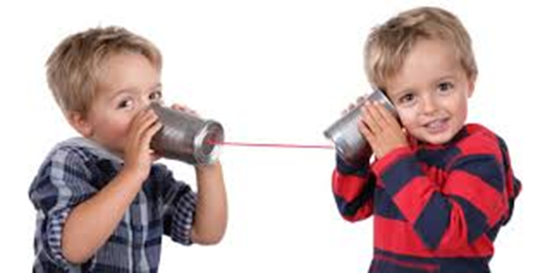
Language
Cognitive changes impact language
Language itself may not be disrupted after TBI (but it might be after a stroke)
Notes:
Relate to perseveration

Slide 19



Receptive Language
Information Processing
Speed
Duration
Complexity
Vocabulary, grammar, content

Slide 20



Information Processing
Receptive Language
Talk slower
Pause more
Use less information and/or words
Simplify vocabulary
Simplify grammar
Simplify the overall topic
Control distractions
Make sure they have understood
Speed
Duration
Complexity
Notes:
Info processing –
Speed – we need to just slow down.
Duration – I can understand this but only for a little period of time.
Complexity – Make it simple. Doctors talking compared to their favorite topic.

Slide 21

Receptive Language
Also need to consider:
Distractibility – what type of environment do they need?
Won’t necessarily ask questions – may not realize they didn’t understand

Slide 22

Expressive Language
Amount of talking – too much/too little
Organization
Tangential (sidetracking)
Finding Words
Complexity
Prosody (change in tone)
Perseveration

Slide 23

Language
Look at cognitive problems and see how they impact language
Receptive Language Example:
Cog: Attention and Awareness problems
Result: Not understanding, but don’t ask questions because they don’t realize
Expressive Example:
Cog: Disorganized and perseverative
Result: Retell of day jumps all over and tends to keep coming back to one event

Slide 24
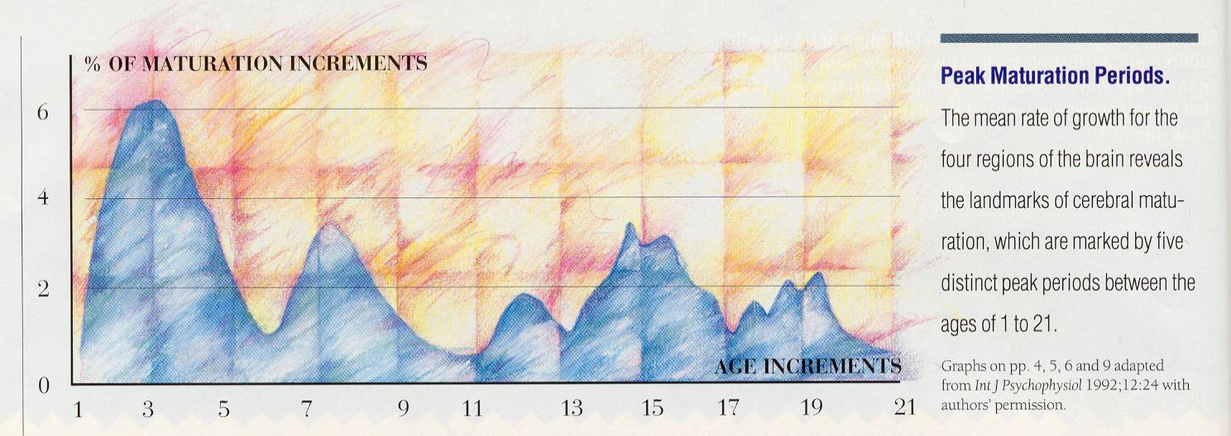
Need for Ongoing Monitoring
Rates of Development for the Four Regions of the Brain
5 Distinct Periods of Maturation
P-O parietal/ occipital
C central (limbic & brainstem)
T temporal
F-T frontal/ temporal
% of maturation increments
6
P-O
C
T
F-T
4
P-O
C
F-T
T C
2
F-T
P-O
0
age increments
1 3 5 7 9 11 13 15 17 19 21
Notes:
This chart gives you a glimpse of how many times there is a major peak in brain development from birth to early twenties.
From 0-5 years is a critical stage of development for children. They’re learning how to walk, talk, become independent and are also learning who to trust in their lives.
From 14-18, they’re learning how to transition into an adult. They’re learning who they are as a person.
If there is an injury at any of these ages, learning from that point on can be delayed or maybe not happen at all. So if that young adult’s injury causes changes and they never achieves that development of “who they are” – (with a frontal lobe injury, could be more impulsive, less confident in themselves, they’re more likely to not have positive relationships, maybe less likely to hold a steady job.)
CC- Let look at this from standpoint of Erikson’s theory
What if this happens around 2 years - Autonomy versus shame and doubt –
-this stage is focused on developing a greater sense of self-control. successfully completion this stage feel secure and confident, while those who do not are left with a sense of inadequacy and self-doubt. - https://www.verywellmind.com/autonomy-versus-shame-and-doubt-2795733
What about age 15 - Identity Versus Confusion “Who am I”
-Successfully completing this stage leads to a strong sense of self that will remain throughout life
-successful development is characterized by the ability to relate to others and form genuine relationships
- Unsuccessful - role confusion. not sure who they are or what they like. They tend to drift from one job or relationship to another, never really sure what they want to do with their lives. - https://www.verywellmind.com/identity-versus-confusion-2795735
This chart shows the development of the brain at different ages 0-21. Brain injury can have a big impact on new learning. What if that injury occurred at 8? At 1? All development from that point of the injury is potentially affected. Sometimes it take new learning to show the deficits. New learning can be disordered, delayed, or not happen at all.

Slide 25


Dig Deeper into Problem Areas
Charlie is “Forgetting”
Memory
Attention
Depression
Lack of organization
Initiation
Something else?
Notes:
Why might he be exhibiting this behavior that looks like forgetting?
Memory
Attention
Depression
Lack of organization
Initiation
Etc.

Slide 26
Testing Options
  School Psychologist or Learning Specialist
  Academic Testing
  IQ Testing
  May add other tests
  Neuropsychological Testing:
  Gold Standard for TBI Testing
  Brain-Behavior Relationships
  Academic Testing
  IQ Testing
  Specific Domains of Cognitive Function
    Attention
    Memory
    Executive Functioning
    Visual-spatial Function
    Information Processing
Notes:
Advocate for Neuropsyche testing when needed.

Slide 27
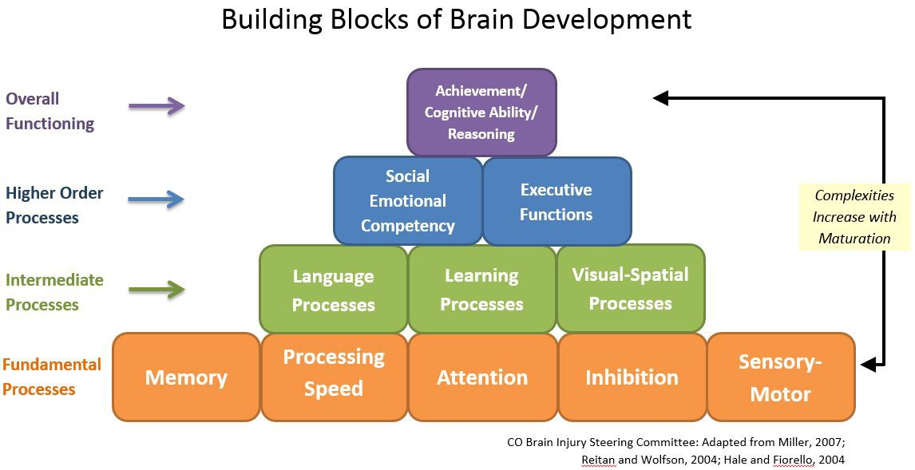

Slide 28
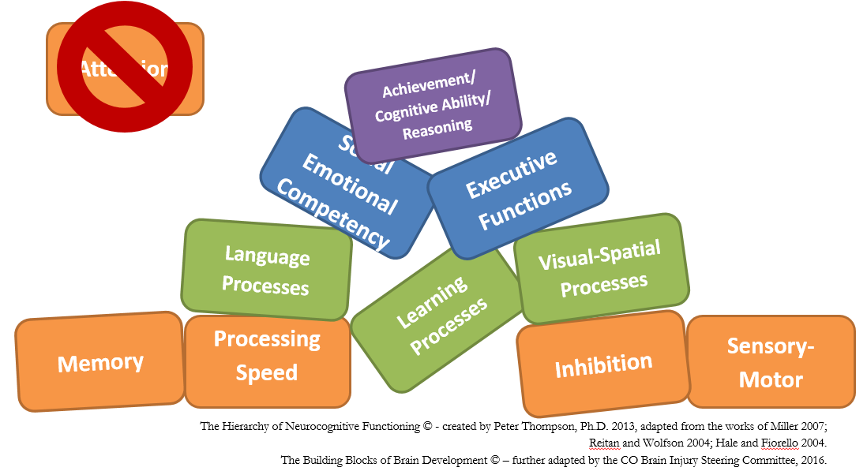

Slide 29

Cognitive-Linguistic Testing
Speech Language Pathologist
Receptive Language – Understanding information
Expressive Language – Talking
Reading
Writing
Social Skills

Slide 30
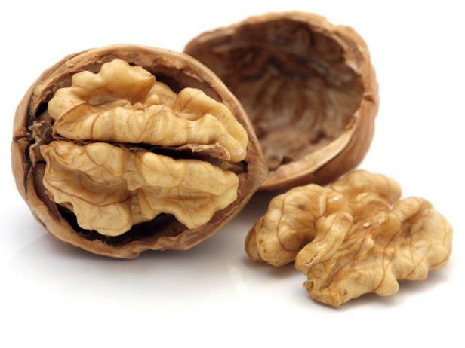
Cognitive Rehab (in a Nutshell)
Understand their cognition
    Through NP testing, observation and reports of people who know them
    Strengths and weaknesses
Form an alliance
    Build relationship
    Get agreements around goals/outcomes and strategies
Determine level of support needed (for each task)
Develop strategies*
    Internal
    External
Notes:
You are not doing cog rehab, but I think some of the principles are relevant because you are providing services to people with cognitive challenges.

Slide 31

Strategies
Can be internal or external
Internal Strategies: things that happen inside your head
  A reminder phrase
  Rehearsal
  Self-cues
  Elaboration
  Imagery

Slide 32

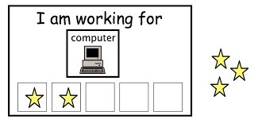
Strategies
External Examples:
  Modifying the environment
  Devices – electronic, low-tech
  Notebook
  Visual supports
Visual schedule
Pictures
  First-Then boards
  Checklists
  Signs, Post-its
Do2learn.com

Slide 33

Father
Write it down in a planner
Expect to bring planner at each meeting
Call/text to remind (may need more than one)
Set appointment on their phone
Little Girl
Depends on findings of testing:
  Quiet environment
  Highlighting
  Planner
  Creating an Outline
Brother
Recognizing he’s angry and use key phrases like “I feel frustrated, I need a minute to think.”
More to come…Webinar 3 on Behavior

Slide 34
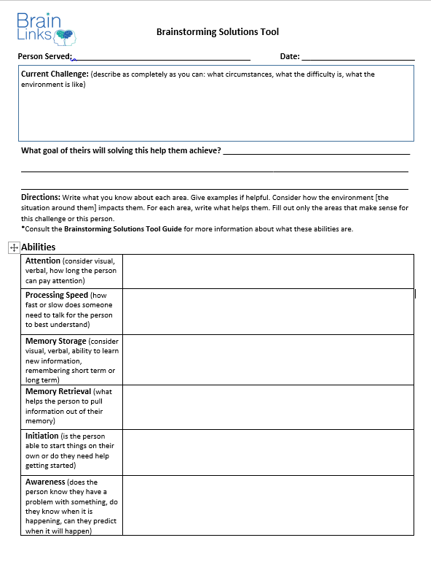
Cognitive Brainstorming Tool
To help you better understand what’s happening cognitively, behaviorally and emotionally so you can find solutions to challenges.

Slide 35
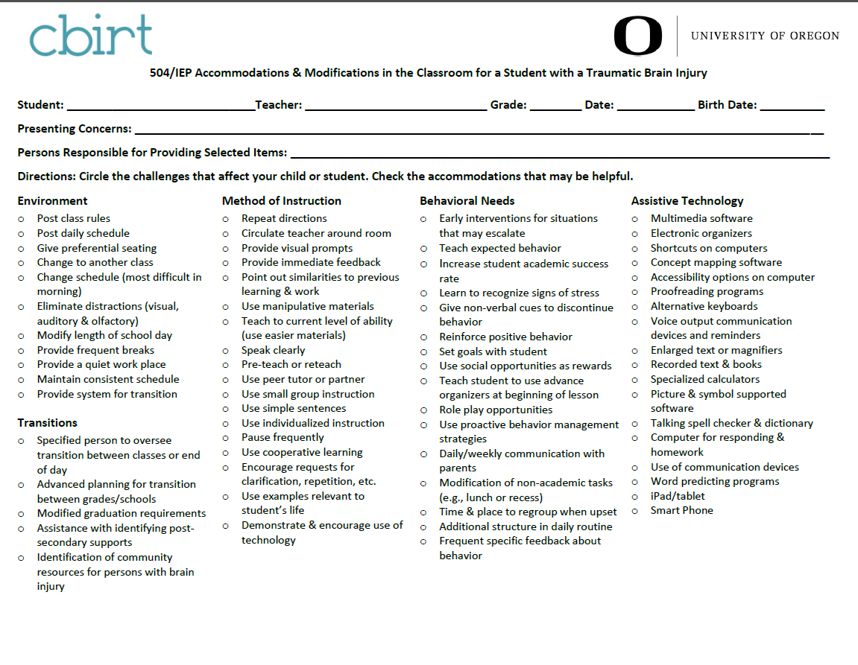
Accommodations - cbirt
!
!

Slide 36
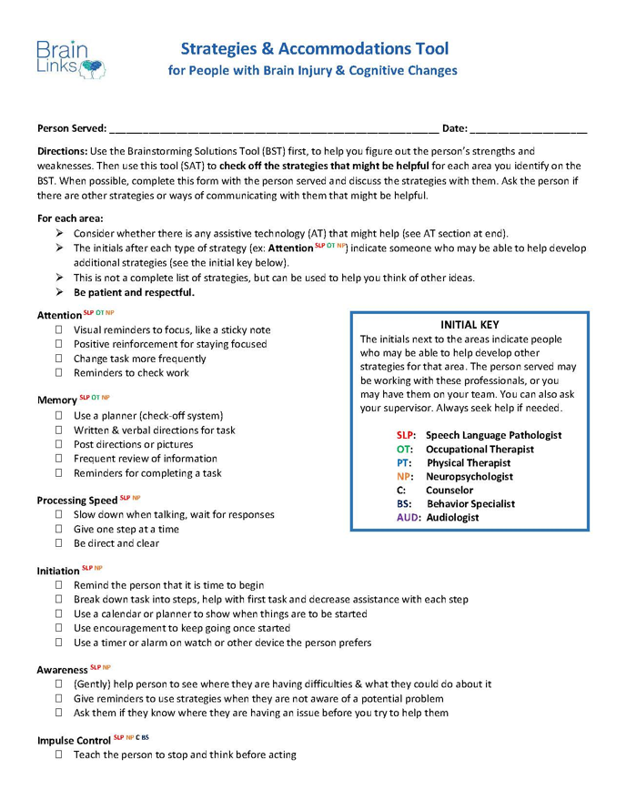
Strategies & Accommodations Tool
Lists of strategies grouped by category
Categories match the Brain Storming Solutions Tool
Room to keep track of what works and what doesn’t
Includes behavior strategies and assistive technology ideas
Indicates which professional can help
Notes:
Give examples with memory, organization, etc…so once we’ve identified what’s wrong, we can get an idea of some things to try from one of these tools. Can also help you to give suggestions when you are sitting in on an IEP meeting or a parent meeting. Maybe can also be used to train foster parents? Maybe they should have a copy of the BST and this SAT as well?

Slide 37

Sample Goals - cbirt
Goal setting: Lucy will establish a timeline for the completion of a project, articulate it with the staff, and meet the timeline requirements in 9 out of 10 opportunities.
Planning: Given a task that she correctly identifies as difficult for her, Molly will create a plan for accomplishing that task, including articulating the nature and frequency of help in 8 of 10 opportunities.
Organizing: Cory will prepare a semantic web before proceeding with writing projects in 5 of 5 opportunities.
Memory: To be better prepared for homework, Sam will record class assignments in a planner and review it at the end of the day with Mr. Green in 4 of 5 days.
cbirt.org Sample IEP Goals
cbirt.org Sample IEP Goals
Notes:
https://cbirt.org/sites/cbirt.org/files/resources/sample_iep_goals_for_students_with_tbi.pdf

Slide 38
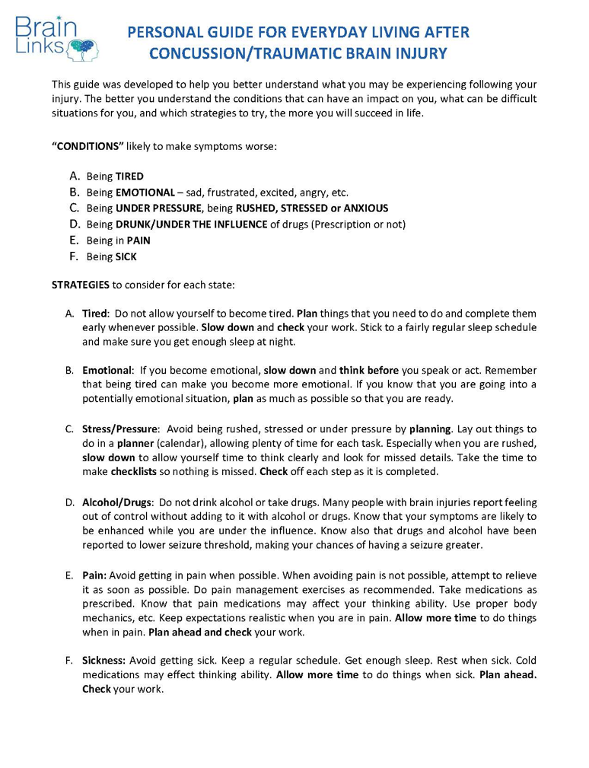
Personal Guide
Purpose
For raising understanding/ metacognition
Good for the older child/teen and their caregiver
Content
States that make performance worse
Strategies to help
Situations that will challenge them
Understanding what distracts you
Eliminating distractors
Use old strategies
Notes:
Discussed metacognition earlier as the biggest gift.
Using “old” strategies will be less relevant for younger kids.

Slide 39

Treatment
Treatment can still be helpful at any time.
Examples:
      Young girl
      Father forgetting
      Teen in Juvenile Detention
Notes:
Image fits all 3.
The young girl we were talking about – get treatment right away.
The father, can benefit now from either some informal strategies or from formal therapy
The teen in Juvenile Detention – imagine how life-changing it can be to learn that you are not the way you are because you are bad, but because you had an injury. Might make you much more willing to participate in therapy.
And then an extreme example…(next slide)

Slide 40
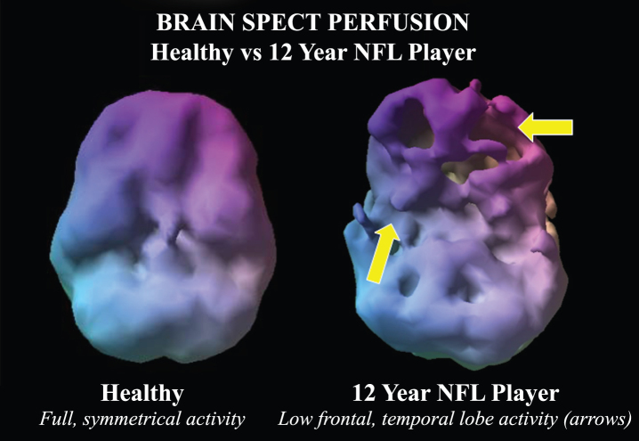
Treatment
It’s never too late to benefit from treatment.
Extreme Example:
NFL Football Player
Multiple concussions across many years
Treatment changed his brain.
J. Alzheimer’s Disease, 2016
Notes:
Post treatment brain can look much like the one on the right. Many examples by Dr Amen. Be a part of Webinar 4 on Brain Health to find out how!

Slide 41
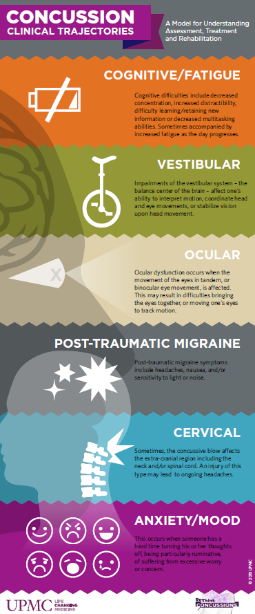
Treatment
Type: Formal or informal
Place:
  School
  Inpatient brain injury unit
  Outpatient cognitive rehab
  Concussion Center
  Symptom Specialist – see 6 Types

Slide 42
Your Role with the School*
*Regardless of whether you are a
Case Worker, parent or foster parent
Help identify the TBI history by asking lots of questions
Help get the TBI diagnosis from the doctor
Facilitate communication between family, school and doctor
Advocate for testing, then services if warranted
Help determine whether a neuropsychology evaluation is needed
Help the school understand TBI
Make sure the school can appropriately treat
But wait, …

Slide 43

Your Role with the School*
*Regardless of whether you are a
Case Worker, parent or foster parent
… there’s more!
Get outside services if needed
Give input at the IEP meeting
Tell what’s happening outside the school
Give strategy/accommodation examples
Make sure the child (all ages) is monitored over time
Don’t give up on the child

Slide 44

College Help
Students with special needs
Who want to go to college
Who need help with independent living & school
Apartment living
Provides structured help which diminishes
Uses TN Promise Program
Franklin, TN
Experiencecle.com

Slide 45
?
How do you determine if a Concussion /TBI exists when the child already has another issue?
For instance a child with ADHD or Autism
ADHD
TBI
Medical
Notes:
What if your child already has another issue and it’s hard to tell if they’ve had a concussion? For example, ADHD, Developmental or Intellectual Disability, or are Medically Fragile. They may communicate without words and can’t tell you. What do you do?

Slide 46
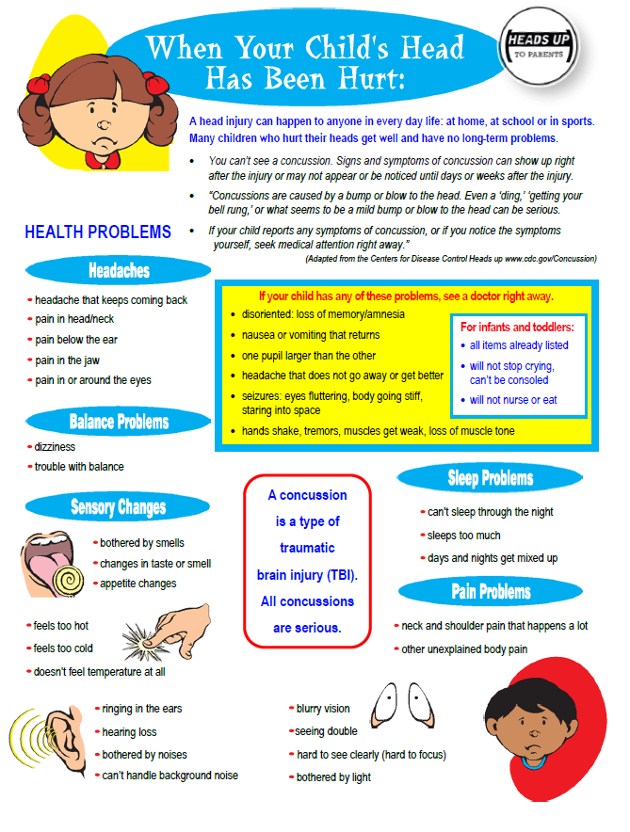

Think about their history. Look for any history of an injury.
Must be persistent and creative in your questioning.
Use the Intake Form as a guide.
Notes:
First thing we would do is to ask – are there any signs of concussion?
Do they have a history of injury? Go back to the concussion signs and symptoms tool. Did you see signs of the injury, bruising? Were they in pain? IF you saw signs of the concussion, maybe it was.
Looking for any change in that person and it will help us to figure out what to do.
Have they ever fallen off from the bed, fallen down stairs, bike or car accident?
Were there symptoms – like headaches or crying without being able to console them?
If a medically fragile child, did they fall out of their chair? Because it doesn’t take such a severe injury to cause symptoms.

Slide 47
Worsening of Pre-existing Behaviors
Used to focus for an hour before breaking, now breaks after 30 minutes.
Balance was not great, but is falling more now.
Behavioral outbursts were once a day, now they are 3 times a day.
Notes:
“He always had ADD.”

Slide 48

Adverse Childhood Experiences (ACEs)
Notes:
A lot of this information is coming from an article on PsychologyToday.com entitled Ways Childhood Adversity Can Change Your Brain. When a child’s brain is chronically stressed, it produces a hormone which shrinks the size of the hippocampus. The Hippocampus processes emotion, memory and helps with managing stress.

Slide 49
ACEs
Less Gray Matter
ACE Score
Notes:
MRI studies show that the higher the ACE score, the less gray matter in key areas of the brain:
The prefrontal cortex, and the amygdala which is involved in fear processing.
They are more likely to react to even minor stressors.

Slide 50
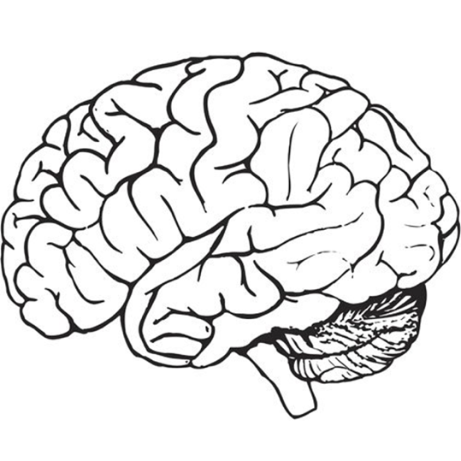

ACEs
Microglial Cells
Produce Neurochemicals
ACEs
Cause
Inflammation
Notes:
ACEs (or unpredictable, chronic stress) causes microglial cells in the brain to produce neurochemicals that lead to inflammation in the brain.
This sets up long term change in the brain. Chronic inflammation anywhere is not good, but it’s really not good in the brain.

Slide 51

ACEs
Kids with ACEs much more likely to develop
Mood disorders
Poor executive functioning
Decreased decision-making skills

Slide 52
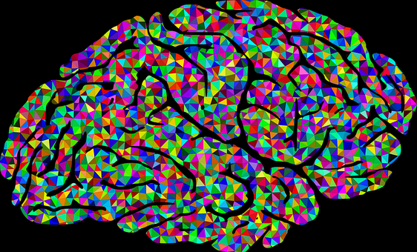
ACEs
Kids with ACEs much more likely to
Have weaker connections between the Prefrontal cortex and other key areas of the brain
Notes:
(Especially between the PFC and the hippocampus for all. And btwn the PFC and the amygdala in girls.) So any stressful situation is experienced with greater fear and anxiety, esp in girls.
In general, weaker connections means slower speed of processing.

Slide 53
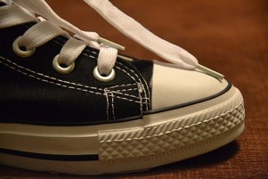
ACEs
Telomeres Erode
Aging at a Cellular Level
Disease & Cellular Aging
Notes:
Telomeres are the protective caps on the ends of our DNA. (Imagine a shoelace with the protective end.) The chronic stress of ACEs cause the telomeres to erode or shorten. The size of our telomeres predicts how long we will live. When the telomeres erode, they cause aging at a cellular level which can then make it more likely that we will develop diseases and our cells age faster. We have been focusing on the brain, but there are a number of chronic diseases that go along with higher ACE scores.

Slide 54
BUT…
Improvement
IS
Possible!
Stay Tuned
For
Webinar 4
On
Brain Health!

Slide 55

Tools & Resources

Slide 56
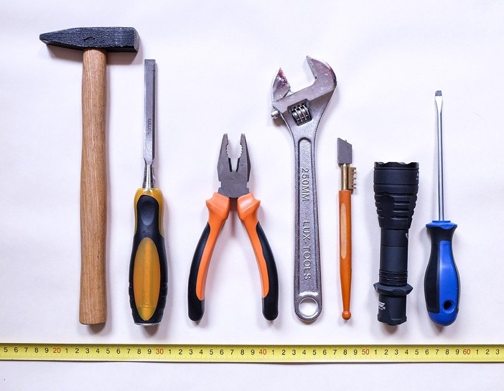
Already Discussed
Brainstorming Solutions Tool – Brain Links
Accommodations – cbirt
Strategies & Accommodations Tool – Brain Links
Sample IEP Goals – cbirt
Personal Guide for Everyday Success – Brain Links
Six Types of Concussion Fact Sheet – Brain Links & UPMC
College Living Experience
Notes:
We want to make sure you have all the tools you need for the job.
The tools that we discussed that have to do with today’s webinar.

Slide 57

More Tools
Brochure for explaining Pediatric Neuropsychology to parents

Slide 58


Your Intake Form
(Already discussed, but worth highlighting on its own!)
Probably your greatest tool for
  Identifying an injury
  Identifying possible “aftermath” symptoms
Notes:
Have we asterisked TBI items?
TBI is SO pervasive. TBI will not explain EVERYTHING in EVERYONE you see, but it will explain A LOT in MANY.

Slide 59







Thank you!
www.tndisability.org/brain
*** More web-based training available https://bit.ly/2W5GCIK
Brain Links is supported by the Administration for Community Living (ACL) of the U.S. Department of Health and Human Services under Grant No. 90TBSG0024-01-00 and in part by the TN Department of Health, Traumatic Brain Injury Program.
Tennessee Disability Coalition
955 Woodland Street | Nashville | TN |37206 | 615-383-9442 www.tndisability.org/brain
Notes:
If you take a picture with your phone – it goes to our survey and you can do it in one minute. We appreciate getting the feedback and need it for our grant records. Today is June 23. And for the session title you can put RTL &TACT.

Slide 60
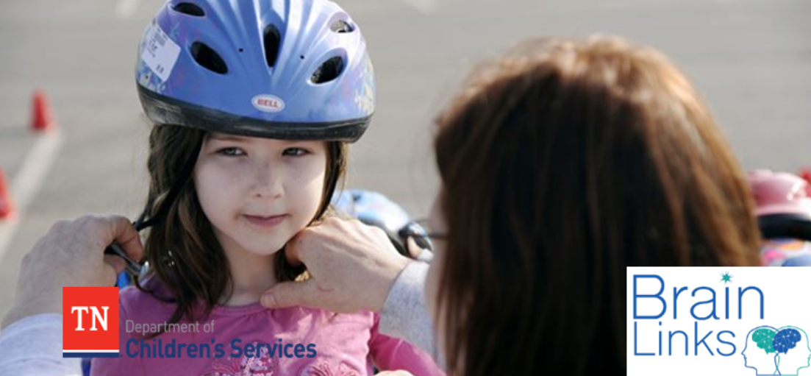
Webinar Series with Dept. Children’s Services
2020 Webinars:
June 23 10-11:30 CST
11-12:30 EST
Behavior/Psychosocial
July 21 10-11:30 CST
11-12:30 EST
Brain Health
For DCS Staff, Foster Parents and entire community
*** More web-based training available https://bit.ly/2W5GCIK
Notes:
https://tngov.webex.com/mw3300/mywebex/default.do?service=7&nomenu=true&main_url=%2Ftc3300%2Ftrainingcenter%2FLoading.do%3Fsiteurl%3Dtngov%26UID%3D-99999999%26RT%3DMiM3%26siteurl%3Dtngov%26apiname%3Dj.php%26MTID%3Dtad2f961b83c313356d26e9fa443619d0%26FM%3D1%26rnd%3D0326843294%26servicename%3DTC%26ED%3D945810632%26needFilter%3Dfalse&siteurl=tngov

