Slide 1
Concussion, TBI and Abusive Head Trauma: Supporting Children and Families
Department of Children’s Services, Brain Links
Carrie Carlson, BSW
Jennifer Rayman, EdS, CRC, CBIS
Notes:
Thank you all for your interest in this topic and for letting have some time with you today to talk about Concussion, Traumatic Brain Injury and Abusive Head Trauma.

Slide 2
Brain Links is supported by the Administration for Community Living (ACL) of the U.S. Department of Health and Human Services under Grant No. 90TBSG0024-01-00 and in part by the TN Department of Health, Traumatic Brain Injury Program.
Notes:
To tell you just a little about our grant, we are funded by a federal grant with the Administration for Community Living and in part by the TN Dept. of Health.
Brain Links is a program of the TN Disability Coalition.

Slide 3
Brain Links
Who we are
Statewide team of brain injury specialists
What we do
We equip professionals to better serve people with TBI with current research-based training and tools.
Family-friendly educational materials
Resources for return to school, work & care settings
Toolkits for healthcare providers and school nurses
YouTube Training Channel
Notes:
Here’s a little more about us: Brain Links is a statewide team of brain injury specialists. There are four of us total. I’m in East TN, we have Wendy and Paula in Middle and Carrie who is in West TN.
We equip professionals to better serve people with TBI with current research-based training and tools.
One thing I like best about us - We work had to make sure that we offer family friendly materials that are interesting and easy to use.
Our resources are made to serve people all ages – from 0-5 to school age, to adult and older adults.
Our toolkits are a collection of TBI resources for healthcare providers and school nurses.
We now have full training and short clips on our YouTube Channel. We have playlists including one just for DIDD.

Slide 4
Incorporating Person-Centered Practices
To best support the individual what the individual wants and needs by:
Ensuring the person is served by a well-informed staff
Making materials and training available to family members
Keeping the individual’s safety and care in relation to symptoms a priority
Treating the individual with the same patience and respect you would like for yourself
Notes:
All of Brain Links’ staff have been trained in Person Centered Practices and we want to be sure we’re always keeping the person in mind with our training, our materials, and reinforcing the things that supporters of the individual should know.
.

Slide 5
Agenda
Overview of Traumatic Brain Injury (TBI) & Concussion, including a new model
Overview of Abusive Head Trauma
Discuss special issues for DCS
Long term consequences
Tools and ways to help
Notes:
"Traumatic brain injury (TBI) is a leading cause of death and disability among children and young adults in the United States. Each year an estimated 1.5 million Americans sustain a TBI.”
It’s likely that you are joining because you have someone you know who has or may have sustained a brain injury.
************If you’ll take a moment, please go to the green check mark and let me know if you have someone you care for or work to support who has a TBI.
With our time today, we’ll talk about a new model for treatment of TBI/Concussion.
We will give an overview of Abusive Head Trauma.
We’ll talk about special issues for DCS.
For many, there can be long-tem consequences after TBI, including concussion.
We will share some of our tools and ways to help.

Slide 6
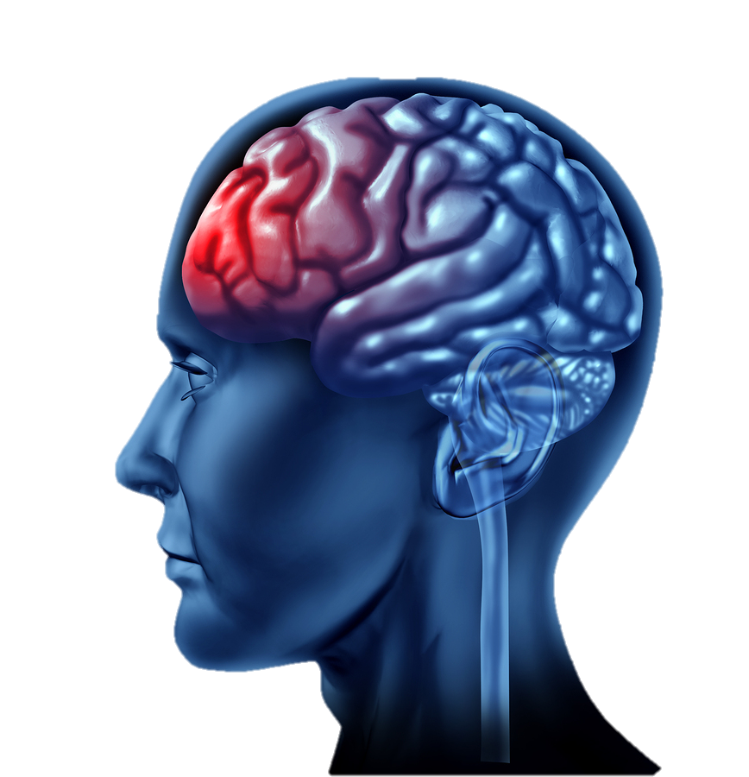
What is TBI?
A Traumatic Brain Injury is caused by a bump, blow or jolt to the head or body, or a penetrating head injury that disrupts the normal function of the brain.
A Brain Injury can be ACQUIRED in other ways: brain tumor, stroke, infection, surgery and drug overdose
Notes:
One of the most important things to remember about a TBI is that your head doesn’t have to hit something. You can experience a concussion or more severe brain injury when you experience a hard jolt, like in a car crash – like whiplash. You don’t have to lose consciousness. Only 1 out of 10 people actually lose consciousness.
There is so much to consider when you talk about injuring your brain. The injury and the changes that occur are unique to the individual. As you think about things today, maybe you’ll have questions about someone you know. We are starting this series for DCS because there are many topics to cover. Your brain controls everything you do, think, say, feel, remember and learn. Your brain controls your breathing, your heart. Every part of your life is controlled by your brain and if you sustain an injury, it’s likely that you’re going to need some supports.

Slide 7
TBI Can Happen in Many Ways
Fall-related TBI
Struck by/Against
Motor Vehicle /traffic related TBI
Assault/Self-harm related TBI
Unknown causes
Injuries classified as “Other”
Notes:
TBI can happen when you’re least expecting it. You don’t have be doing something dangerous to get hurt. It may be more common when driving or playing sports, but sometimes a common daily activity like stepping down from a bus is how people are hurt and have long lasting symptoms.
Falls are most common in the youngest and oldest but in some states – falls are highest for all ages, followed by motor vehicle related accidents, etc.
Sadly, some injuries are caused by violence - harming ones self or another person. This may be a little difficult to think about but some injuries could be prevented.
If extra time:
Give the example from Parris’ fall from an overcrowded deck, student who used ATV to go get mail on a large property, kids knocking into other kids’ heads when playing.
Here are some of the many ways that children can sustain a TBI. Most of them are pretty obvious. Two that I want to point out that are a bit less obvious are whiplash and being shaken. You don’t actually have to hit your head to sustain an injury. BRIEF description of coup contrecoup: The brain is thrown forward and hits the skull which is very hard. In most cases this is a really good thing because the skull acts like a helmet to protect the brain. In other cases, though, the brain bangs into the skull hard enough to cause damage where it hits. Let’s say it hits in the front of the skull. The brain then bounces back onto the back of the skull and causes another injury. So now we have an injury in the front AND back of the brain. (Obviously this can be side to side, etc, depending on where the brain hits.) To make matters worse, there are boney protrusions in a few places inside the skull, especially on the sides. As the brain is thrown around inside the skull it is also scraping against those protrusions and causing more damage. We’ll see more about coup contrecoup in a few minutes.
Causes Source:
http://www.brainline.org/content/2013/08/in-the-classroom-traumatic-brain-injury-what-teachers-should.html

Slide 8
Can also Include:
Repeatedly smacking someone in the back of the head
Throwing someone against a wall
Punching them in the face
Falling off a bed
Whiplash from a car accident or being pushed
Strangulation
Being physically bullied at school
Notes:
When we think about TBI, we probably first think of car crashes and sports injuries. You may not think of an injury like whiplash from a car accident that seemed minor. You may not think of being pushed or hit or hurt while being bullied as a cause to sustain a brain injury, but it can be. A hard hit to the head or body can cause a brain injury. Stopping from breathing can cut off oxygen to the brain and cause an injury. Any injury to the brain is serious.

Slide 9
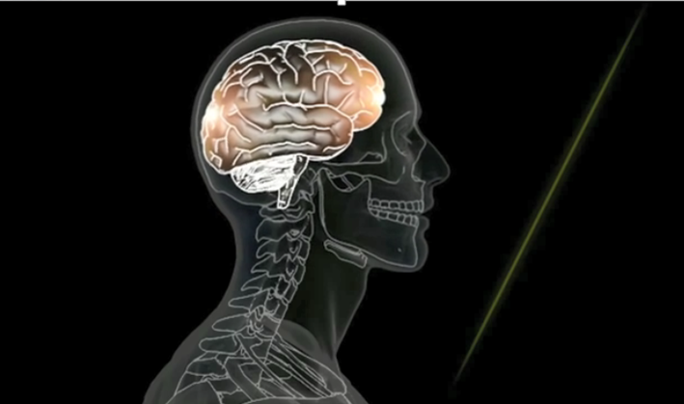
Concussion is a Type of TBI
Functional Injury vs. Structural Injury
Chemical Cascade
CT Findings
https://www.youtube.com/watch?v=Sno_0Jd8GuA
Notes:
https://www.youtube.com/watch?v=Sno_0Jd8GuA
If you have had a concussion or know someone who has, concussion is a type of brain injury.
With concussion, it’s more apparent as a functional injury – that means it shows up more in change of your ability to do things and less as a structural injury – where you might see the injury from the outside or on a brain scan.
We were talking about whiplash and how being pushed or shaken or a seemingly minor car accident can cause TBI.
Look at this image and think about the lit up spots in the front and back of the brain. I’m going to give a BRIEF description of a coup contrecoup injury. Think of the person driving and they are hit from behind and slam on their breaks and the car stops suddenly. Their head may jerk forward, the brain moves forward, too, inside the skull. That’s injury #1 – the coup in front – just over the eyes. Then all in the same split second, they are bouncing back against the seat. The brain moves, too, and then is injured a second time in the back – that’s the contra coup. This could happen from side to side, at multiple sites. It depends on how you are moving. Your head doesn’t have to come into contact with anything for the injury to occur. And it is likely invisible from the outside.
The chemical cascade is when chemicals at a cellular level rush out from parts of the brain to other parts and cause the injury (like tearing, swelling) and symptoms.
The brain is thrown forward and hits the skull which is very hard. In most cases this is a really good thing because the skull acts like a helmet to protect the brain. In other cases, though, the brain bangs into the skull hard enough to cause damage where it hits. Let’s say it hits in the front of the skull. The brain then bounces back onto the back of the skull and causes another injury. So now we have an injury in the front AND back of the brain. (Obviously this can be side to side, etc, depending on where the brain hits.) To make matters worse, there are boney protrusions in a few places inside the skull, especially on the sides. As the brain is thrown around inside the skull it is also scraping against those protrusions and causing more damage. We’ll see more about coup contrecoup in a few minutes.

Slide 10
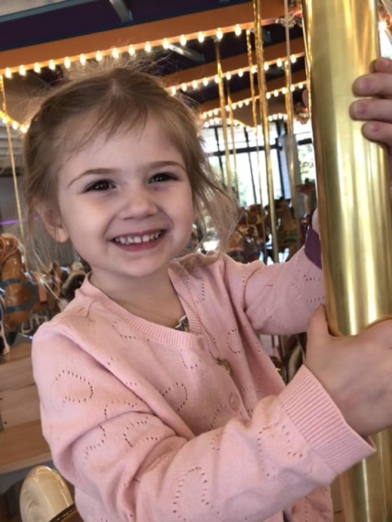
Common Symptoms following Concussion
Cognitive/Communication
Feeling dazed or in fog
Word finding problems
Slowed information processing
Physical
Headaches
Changes in vision
Sleep disturbance
Fatigue
Balance/Dizziness
Sensitivity to light/sounds
Emotional/Behavioral
Irritability
Quick to anger
Decreased motivation
Cries easily
Notes:
As we just said, everything you think or do, your personality and emotions – EVERYTHING – is controlled by the brain. So the list of possible symptoms is HUGE!
Some symptoms you can’t see from the outside, but those can be just as serious as those you can see. In children, you might see a child who is more irritable, cries more, seems like they are not motivated or can’t get started on tasks.
Headaches and fatigue aren’t always easy to observe, especially in younger children, but they can make it hard to learn in a classroom. Think about getting a poor night’s sleep and having any of these other physical symptoms and trying to listen to instructions or follow directions.
Easier to observe: Balance, Motor Coordination, Word retrieval, Forgetfulness, Irritability, Sleep Disturbance.
Less noticeable: Headaches, Changes in vision, Feeling Confused, Depression

Slide 11
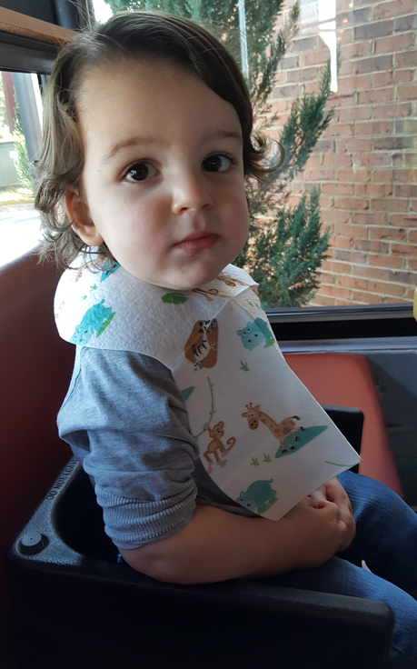
Common Symptoms Following Concussion for the Younger Child
Same as Older Child or Adult, but also
Appetite Changes
Behavioral Dysregulation
Decreased Engagement
Disrupted Sleep
Continence Issues
Increased Dependence
Stomachaches
Suskauer et al, 2018
Notes:
With younger children, they may not be able to tell you what they’re feeling or what is wrong. So you may have to look more carefully to notice changes – changes in sleep, appetite, continence issues.
There was a study in 2018 about concussion symptoms in younger children, that focused on reports from the main caretaker (parent or guardian in same home). There was a significant finding in all of these types of symptoms.
With Behavior dysregulation – they reported tantrums, hitting, biting, more crying that before injury.
With Decreased Engagement – may overlap with feeling fatigued or slowed down.
Additional young child symptoms from: Suskauer, S.J., rane,S., Reesman, K., and Slomine, B.S. Caregiver-report of symptoms following traumatic brain injury in a small clinical sample of preschool-aged children. J. of Pediatric Rehabilitation Medicine: An Interdisciplinary Approach 11 (2018) 7-14.

Slide 12
Missing the Very Young:
What to look for
Touching or holding their head
Startling to light or noise
Forgetting routines
Changes in any skill they already had
More clingy, emotional or withdrawn
Not eating their favorite foods
Waking at night
More tantrums or disruptive
Stomach issues
* These behaviors would also be relevant for someone who communicates without words
Notes:
You can look for these changes, like touching or holding their head, reacting differently – startling to light or noise. Less interest in favorite foods, waking up during the night, stomach issues.
We’re talking about children, but keep in mind that these behaviors would also help you to look for signs of concussion symptoms in someone who does not speak or communicates without words.
************Do you work with or care for someone who may not be able to verbally tell you what they’re experiencing?

Slide 13
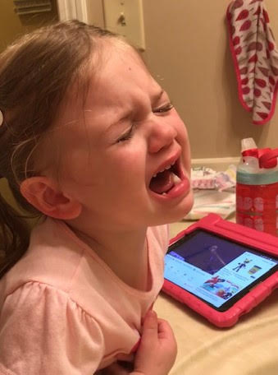
Missing the Very Young:
Pain Indicators
Signs of Pain:
Excessive crying
Anxious or agitated
Increased muscle tightness
Facial changes (tense or stressed)
A lot of physical movement
Changes in breathing
* These behaviors would also be relevant for someone who communicates without words
Notes:
Signs of pain in the very young could include being agitated, tense or stressed facial changes, changes in breathing.

Slide 14
Danger Signs
One pupil larger than the other.
Drowsiness or inability to wake up.
A headache that gets worse and does not go away.
Slurred speech, weakness, numbness, or decreased coordination.
Repeated vomiting or nausea; seizures.
Unusual behavior, increased confusion, restlessness, or agitation.
Loss of consciousness.
Emergency
CDC.gov
Notes:
These are danger signs, Although you might have heard about checking pupils or keeping someone awake with a head injury, they’re not usually associated with concussion.
One pupil larger, drowsiness, loss of consciousness – these are all danger signs to seek medical attention immediately.
*Once they have been assessed, no need to wake them every hour like we did in the past.

Slide 15
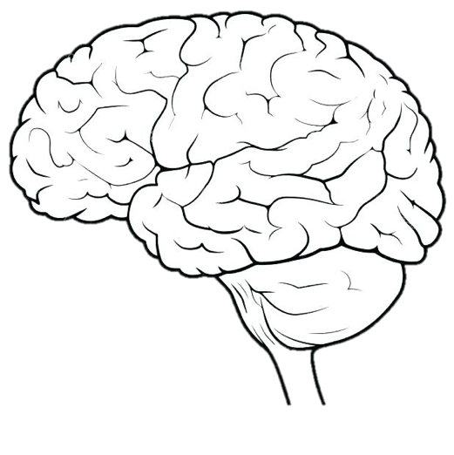
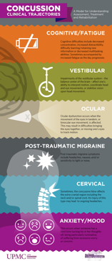
6 Types of Concussion
Vestibular
Mood/
Anxiety
Ocular
Concussion
Cognitive/
Fatigue
Cervical
Post-Traumatic
Migraine
Courtesy of UPMC Sports Medicine Concussion Program
Notes:
From 6 types of concussion back page:
At the University of Pittsburg Medical Center, they have been following a newer method of treatment for concussion. Instead of treating all concussions the same – with rest and time, they’ve focused on the individual’s symptoms and an active treatment plan to begin addressing those symptoms.
Symptoms will be broad and generalized during the first week following concussion and will often include symptoms like headache and fatigue.
After the first week, if symptoms persist, they will tend to fall into one of the 6 clinical trajectories.
There could be more than one trajectory type present. Someone may have mood/anxiety related symptoms and fatigue for example.
Which types and the outcomes depends on several factors:
Direction of force
Location of impact
Amount of force involved
Pre-injury risk factors (migraine, prior concussions, attention & learning issues, age – younger children take longer to recover) and more.
From 6 types of concussion back page:

Slide 16
Targeted Treatment
Vestibular Rehabilitation
Exercise
Vestibular
Medication
Exercise
CBT
Psychotherapy
Mood/
Anxiety
Vision
Therapy/
Orthoptics
Ocular
Manual Therapy
Exercise
Injection
Acupuncture
Biofeedback
Medication
Surgery
Concussion
Structured Rest
Exercise
Medication
Cognitive/
Fatigue
Cervical
Post-Traumatic
Migraine
Behavior Regulation
Exercise
Medication
CBT Cognitive Behavioral Therapy
Education/Trigger Modification
Courtesy of UPMC Sports Medicine Concussion Program
Notes:
Research is showing that active, specialized treatment – focused on specific symptoms – helps the brain recover from injury.
Notice how exercise is included (even vision therapy) in each area as part of the active treatment. It’s important to note that a short period of rest 2-3 days is still part of healing and recovery. The exercise component of treatment is not meant to bring about or worsen symptoms. With a professional’s help to gradually increases the activity, the person may exercise until the begin to have a symptom, then back off and try again later. It’s not for a someone to “push though” the symptom and keep going, but to gradually work up to doing more. The main goal is to return to some level of normal activity and routine, even if it’s only a little at the beginning.

Slide 17
Dispelling the Myths
TRUTHS:
Don’t need to hit your head to have an injury
Don’t need to have a loss of consciousness to have an injury – even a serious one
A clear CT scan does not mean no concussion
Having “only” a concussion does not mean no long-term consequences
Notes:
A clear CT scan does not mean there is no concussion: Remember that because it’s a functional injury, not a structural one, it won’t show on CT unless there is a skull fracture or pretty significant brain damage.
A concussion can cause long-term symptoms. Let’s try to get away from downplaying concussion as a minor injury.
A new study, though, showed microbleeds with some concussions on MRI. Not that we would do an MRI at this point, because we can diagnose concussion based on symptoms and we don’t really know the functional implications of the microbleeds. Soon, though, they will be able to diagnose concussion by a saliva test! And they will be able to predict which symptoms will predominate and how long they will last.

Slide 18
Dispelling the Myths
More TRUTHS:
Just because you can’t see the injury doesn’t mean there’s nothing wrong
There are now active treatments for a concussion
Inconsistency in symptoms/abilities does not mean they are “faking it”
Notes:
You often won’t see a concussion.
We are learning more every day about the brain and there are active treatments for concussion. Specialist in each area can help with those symptoms.
We often get questions about children “faking” symptoms. It’s common for symptoms to seem to come and go with brain injury – it can be frustrating for the person and those around him or her.

Slide 19
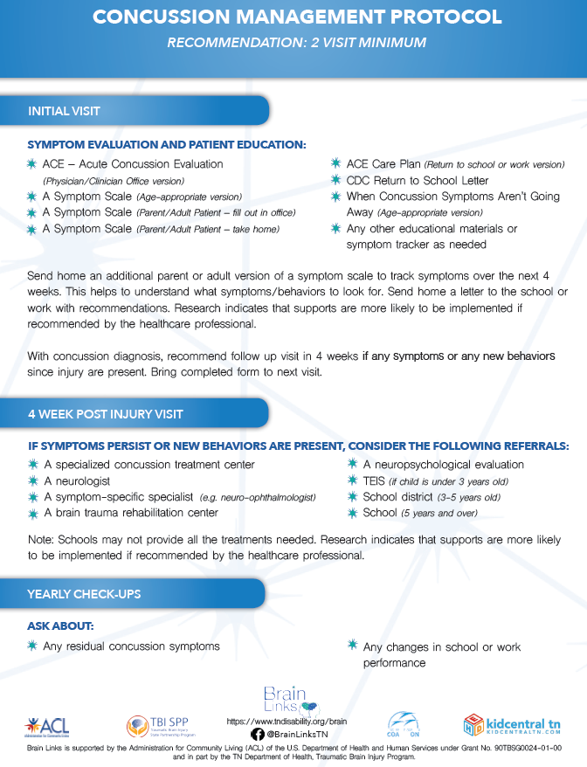
Concussion Protocol
Asking Healthcare Providers to
Think of Concussion as a 2-visit diagnosis
1st visit: Symptoms Evaluation and Patient Education. Give parent/patient a symptom list to take home and observe.
Return in 4 weeks if symptoms exist/persist
Referral for treatment
Check in at yearly check-ups specifically
about the concussion
Notes:
In our toolkit for healthcare providers, we have the Concussion Protocol. We are no longer waiting for symptoms to go away on their own. We are being more proactive because active treatment works and we know if we do nothing, many kids will go on to have significant issues.
The protocol is simple. All patients with concussion get two doctor visits.
The first for symptom evaluation and patient education. We have a lot of great information for the office and for the patient.
The patient/family gets a symptom list to take home and observe. You make the 2nd appt. before you leave the doctor’s office.
4 weeks later, if symptoms have continued, you go back and may need a referral to a specialist. If no symptoms, cancel the appointment.
Check in every year about the concussion as it could cause changes that show up with new learning.

Slide 20
Returning to School after Concussion
Return gradually, as the student can tolerate more
Few hours, half day
Allow to rest in a quiet area as needed
In the classroom
In the building (nurse’s office)
At home
Notes:
When the child returns to school, they may need to take it slowly. That can mean staying home at first for rest. Then as they can tolerate more, they could go for part of the day, or half-days. It may need to be the part of the day they need most – like socialization or a favorite class. Maybe they feel better first thing in the morning, while some may need extra time to sleep and afternoon is better.
Rest for down time can help – it can be in steps – maybe in the classroom at their desk the can put down their head for a few minutes. They could leave to have quiet or rest in the nurse’s office or may need to go home.
Image: https://pixabay.com/photos/classroom-school-education-learning-2093744/

Slide 21
Making the Transition to Preschool
Allow a comfort item from home
Don’t push participation
Don’t expect them to remember rules and normal routines immediately
Notes:
For a younger child, It may help to have something from home make this transition back to preschool easier (stuffed animal, blanket). These comfort items can SLOWLY be transitioned away as the child is ready.
Don’t push participation – the child may need more time and patience to get back into the routine. They need time to readjust, especially, after a long absence from school. For a small child a few days and a weekend, can feel like a long time.
Remembering Rules and routines may be hard. Offer patient and gentle reminders even if they knew all of the rules before the injury. Look for cues that this child is beginning to remember, and praise them on this.

Slide 22
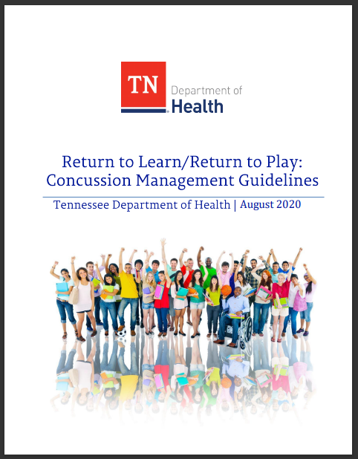
Return to Sport/Physical Activity
No remaining symptoms
Warn parents/other caregivers of the dangers of returning to sport while symptoms persist – risk of Second Impact Syndrome
Gradually increase participation/exertion each day, as long as no symptoms arise
TN Dept. of Health RTL/RTP Guideline
Notes:
The TN Dept. of Health RTL/RTP Guideline was created to help professionals and families when a child has sustained a concussion. The child cannot return to a sport or physical activity with symptoms.
Second Impact Syndrome is one risk, especially in children and young adults with a growing and developing brain. This occurs when a second injury occurs before the first has healed and causes a catastrophic reaction in the brain and can be fatal. This type of injury is why we have sports concussion laws in all of the states to protect athletes.
Returning to participation can be done gradually as long as no symptoms arise.
Source:
https://www.tn.gov/health/health-program-areas/fhw/vipp/tbi/tn-sports-concussion.html
https://www.tn.gov/content/dam/tn/health/documents/Returning_to_Learn_Guidelines.pdf
We can ask Anna R – but for children within DCS playing a contact sport they need to have permission.
Next slide can give the chart – detailed info to mention – for concussion protocol.
Differentiate if needed:
6 types – prescribed exercise treatment in a concussion treatment program with a physician’s input.
Once you are released from the treatment center program – you would be are okayed to go back to your return to play under the guidance of Athletic Trainer or Coach.
TSSAA letter – possible resource down the line.

Slide 23
TSSAA – mTBI Return Form
Enhanced language to better protect the student athlete and the healthcare provider
HCP and Athletes initials
- No symptoms at this time
- Implications of returning early
Language to clarify the Tennessee Sports Concussion Law
Gradual Return to Play Guidelines on the back
Notes:
The TSSAA (TN Secondary School Athletic Association) has an update to the TSSAA Return to Play Form.
It contains several enhancements that better protect both the student athlete and the healthcare provider and better clarify the language
to ensure the Tennessee Concussion Law is followed as intended. The healthcare provider and the athlete initial – no symptoms and the implications of returning early.
There is now an area for the provider to initial noting that the student reports no symptoms while active and that the student has been educated on the dangers of returning to play before the symptoms have cleared.
The dangers of returning to play too early are now more explicitly stated on the form.
The Gradual Return to Play Plan has been incorporated more specifically into the Recommendations section for both physical education classes and sports.
Added to the Gradual Return to Play Plan is the reminder that athletes should be free of concussion symptoms without pain medications before returning to play

Slide 24
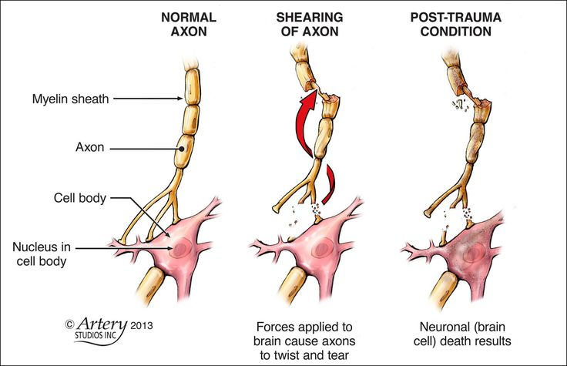
Abusive Head Trauma aka Shaken Baby Syndrome
Ages 0-5
From Shaking
Injury to the Brain
Diffuse Axonal Injury
Oxygen Deprivation
Swelling of Brain
Skull injures Brain
Notes:
Abusive Head Trauma is the primary cause of death and disability in infants and young children from child abuse. Shaken Baby Syndrome is a type of abusive head trauma.
If you look at the images here, you’ll see a normal axon – a tiny connection in the brain. Diffuse (widespread) axonal injury is when the axons throughout the brain are torn. Axons send messages through your brain
Oxygen deprivation or “anoxia” can result in widespread damage, too, but also tends to focus on the area of the brain responsible for memory (hippocampus).
Swelling of the brain is so problematic because there is no place for the brain to swell to. It is enclosed in the skull which is a hard bon with nowhere for swelling to go. If swelling can’t be stopped, the brain pushes down through the hole at the bottom of the skull at the brain stem - where the brain meets up with the spine and can affect breathing and other basic functions. This is why brain swelling can be life-threatening.
The brain gets scraped, particularly at the temporal horns on the side of the head, but other places, too, where the skull is not smooth on the inside.
Diffused axonal tends to be widespread through the brain, slows down information passing though the brain
Anoxia can be bad on the memory

Slide 25
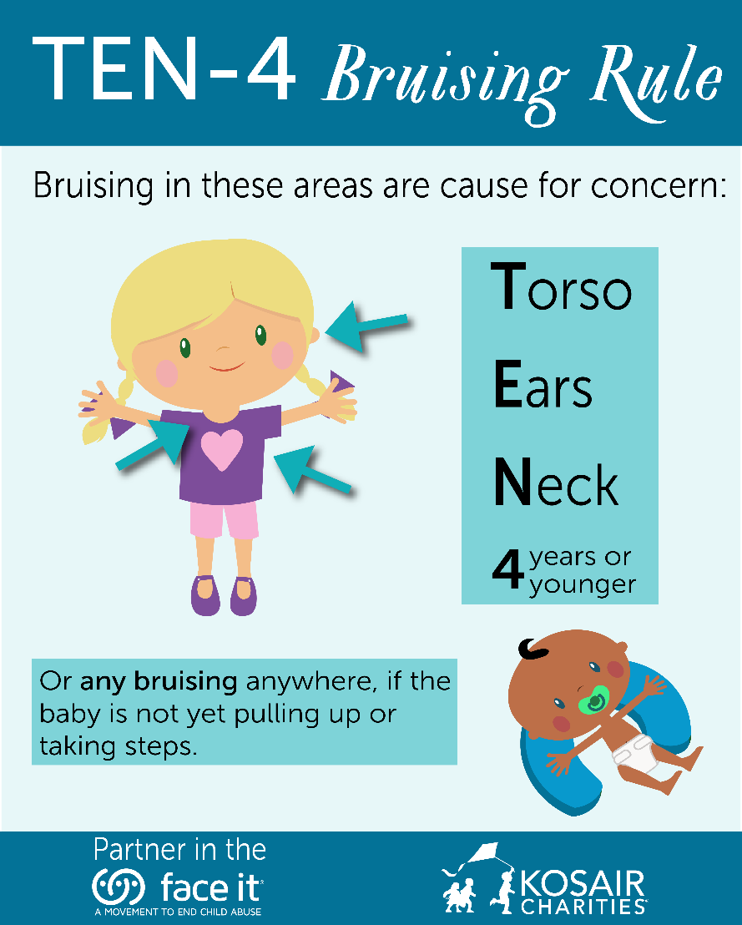
Early Symptoms Abusive Head Trauma
Bruises on arms and chest
Larger than usual head or forehead
Bulging or tight fontanels
Different –sized pupils
Retinal bleeds (85%)
Not able to focus
Favoring one arm or leg
Stop smiling/talking/walking
https://faceitabuse.org/ten4rule/
Notes:
*****************************How many of you have heard of the Ten-4 Bruising rule?
Bruising in infants should alert the physician to the possibility of abuse. Particular attention should be given to “TEN-4” bruising (bruising of the Torso, Ears, and Neck in children younger than 4 years
or any bruising in an infant younger than 4 months).
These are Early symptoms:
Large head or forehead – Head could be larger due to swelling
Bulging or tight fontanels (where the bones of an infant’s skull have not yet grown together)- occurs when fluid builds up in the brain or the brain swells, causing increased pressure inside the skull. When the infant is crying, lying down, or vomiting, the fontanelles may look like they are bulging.
Different sized pupils –
The inability to use an arm or leg could be from injury to the limb but could be from the bleeding on the brain
Retinal bleed – you may be able to see a bleed in the white part of the eye (Sclera)
Oral injuries in infants, such as frenulum tears, (the little stretchy tissue connecting between your lips and gums) may also accompany or precede AHT and should prompt consideration of abuse.

Slide 26
Early Symptoms Abusive Head Trauma
Less interested in eating
Vomiting
Tremors or shakes
Trouble sucking
Irritability
Difficulty staying awake
Seizures
Abnormal breathing
Report Child Abuse:
877-237-0004
Reports also can be made online on DCS secure site.
Direct link: https://apps.tn.gov/carat/
In Case of Emergency and Life-Threatening
Situation Call 9-1-1
For more information:
https://www.tn.gov/dcs/program-areas/child-safety/reporting/child-abuse.html
Notes:
More symptoms include vomiting, seizures, less interested in eating, trouble sucking, trouble staying awake.
If some suspects abuse or neglect related to shaken baby syndrome, they should make a referral to the Child Abuse Hotline. If it’s life threatening they should contact 911 immediately.
Under the exclamation point is he DCS webpage that will give you more information including frequently asked questions and what you need to know.
https://www.tn.gov/dcs/program-areas/child-safety/reporting/child-abuse.html

Slide 27
Injuries You Can’t See Abusive Head Trauma
Fractured ribs or other bones
Spinal cord injury
Neck injury
Bleeding on the brain
Notes:
Infant’s heads are large and heavy, and the neck muscles are still too weak to support a large head – That’s why we have to support it for them when holding a baby.
A child’s brain has a higher water content than adults, so the brain is more susceptible to shaking injuries
As you see in the image, the neck is hyper extended and this allows the brain to really shake and is injured by the skull.
Something you might notice - Children may not be able to hold something trying not to move an arm due to rib pain or not breathing correctly due to rib bruising or pain.
The infant or child may present with mild flu-like signs and symptoms
or extreme illness which includes apnea, severe respiratory distress, bradycardia, bulging fontanel, decreased consciousness, seizures, and cardiovascular collapse.
You will see evidence of active and/or bleeding on the brain – Dangerous. More likely from a brain bleed, there is not a lot of space for that bleed so you will see life threatening changes – breathing, sleep patterns, mental status change.
Midline shift – mental status/concussion danger signs.
•https://www.ncbi.nlm.nih.gov/books/NBK499836/

Slide 28
Later Symptoms Abusive Head Trauma
Learning Disabilities
Behavior Disorders
Vision Problems or Blindness
Hearing Issues
Speech and Language Issues
Seizures
Cerebral Palsy
Hydrocephalus
Can be Fatal
More than ½ of the children
0-4 injured by Abusive Head Trauma will die before they turn 21
Children who are severely injured have a 55% reduction in health-related quality of life
Notes:
Over half of children injured by abusive head trauma by age 4 will die before turning 21. Those who survive have a 55% reduction in health-related quality of life.
Symptoms include:
Blindness – possible optic nerve, or pressure, occipital lobe damage, retinal damage
Hydrocephalus aka “water (hydro) on the brain (cephalus means head)”- an accumulation of cerebrospinal fluid (CSF) occurs within the brain. This typically causes increased pressure inside the skull. Symptoms for Infants - a rapid increase in head circumference, eyes that are fixed downward.
Cerebral Palsy –is a problem that affects muscle tone, movement, and motor skills Most common motor disability of children. CP often is caused by brain damage that happens before or during a baby's birth, or during the first 3-to-5 years of a child's life.
Cerebral – brain Palsy – problems using muscles.
May have someone with a dx that aht could be the cause.
Congenital cp has nothing to do with trauma - 28 Days after birth – brain infection or injury
https://kidshealth.org/en/parents/cerebral-palsy.html
Adults- cognitive issues

Slide 29
Profile of an Abuser/Shaker Abusive Head Trauma
Think of:
These issues may also occur with TBI
Single Parent Families
Young Parents without Support
Lack of Childcare Experience
Lack of Prenatal Care
* Behavioral Health Problems
* Domestic Violence History
* Low Frustration Tolerance
* Low Educational Level
* Low Socioeconomic Status
Notes:
While we may have an image in our mind of an abuser who would hurt a baby or a young child, think of single parents, young parents, and inexperience caretakers.
Now look at all the list on the right. These tend to go along with adults who have had a traumatic brain injury along with impulsivity, frustration. Consider asking if the shaker might be a person with TBI.

Slide 30
Domestic Violence
The Problem:
50% Of women who report Intimate Partner Violence (IPV) also report blows to the head or face
Chronic Traumatic Encephalopathy (CTE)
TBI-related symptoms beyond 3 months:
- depression
- anxiety
- tension
Inability to adapt to changing situations
problems keeping appointments, following through, or completing tasks that require multiple steps
* TBI is a consequence of Domestic Violence, but it is also a cause.
Notes:
https://www.biav.net/traumatic-brain-injury-domestic-violence/
CC – Remember that IPV and DV are used interchangeably with regards to abuse. Men are abused, too!
The US Justice Department & CDC indicates that each year about
-269,000 women and
-54,000 men seek physician care after being assaulted.
Ohio State University and the Ohio Domestic Violence Network found that
-81 percent of women have sustained a head injury and
-83 percent have been strangled
-victims of intimate partner violence who have experienced strangulation are much more likely to die as a result of intimate partner violence
National Domestic Violence Hotline reports that a growing number of callers say that their abusers are using COVID-19 as a means of further isolating them from their friends and family. “Perpetrators are threatening to throw their victims out on the street so they get sick,” Katie Ray-Jones, the CEO of the National Domestic Violence Hotline tells TIME
JR – Add statement about IVP being underreported overall. Many don’t report until multiple injuries/occurrences.
- DV & TBI is limited in part because abuse goes unreported so there is limited research.
- Because DV is a pattern of abuse, victims are typically exposed to repeated instances of violence, which includes traumatic brain injuries.
Service providers should keep in mind that brain injury can make it harder for a victim of domestic violence to:
Assess danger and defend against assaults.
Make and remember safety plans.
Go to school or hold a job (increasing financial dependency on the abuser).
Leave an abusive partner
Access services
Adapt to living in a shelter/residential program for victims of violence. The person may become stressed, anxious and confused or disruptive, or have trouble understanding or remembering shelter procedures.
The signs and behaviors associated with TBI and domestic violence can look very similar – the impact of physical and emotional violence on the body and mind is complex. That’s why practicing trauma-informed care when interacting with survivors is key.

Slide 31
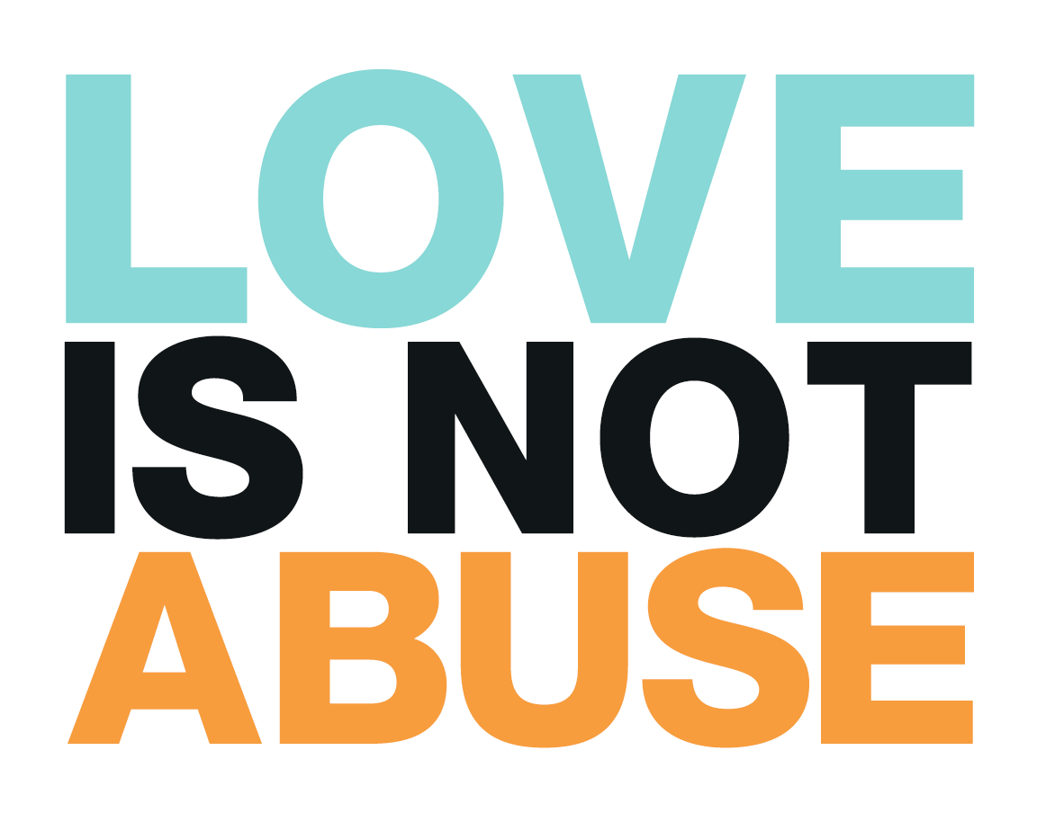
Teen Dating Violence
Physical violence
1 in 11 female
1 in 15 male high school students
Sexual violence
1 in 9 female
1 in 36 male high school students
Stalking & Digital abuse examples:
repeated unwanted or threatening phone calls or messages
showing up unwanted using social media or GPS/spyware to track someone’s location
stealing passwords or pressuring them to send explicit photos and videos
Psychological abuse
Examples: Name-calling, insulting, threatening
Notes:
Keep in mind Teen Dating Violence, too.
1.Physical abuse
2.Sexual abuse includes forcing, pressuring, or blackmailing (kissing, touching, or having sex)
3.Emotional abuse includes bullying behaviors
4.Digital abuse is a type of emotional or sexual abuse. It includes constant texts and phone calls, using social media or GPS/spyware to track someone’s location, stealing passwords, or pressuring them to send explicit photos and videos
https://www.childrenssafetynetwork.org/blog/facts-teen-dating-abuse
The burden of TDV is not shared equally across all groups—sexual minority groups are disproportionately affected by all forms of violence, and some racial/ethnic minority groups are disproportionately affected by many types of violence. - https://www.cdc.gov/violenceprevention/intimatepartnerviolence/teendatingviolence/fastfact.html
Nearly 1 in 11 female and approximately 1 in 15 male high school students report having experienced physical dating violence in the last year.
About 1 in 9 female and 1 in 36 male high school students report having experienced sexual dating violence in the last year.
26% of women and 15% of men who were victims of contact sexual violence, physical violence, and/or stalking by an intimate partner in their lifetime first experienced these or other forms of violence by that partner before age 18.
The burden of TDV is not shared equally across all groups—sexual minority groups are disproportionately affected by all forms of violence, and some racial/ethnic minority groups are disproportionately affected by many types of violence.
https://www.childrenssafetynetwork.org/blog/facts-teen-dating-abuse

Slide 32
Need for Ongoing Monitoring
Even if “cleared” earlier, children may need supports later.
Recommendation
Alert caregiver to what the child should be doing next developmentally and warn caregiver about things to things to watch for over time.
Example: Early Intervention System
Child passes the first developmental screening – but might fail the next one.
May need a referral back to TEIS if delays or issues arise
Notes:
For example:
Admitted to Hospitals, released w/rehab or services
Treated and released, no recommendations Regardless of the age of the child, where they were seen, or where they get “cleared,” don’t think it’s in the past. TBI needs to be addressed and monitored long-term.
One year – Studies show more likely to have a decreased IQ at 12 months. Samant, et all 2008

Slide 33
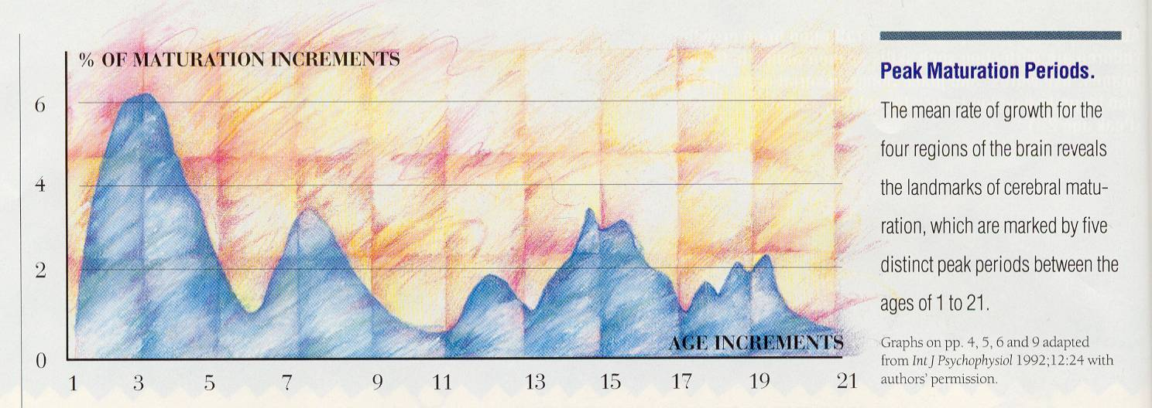
Need for Ongoing Monitoring Rates of Development for the Four Regions of the Brain
5 Distinct Periods of Maturation
P-O parietal/ occipital
C central (limbic & brainstem)
T temporal
F-T frontal/ temporal
% of maturation increments
6
P-O
C
T
F-T
4
P-O
C
F-T
T C
2
F-T
P-O
0
age increments
1 3 5 7 9 11 13 15 17 19 21
Notes:
This chart gives you a glimpse of how many times there is a major peak in brain development from birth to early twenties.
From 0-5 years is a critical stage of development for children. They’re learning how to walk, talk, become independent and are also learning who to trust in their lives.
From 14-18, they’re learning how to transition into an adult. They’re learning who they are as a person.
If there is an injury at any of these ages, learning from that point on can be delayed or maybe not happen at all. So if that young adult’s injury causes changes and they never achieves that development of “who they are” – (with a frontal lobe injury, could be more impulsive, less confident in themselves, they’re more likely to not have positive relationships, maybe less likely to hold a steady job.)
This chart shows the development of the brain at different ages 0-21. Brain injury can have a big impact on new learning. What if that injury occurred at 8? At 1? All development from that point of the injury is potentially affected. Sometimes it take new learning to show the deficits. New learning can be disordered, delayed, or not happen at all.
*Source of chart - Lash & Associates Publishing booklet: Brain Development in Children and Adolescents. https://lapublishing.com/brain-development-in-children-adolescents/
CC- Let look at this from standpoint of Erikson’s theory
What if this happens around 2 years - Autonomy versus shame and doubt –
-this stage is focused on developing a greater sense of self-control. successfully completion this stage feel secure and confident, while those who do not are left with a sense of inadequacy and self-doubt. - https://www.verywellmind.com/autonomy-versus-shame-and-doubt-2795733
What about age 15 - Identity Versus Confusion “Who am I”
-Successfully completing this stage leads to a strong sense of self that will remain throughout life
-successful development is characterized by the ability to relate to others and form genuine relationships
- Unsuccessful - role confusion. not sure who they are or what they like. They tend to drift from one job or relationship to another, never really sure what they want to do with their lives. - https://www.verywellmind.com/identity-versus-confusion-2795735

Slide 34
Children & Families Need Help Transitioning to School
“If, as a part of their medical care,
we provide systematic transition services,
they are more likely to receive the supports the student needs at school.”
Haarbauer-Krupa, King, et al., 2019
Notes:
Timing is critical as part of the child’s medical care to have supports during transition because of the possible behavioral and/or educational challenges. The school is more likely to take the advice of a physician when services are needed.
Because of their stage of development, young children are at highest risk for long-term behavior and learning challenges following a TBI
Longitudinal outcome studies in young children report cognitive and language deficits that influence school readiness and later school achievement
more severely injured children demonstrating greater risk for long-term neuropsychological impairment - These children enter school with potential for reduced capacity for learning and at great risk for development of secondary social and behavioral issues because of TBI-related cognitive changes

Slide 35
When there is no transition and follow up
Zack Age: 4 years
In an ATV accident
Loss of consciousness
Initial Glasgow Coma Scale = 8
(agitated, non-verbal, moves all extremities)
Multiple skull and facial fractures
Brain shifted to the left
(Not a concussion)
Recovers “beautifully”
Zack Age: 5 years
By October, “failing kindergarten”
Hitting other children
Wandering around the classroom
Disruptive
Impulsive
Not identified as having had a TBI
“Just a boy being a boy”
Notes:
Explain recovers “beautifully” – invisible injury
Not identified, Boy just being a boy
Let’s first look at just one year after the injury. This is, unfortunately, an all too typical case for us. Zack…

Slide 36
Families
Where there was family dysfunction/poor coping, the child had greater dysfunction
Schwartz, 2003; Anderson, Catroppa, Dudgeon, et al., 2006; Taylor, Swartwout et al., 2008
Families reported needing information, emotional support and access to community-based services
Jones, 2017

Slide 37
Long-Term Consequences of TBI

Slide 38
Need for Ongoing Monitoring/Treatment
All ages: More likely to
Have another injury
Become obese
Be incarcerated
Abuse substances
Become depressed
Be socially isolated
Notes:
For obesity, TN is one of 12 states with food insecurity
We have one of the highest rates of obesity, diabetes,…
Having food insecurity and TBI both decrease school performance and cognitive development in children.

Slide 39
Ages 15-19 with TBI
Youth ages 15-19 with TBI have higher levels of
Anxiety
Depression
Attention deficit and hyperactivity disorder
Attempted suicide
Abuse of alcohol and/or drugs (T Renn & C Veeh, 2019)
Notes:
Substance abuse – AAP suggests screening for drug and alcohol use at age 9.
Teen death increases following death of celebrities by suicide.
Deborah Little, PhD., webinar on Injury, Severity, Risk, Outcomes, and Surveillance.
“Youth age 15-19 with TBI attempt suicide at a greater rate than peers their same age without TBI”
https://reportingonsuicide.org/
http://suicidepreventionmessaging.org/
Brittany Willis| Suicide Prevention Program Director
Brittany.Willis@tn.gov
Wording is very important for describing suicide: people first, more below
https://www.irmi.com/articles/expert-commentary/language-matters-committed-suicide
Say Died of suicide Instead of Committed suicide
Suicide death instead of Successful attempt
Suicide attempt instead of Unsuccessful attempt
Say Person living with suicidal thoughts or behavior instead of Suicide ideator or attempter
Say Suicide instead of Completed suicide
(Describe the behavior) instead of Manipulative, cry for help, or suicidal gesture
Say Working with instead of Dealing with suicidal crisis

Slide 40
Juvenile Justice System
Within 5 years post injury, nearly 1/3 report some involvement with criminal justice system
(Farrer & Hedges, 2011)
Of those in the Juvenile Justice System, 41% have had a TBI.
In the adult Justice System, 50-80% have had a TBI.
Notes:
-TN has the highest incarceration rate of any state in our country.
Of those injured, nearly 1/3 report some involvement with the criminal justice system within 5 years post TBI.
Within the Justice System, 41% of Juveniles and 50-80% of adults have sustained a TBI.
-Juveniles in adult prisons were 50 more likely to report being attacked with a weapon by staff and one in ten juveniles report being “beaten up” by staff.
If you’re dealing with a juvenile getting out of the system, they need to be monitored and observed for TBI.
Incarceration - Tennessee has an incarceration rate of 853 per 100,000 people (including prisons, jails, immigration detention, and juvenile justice facilities)
According to the CDC - 25-87% of inmates report having experienced a head injury or TBI. https://www.cdc.gov/traumaticbraininjury/pdf/Prisoner_TBI_Prof-a.pdf
Children and teenagers who have been convicted of a crime are more likely to have had a pre-crime TBI and/or some other kind of physical abuse.
close to http://www.justicepolicy.org/images/upload/97-02_REP_RiskJuvenilesFace_JJ.pdfone in ten juveniles report being “beaten up” by staff.
The juveniles in adult prison were also 50 percent more likely to report being attacked with a weapon
…(at end) “In fact, more than half of those individuals with TBI who reported an incarceration history were found to belong to FOUR or more vulnerable groups.”
https://www.freeimages.com/photo/contemplate-1225745

Slide 41
Substance Abuse
People with TBI:
70-80% discharged from health care facilities with a Rx for opioids
Greater risk of opioid misuse and death due to overdose
10-20% develop a substance abuse problems 8 -12 months after injury
Of those with Substance Abuse Problems:
As high as 50% may have incurred a TBI
CDC
Notes:
After TBI, many are discharged with opioid prescriptions for pain – 70-80%
They’re 20% more likely to develop a problem months later, but with education about this risk, they’re more prepared.
50% of TBIs occur when someone is under the influence of drugs or alcohol.
Alcohol or drug abuse –
•14% of high school students reported having ever used select illicit or injection drugs (i.e. cocaine, inhalants, heroin, methamphetamines, hallucinogens, or ecstasy).,2
-14% of students reported the non-prescription use of opioids.
-Injection drug use places youth at direct risk for HIV, and drug use broadly places youth at risk of overdose. 2
-Youth opioid use is directly linked to sexual risk behaviors. 2
-Students who report ever using prescription drugs without a doctor’s prescription are more likely than other students to have been the victim of physical or sexual dating violence
-Drug use is associated with sexual risk behavior, experience of violence, and mental health and suicide risks.2
CC – adding source https://www.nashia.org/pdf/opioid-braininjury-connection.pdf
https://www.istockphoto.com/photo/sad-teen-with-a-phone-in-her-bedroom-gm820379104-132554729?irgwc=1&esource=AFF_IS_IR_SP_FreeImages_246195_&asid=FreeImages&cid=IS&utm_medium=affiliate_SP&utm_source=FreeImages&utm_content=246195&clickid=3OV3uR3-YxyORBcwUx0Mo3YVUki0Q6wpzTNTS80
Awaiting purchase for image

Slide 42
Nathan
Age: 10 months
Falls down a flight of steps
Crying, no loss of consciousness
Seen at hospital, “no concussion”
No recommendations
Bruising around his right eye for weeks
Age: 24 years
Is currently in prison
Is an addict (“tried everything”)
Can’t/won’t hold a job
Very smart but struggled in school
Few friends
Borderline personality disorder
Often, the parent or guardian may say, “He won’t get help.”
Notes:
This is a perfect example of why we need transitional services in medical care.
Nathan was injured as a baby, the injury was undiagnosed and he didn’t get follow up care.
Now, he’s in prison, had a drug addiction and struggles with employment, school and relationships. It could have been better for him.
Is he treating symptoms with drugs and alcohol? Having trouble with impulse control?
Now let’s look at a typical outcome years later.
Have to identify early. This injury occurred 23 years ago, the knowledge on TBI/Concussion wasn’t what we have now.
Nathan is more likely to become an abuser as a result of his TBI.

Slide 43
You Can Help with Identification
TN Department of Children’s Services
Initial Intake, Placement and Well-Being Information and History Form
Brain Links identified at least 47 questions or areas that could indicate a TBI
Every page in the first 10 pages (except page 8) had at least one item to look at for TBI
Notes:
We looked carefully at the Intake form and found 47 areas that could indicate TBI.
Every page in the first 10 pages (except page 8) had at least one item to look at for TBI.
Pic: https://pixabay.com/photos/nature-grass-outdoors-summer-child-3072941/

Slide 44
Intake Form
Some questions would point you to the possibility that a person sustained a TBI:
Accidents
Hospitalizations
Serious injury
Natural Disaster
Other trauma
Dating violence
Head injuries
Trauma Screening section:
neglect, physical assault/abuse, sexual assault/abuse, domestic violence, school violence, community violence, extreme interpersonal violence
Notes:
Every page in the first 10 pages (except page 8) had at least one item to look at for TBI.
Natural disaster example – helmets. The helmet stays on their head, unlike things used or held for cover.
Domestic violence is not just a cause of TBI, but also a consequence after TBI.
Explain how they might want to dig deeper if they get a positive response to any of these. Did you hit your head, were you hit in the head, did you have any concussion symptoms afterward, etc.

Slide 45
Intake Form
Some questions would point you to the possible AFTERMATH of a TBI:
special needs/disabilities
vision problems, hearing problems
developmental delays, learning disability, other developmental disabilities
drug/alcohol abuse
presenting and previous court actions
behavioral/mental health section (oppositional, stealing)
Notes:
If you see any of these indicators in a child, you might want to dig deeper. Ask yourself could there have been a TBI at any point prior?
It could be a contributing factor to any of these.
image: https://pixabay.com/photos/detective-magnifying-glass-viewing-788592/

Slide 46
Tools
!
Notes:
If there are any problems identified, we have some tools you can use. We’ll go through a few now and we will share more in the next three webinars on Brain Injury

Slide 47
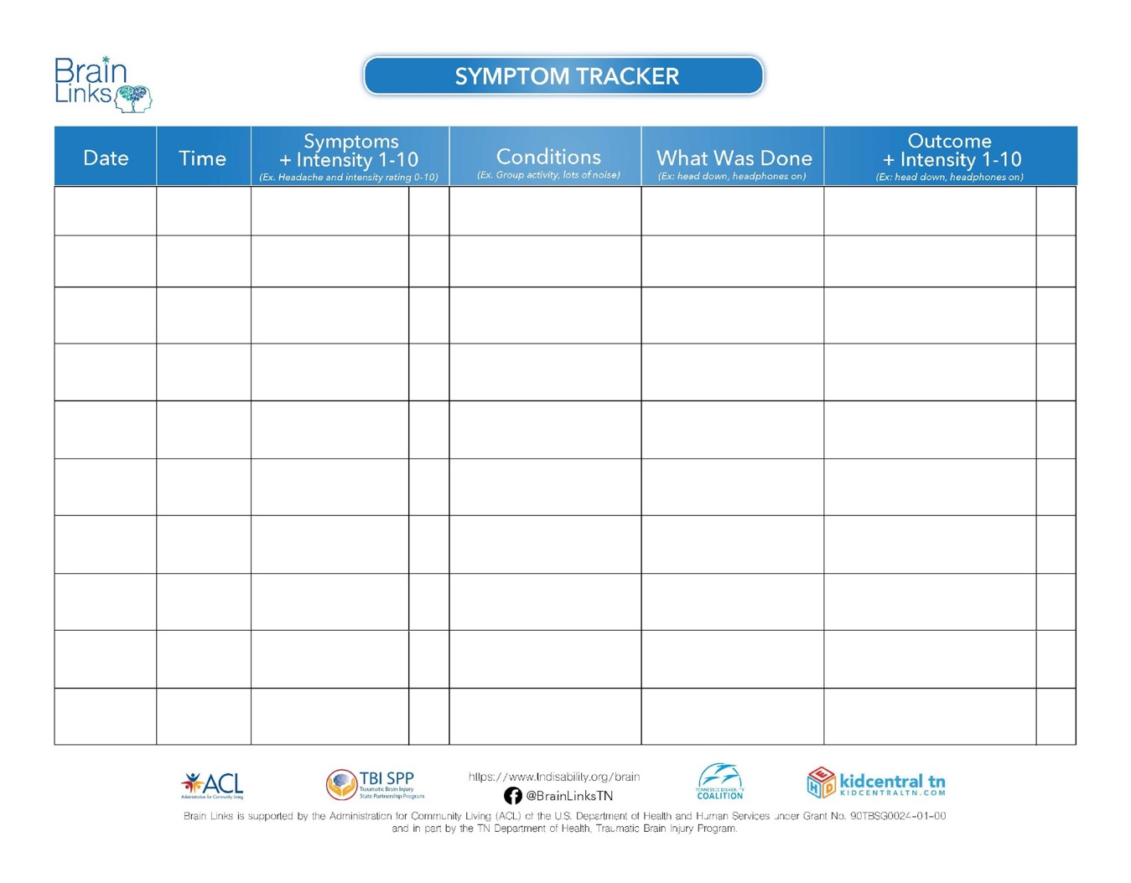
Symptom Tracker
Simple
Quick
List symptom
Occurs during what
What was done
Outcomes
Over time, maybe only a few entries, you learn triggers and how to address them.
Notes:
This is a great for tracking one symptom or a couple to look more carefully at any contributing factors. More so, it gives you something to take back to the doctor and get their help in finding the triggers. You also don’t need to remember the details.
Used to help the family and the school track symptoms. This is particularly good for 1-2 symptoms, like a headache. Then this information can be used to make changes in school or home and should also be taken back to the doctor so they can assess how treatments are working and help determine the need for changes.

Slide 48
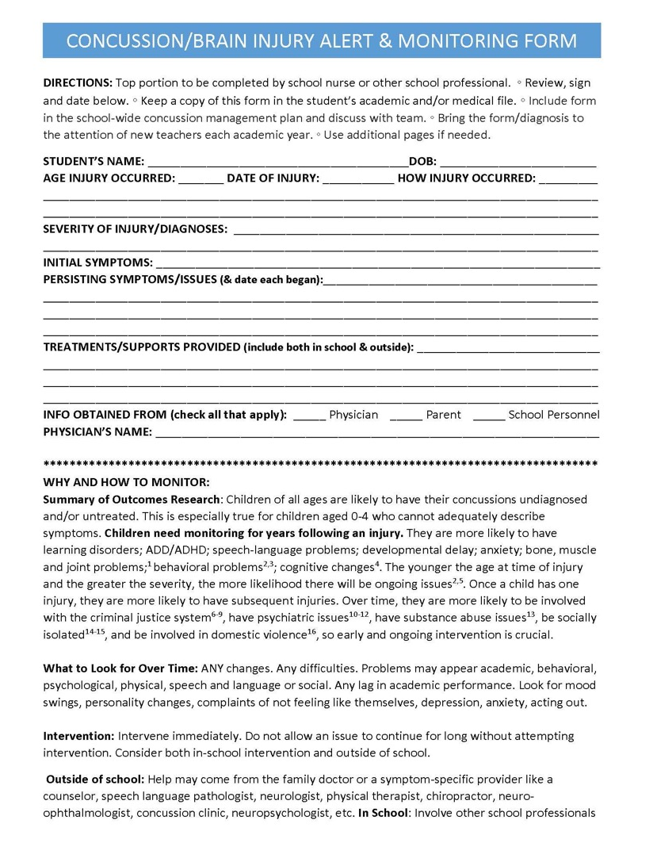
Concussion/TBI Alert Form
In School Nurse’s Chart, Academic Chart, and/or DCS File – great to have in all of these
Injury Overview
Summary of research on outcomes
Summary of what to look for over time: academic, cognitive, social, psychological, behavioral
How to Intervene: In the school, outside of school
Notes:
Can be a front page within a file – Tells you the injury occurred, the doctor who treated the child, and can help you with advocating if needed for a 504 or IEP.
Will also help with getting previous accommodations (adjustments) if injured as a child for ideas for how to help.
Good for alerting new teachers and caseworkers to the injury. (Summarize)
We are working with schools to get this incorporated into their system. Please share with the schools so if issues arise over time, we can point back to the TBI as a possible issue. We need to watch them over time.

Slide 49
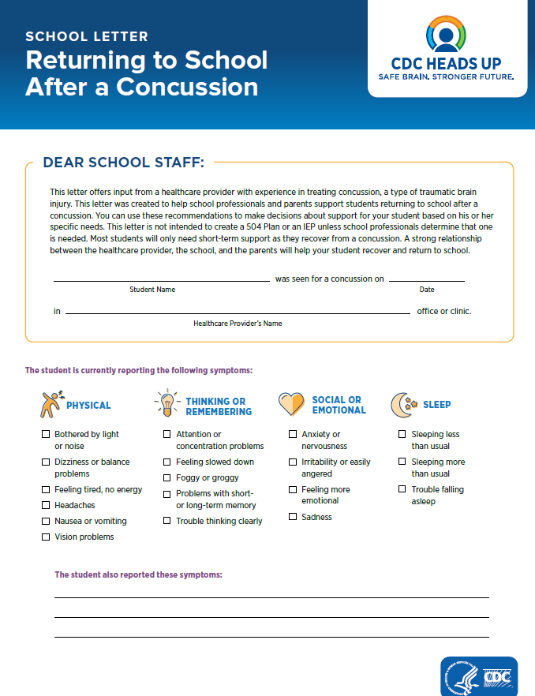
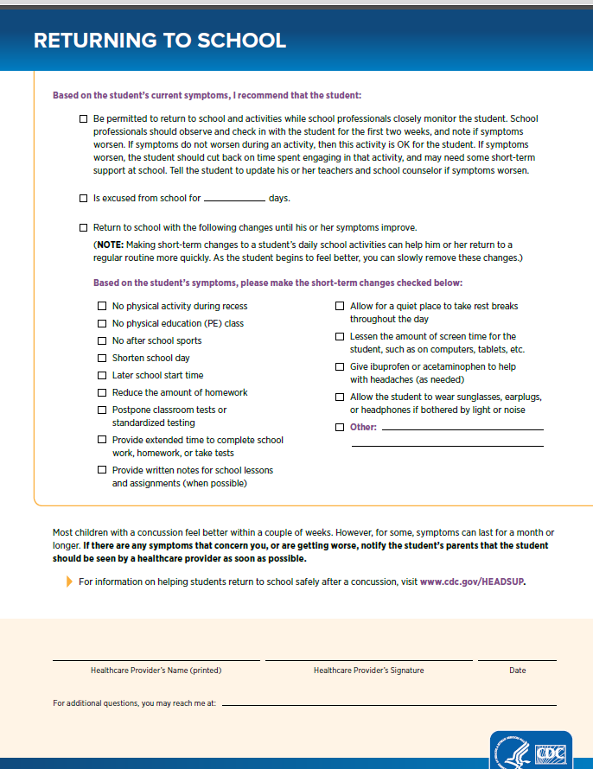
!
!
Notes:
This is the CDC’s Returning to School After a Concussion Letter. We are working with doctors across TN to get it consistently used because research says that if accommodations are given to the school, they are more likely to use them. They don’t have to because they are the experts on academics and only have to follow a doctor’s medical recommendations. But, if the doctor does give them, the child is more likely to get accommodations following a concussion. Please share with any doctors you work with.

Slide 50
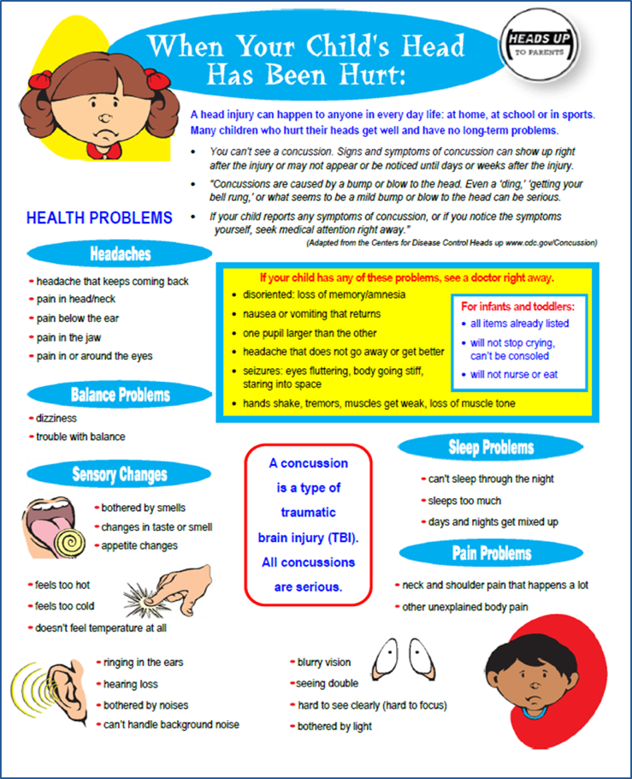
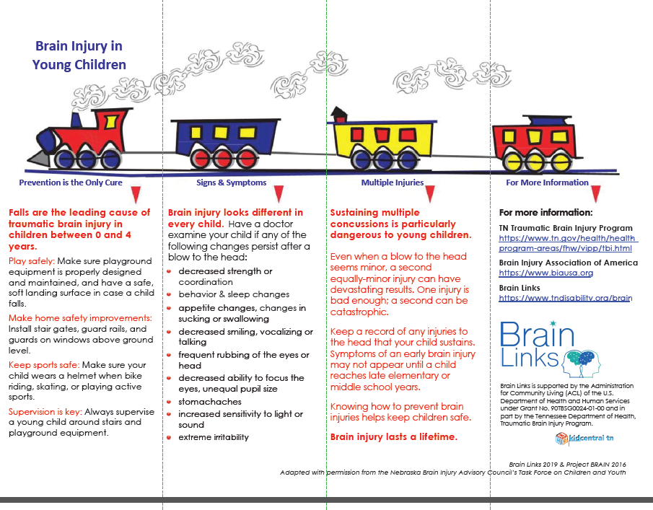
Signs & Symptoms Tools
Adult version and Spanish available
!
!
Notes:
If a child has hit their head, or if a concussion has been diagnosed, you might share this with the preschool and family to help them identify symptoms. This one is for the young child. Spanish is on the back. Please also share this one with doctors.

Slide 51
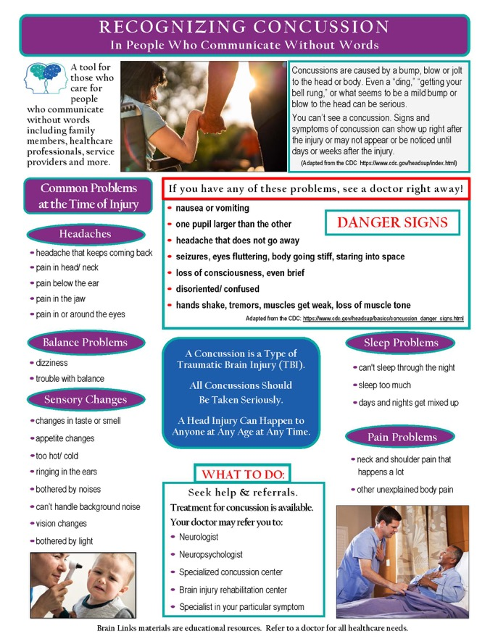
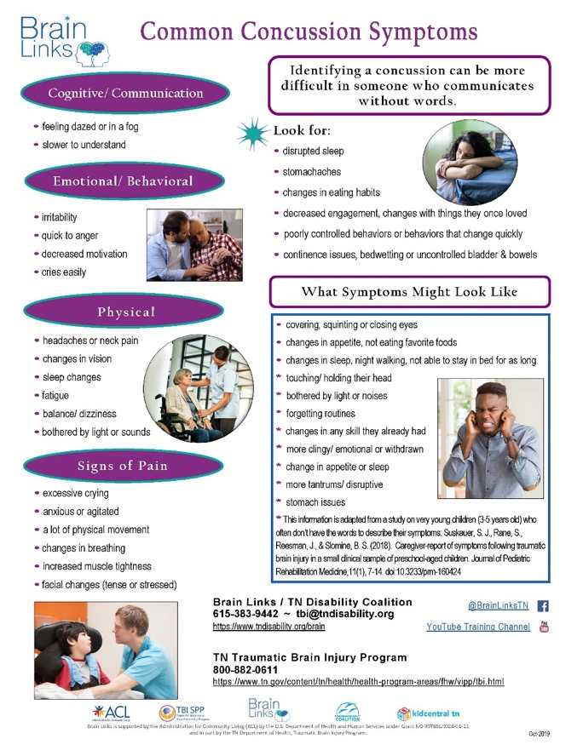
Signs & Symptoms - WOW
Notes:
Our Signs and Symptoms tool is for identifying concussion symptoms in someone who communicates without words. This is good to share with families who have someone like this, even before there is a concussion, so they know what to look for following a fall or other injury. Please also share this with doctors.

Slide 52
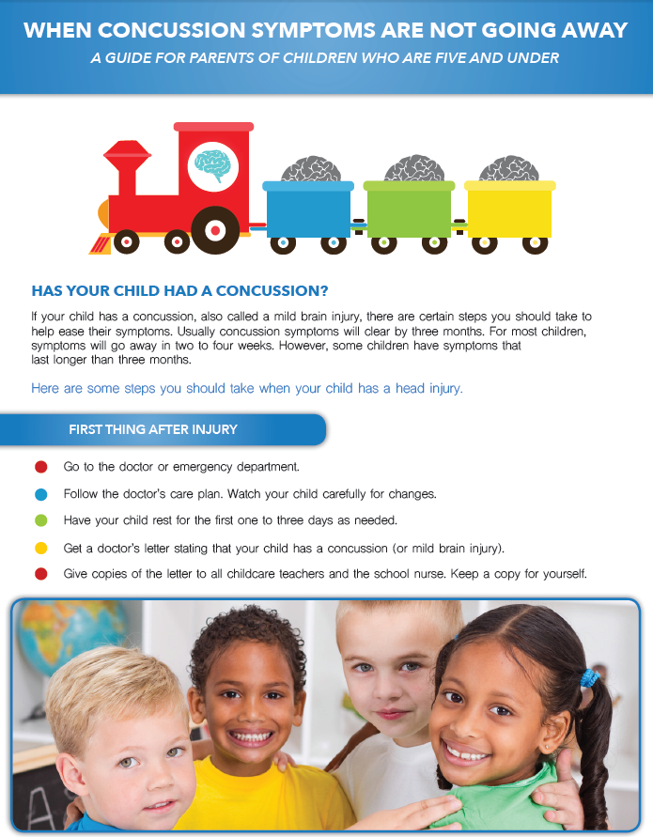
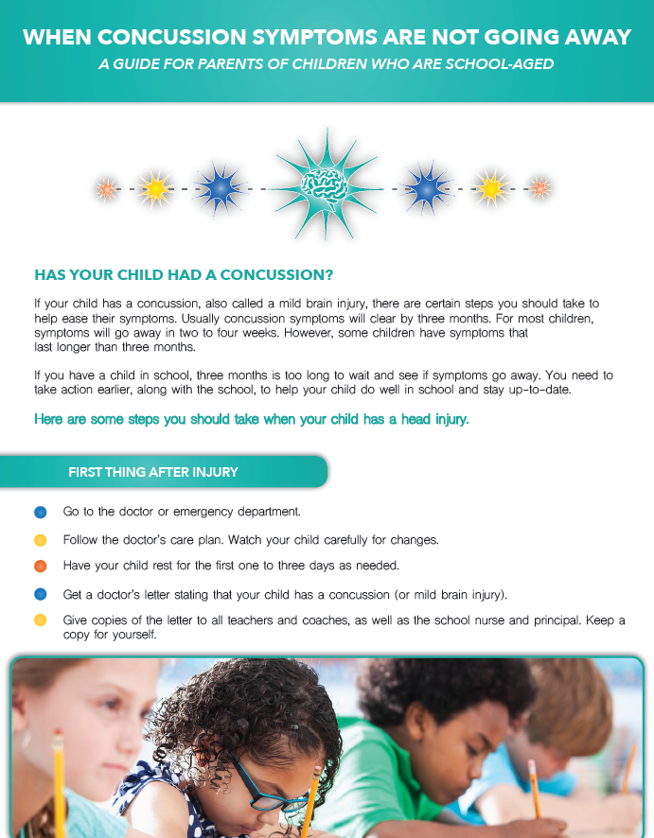
When Concussion Symptoms Aren’t Going Away
Adult version and Spanish Available
Notes:
These two documents are also to give to families when someone is concussed. This is for When Concussion Symptoms Are Not Going Away. This one is for ages 0-5 and helps families understand what to do immediately after an injury but also downstream. It tells them what resources to access and what they should be looking for. This one is for school-aged kids and goes through how to interact with the school and what the school will need. It helps them to understand school concepts like a 504 Plan and an IEP. Please also share both of these with the doctors, along with our website where they can access and download all of these documents.

Slide 53
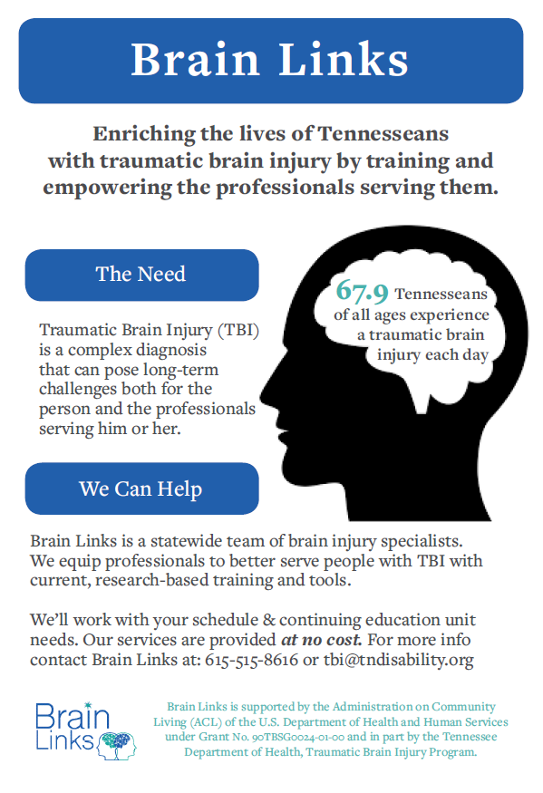
Brain Links Flyer
Trainings for
Schools
Providers in your area
Physicians
SLPs, PTs, OTs, vision, etc.
Anyone else who works with people with TBI

Slide 54
What to Watch for Over Time
Headaches
Changes in sleep
Fatigue
Vision issues
Balance, coordination
Dizziness
Changes in personality
Changes in work performance
Not feeling like themselves
Trouble with attention and thinking
Short term memory problems
Difficulty handling stress
Grades dropping, falling behind in class performance
Notes:
These are included in our signs and symptoms handouts and listed in our When Concussion Symptoms aren’t going away.
We suggest circling those you have noticed and sharing this with your doctor.
Socially – tend to become isolated.
Mood – tend to become depressed.
Behavior – tends to be a big issue. Help them to process situations, plan for problems and brainstorm other responses to avoid unwanted behaviors. Reinforce positive behavior.
Help other people stay involved – help them understand brain injury and this person’s strengths, weaknesses and strategies.
Reputation – be careful what you say. Be sure to stress positive behavior and put challenging behaviors in as positive a way as possible.

Slide 55
Over Time – What You Can Do
Ask “What happened to you, not What is wrong with you?”
Watch them socially
Watch mood (depression, anxiety, mood swings)
Behavior issues
Help other people to stay involved
Watch them physically-greater chance of another injury
Be patient and consistent
Notes:
Especially for a child, don’t expect them to deal with the symptoms like you might expect from an adult.
Be patient. What happened to you, not what is wrong with you.
Socially – tend to become isolated.
Mood – tend to become depressed.
Behavior – tends to be a big issue. Help them to process situations, plan for problems and brainstorm other responses to avoid unwanted behaviors. Reinforce positive behavior.
Help other people stay involved – help them understand brain injury and this person’s strengths, weaknesses and strategies.
Reputation – be careful what you say. Be sure to stress positive behavior and put challenging behaviors in as positive a way as possible.

Slide 56
If You See Any Problems
Refer back to the doctor
Remind doctor of the Concussion/TBI/AHT
Tell doctor all changes that you are seeing
Give doctor the Symptom Tracker
Don’t hesitate to suggest what referrals you think may be needed
Take appropriate steps within the school
!
!
Notes:
Referrals might be a PT or an OT – if you know it’s needed, don’t think you can’t suggest it.

Slide 57
Communication
Caseworkers
Communicate with the
School
Family
Primary care provider and specialists
Rehabilitation
Facilitate communication between these groups
Share information about the injury, its known consequences and potential consequences at every visit and at every transition:
New teacher, new school, new home, new doctor, new caseworker, etc.
Notes:
Foster parents – this can apply to you, too. Share any info you have.

Slide 58
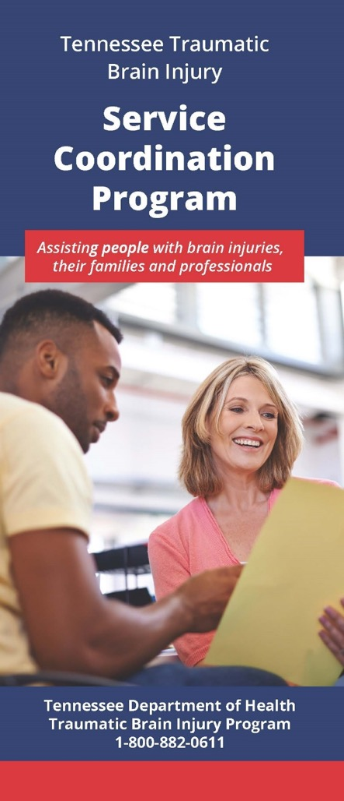
Service Coordination
Free Service
The service coordinator works with survivors and their families to assess their current resources and needs. The service coordinator:
develops a comprehensive plan of care
provides referrals to available resources
coordinates services for individual client advocacy
assists in applying for the Family Support Fund
CURRENTLY OFFERING VIRTUAL SUPPORT GROUPS
http://www.braininjurytn.org/service-coordination.html
Notes:
Also on the TN Dept of Health’s TBI Program’s website – you can find how to talk with your local TBI service coordinator. There are 8 SCs across the state and they work directly with the individual and or their family to connect to brain injury related services. They also host the local support groups. Now, they have the virtual support groups online. Those have been a great way for people to join conveniently from their phone or computer and meet other people. The meeting have different topics and speakers. That’s just a few of the great resources we can share with you today, but please check out our website or follow Brain Links on social media for more.

Slide 59
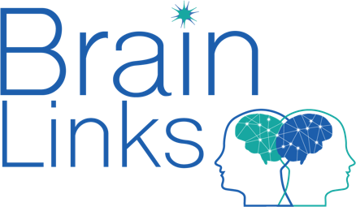
Thank you!
www.tndisability.org/brain
*** More web-based training available https://bit.ly/2W5GCIK
Brain Links is supported by the Administration for Community Living (ACL) of the U.S. Department of Health and Human Services under Grant No. 90TBSG0024-01-00 and in part by the TN Department of Health, Traumatic Brain Injury Program.
Tennessee Disability Coalition
955 Woodland Street | Nashville | TN |37206 | 615-383-9442 www.tndisability.org/brain

Slide 60
Webinar Series with Dept. Children’s Services
2020 Webinars:
May 19 10-11:30 CST
11-12:30 EST
Cognitive Issues
June 23 10-11:30 CST
11-12:30 EST
Behavior/Psychosocial
July 21 10-11:30 CST
11-12:30 EST
Brain Health
For DCS Staff, Foster Parents and entire community
*** More web-based training available https://bit.ly/2W5GCIK
Notes:
https://tngov.webex.com/mw3300/mywebex/default.do?service=7&nomenu=true&main_url=%2Ftc3300%2Ftrainingcenter%2FLoading.do%3Fsiteurl%3Dtngov%26UID%3D-99999999%26RT%3DMiM3%26siteurl%3Dtngov%26apiname%3Dj.php%26MTID%3Dtad2f961b83c313356d26e9fa443619d0%26FM%3D1%26rnd%3D0326843294%26servicename%3DTC%26ED%3D945810632%26needFilter%3Dfalse&siteurl=tngov

