Slide 1
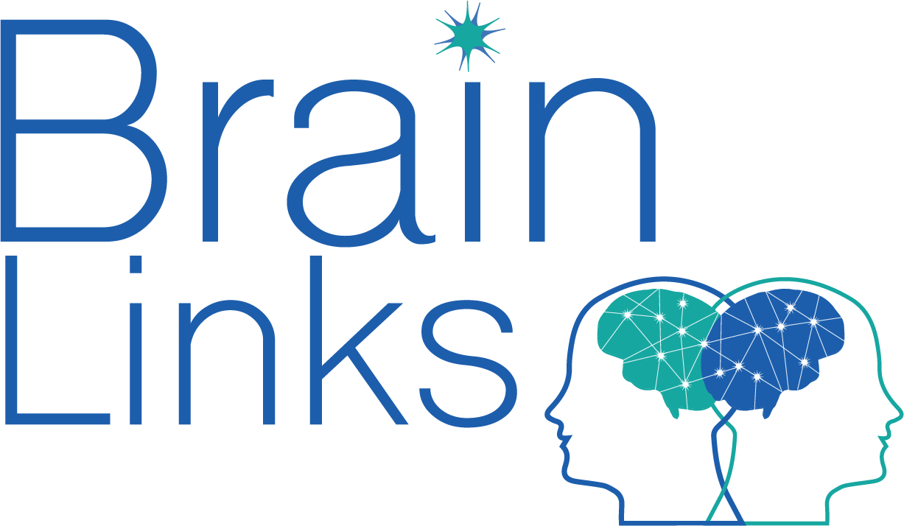
Supporting Brain Health
Department of Children’s Services
Wendy Ellmo MS CCC-SLP, BCNCDS
Brain Injury Specialist
Certified Brain Health Coach

Slide 2
Brain Links is supported by the Administration for Community Living (ACL) of the U.S. Department of Health and Human Services under Grant No. 90TBSG0024-01-00 and in part by the TN Department of Health, Traumatic Brain Injury Program.

Slide 3
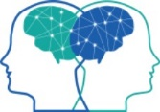
Brain Links
Who we are
Statewide team of brain injury specialists
What we do
We equip professionals to better serve people with TBI with current research-based training and tools.
Family-friendly educational materials
Resources for return to school, work & care settings
Toolkits for healthcare providers and school nurses
YouTube Training Channel
Notes:
Here’s a little more about us: Brain Links is a statewide team of brain injury specialists. There are four of us total. Jennifer in East TN, Wendy and Paula in Middle and Carrie who is in West TN.
We equip professionals to better serve people with TBI with current research-based training and tools.
One thing I like best about us - We work had to make sure that we offer family friendly materials that are interesting and easy to use.
Our resources are made to serve people all ages – from 0-5 to school age, to adult and older adults.
Our toolkits are a collection of TBI resources for healthcare providers and school nurses.
We now have full training and short clips on our YouTube Channel. We have playlists including one just for DCS.

Slide 4
Agenda
How life and what we do can damage/change our brains
Show things you can do every day to improve your brain

Slide 5
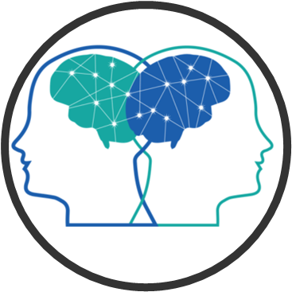
Disclaimer
Brain Health
For additional Brain Health resources:
Speak with your doctor
Center for Disease Control https://www.cdc.gov/aging/publications/features/healthy-body-brain.html
Memory Rescue – book by Dr. Daniel Amen

Slide 6
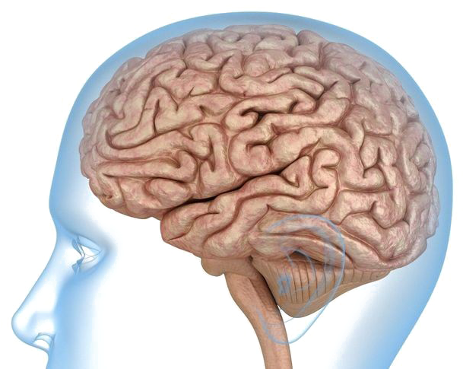
What do you want your brain to look like?
Notes:
As we begin, I’d like you to think about your brain. Or the brain of someone you love or serve. Now think about how you would like it to look as it ages. This, here, is a nice, healthy brain.

Slide 7
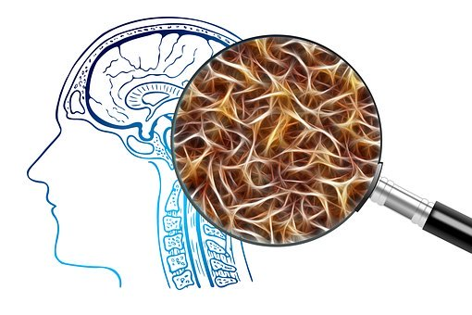
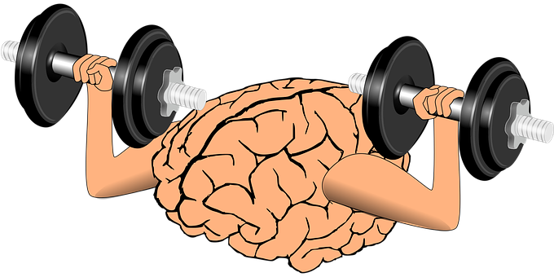
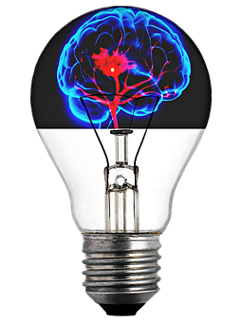
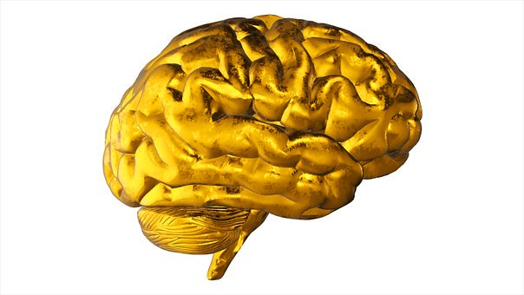
Notes:
Would you like it to be healthy and full of information that is easily accessed? With lots of connections that communicate quickly? One that has lots of ideas and creativity and solves problems?

Slide 8
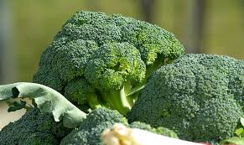
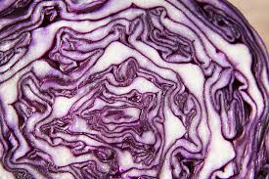
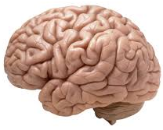
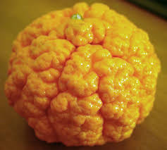
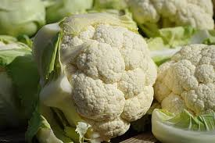
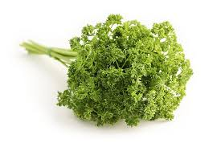
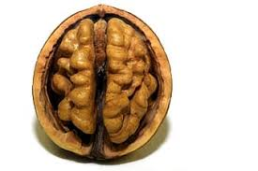
How do you want it to be fueled?
Notes:
What would you like it to be fueled by? Take a look at how much these brain-healthy foods look like the brain.

Slide 9
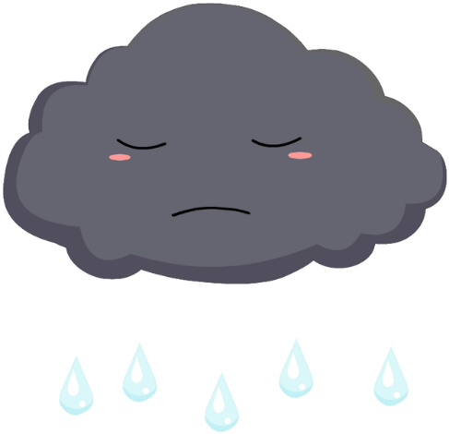
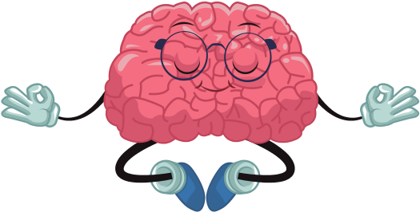
Notes:
What overarching mood would you like our brain to have? And how would you like it to react to stress?
https://www.clipartmax.com/max/m2i8N4K9N4N4K9H7/

Slide 10
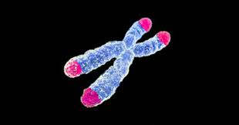
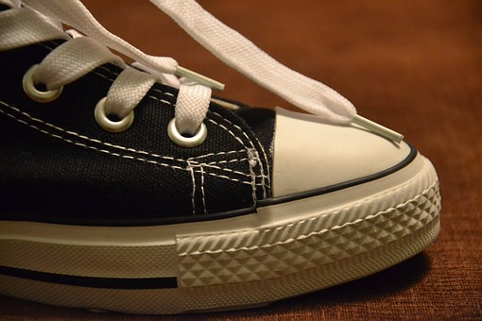
Things that impact our brains
ACEs (Adverse Childhood Experiences)
Brain Changes
The way the brain processes memory & emotion, and how we deal with stress
Produce brain chemicals that lead to inflammation & weaker connections in the brain
Change our telomeres – leads to faster cell aging, more diseases and shorter lives
Notes:
Some of these things are things we have done to our brains. And other things are just the result of living our lives…what has happened to us in our life.

Slide 11
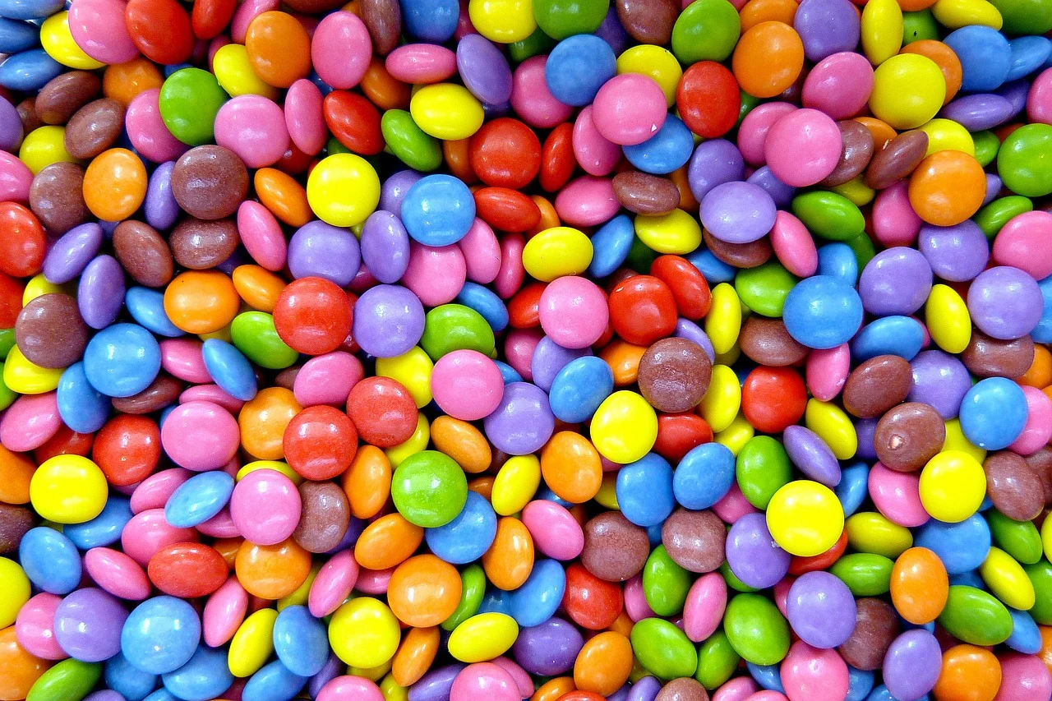
Things that impact our brains
Inflammation
Sedentary Lifestyle
Genetics
Toxins
Mental Health
Infections

Slide 12
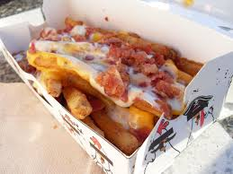
Things that impact our brains
Neurohormone Deficiencies
Obesity
Diabetes
Poor Sleep
Lack of New Learning
Notes:
Some of these things are things we have done to our brains. And other things are just the result of living our lives…what has happened to us in our life.

Slide 13
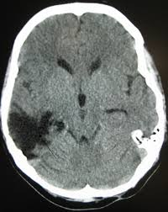
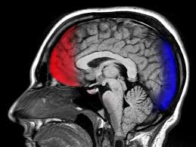
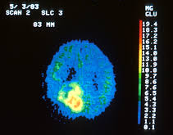
Brain Injuries
Traumatic brain injury
Stroke
Tumor, etc
Notes:
Even concussions can be seen years later on a special type of scan called a SPECT – if we don’t work to change it.

Slide 14
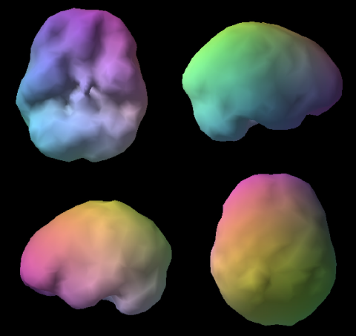
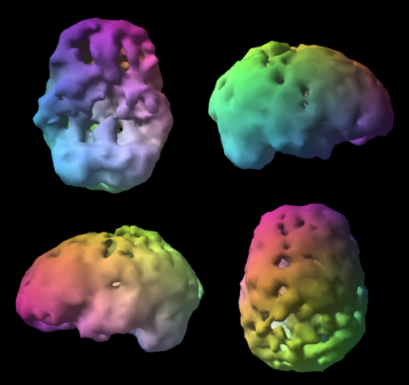
Healthy Brain
Brain on Alcohol & Drugs
Amenclinics.com

Slide 15
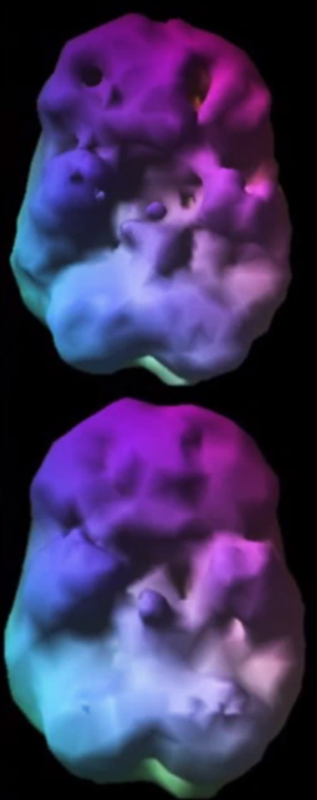
We CAN change our brains!
What we’re seeing in this brain
Multiple concussions
Damage to the anterior temporal poles
Asymmetry – left side worse
Bad temper
But! …
He changed
his brain!
Notes:
Someone with multiple concussions. Anterior temporal poles both damages. Asymmetry – left side worse. Bad temper. Made changes and brain improved.

Slide 16
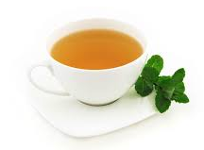
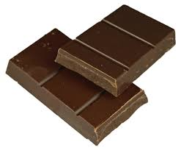
As we go…
Notes:
As we go, and you are sipping on your green tea and nibbling a piece of dark chocolate, I’d like to ask you to keep a list going – separate from any notes you may take – that lists the specific things you are going to do to improve your brain health and or the health of someone you love. At the end I’ll ask you to put one in the chat.

Slide 17
Things You Can Do (or Teach) to Improve Brain Health

Slide 18
Be Resilient
Post Traumatic Growth
Improved relationships
New possibilities for our lives
Greater appreciation for our lives
Greater sense of personal strength
Spiritual development
Tennessee Disability Coalition
Tedeschi & Calhoun
Notes:
2 psychology professors, Tedeschi & Calhoun have done research into resiliency. They found that we actually have the ability to grow through the challenges that we have in our lives. They called this POST TRAUMATIC GROWTH. If we allow ourselves to grow through these challenges, we can actually derive some benefits. Some of these include:
Improved relationships
New possibilities for our lives
Greater appreciation for our lives, and
Spiritual development

Slide 19
A woman’s pastor saw her in the grocery store and asked her why she hadn’t been to church lately. Aren’t you concerned about the hereafter?” he asked. “I’m concerned every day,” she replied.
“I go into the kitchen or the bedroom and am constantly asking myself what am I hereafter?”
Notes:
Hopefully, this is NOT what is meant by “spiritual development in that last study.

Slide 20
Cultivate Resilience
A commitment to find meaning
A belief in your capacity to create a positive outcome
The willingness to grow
The CHOICE to laugh and be grateful
Bonanno
Notes:
So how do we cultivate resilience? Resiliency experts, including psychology professor George Bonanno of Columbia University say that we can become resilient by….
A commitment to find meaning
A belief in your capacity to create a positive outcome
The willingness to grow
The CHOICE to laugh and be grateful

Slide 21
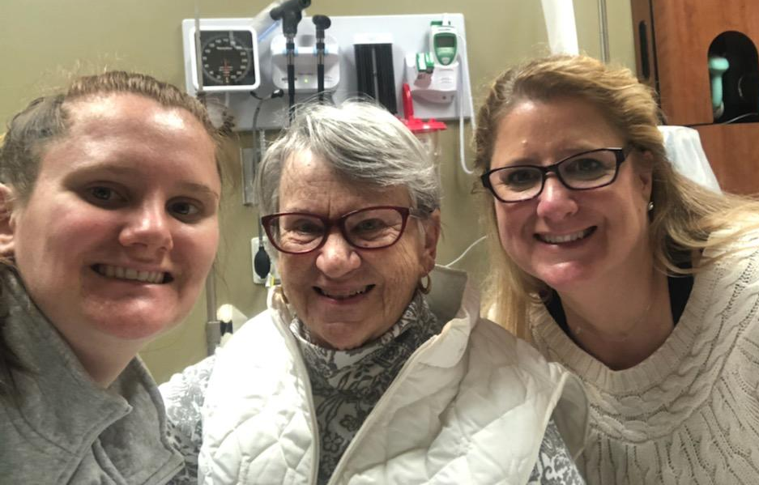
An Approach to Resilience
2 Questions to ask Yourself:
“What could possibly be right about this?”
“What in your life or yourself can you be grateful for right now?”
MJ Ryan, How to Survive Change You Didn’t Ask For
Notes:
MJ Ryan wrote a great book called How To Survive Change You Didn’t Ask For. And in it, she says that she asks 2 questions while in the middle of a challenge or change.
“What could possibly be right about this?” I get that this can be hard to do…. This helps us to find meaning and to grow. Positive psychologists call it “creative construing”, the ability to assign meaning to what we are going through that pulls us into the future in a positive way.
“What in your life or in yourself can you be grateful for right now?” There IS something. Even if it is that right now your family member is alive.
I get that this can be a very hard mind set. Think about someone who you know who is negative or a worrier. It is so easy for them to continue to be negative or to worry. They have literally trained their brain to think that way. So the next time a situation arises, their brain is ready to fire that way. So we may need to make a conscious effort to think this way (positively) for a while, but it can become easier. Let’s talk more about gratitude now.

Slide 22
Be Grateful
Gratitude Study:
Group 1: Journal what they were grateful for
Group 2: Journal things that annoyed or bothered
Group 3: Journal what happened to them
- Emmons & Mc Collough, J. of Personality & Social Psychology
Notes:
So the second question just asked, ”What is there you can be grateful for.?” So that’s the next thing to do…be grateful.
There is some evidence that there’s increased depression in folks with TBI as they age, so that’s something we want to be mindful of and head off at the pass.
Emmons & Mc Collough did a study where they asked one group of people to write down what they were grateful for each day, another group to write down things that bothered or annoyed them and another to just write down what happened. What they found was that…(next slide)

Slide 23
Outcomes of the Gratitude Study
Greater levels of well-being and optimism
Also
Exercised more
Slept better
Woke up more refreshed
Lower blood pressure
Less inflammation
Better immune function
More likely to help someone else with a problem
Lower levels of cortisol (stress hormone)
Notes:
The ones who wrote down something they were grateful for showed positive results and the more they wrote, the stronger the effect.
They had greater levels of well-being and more optimism about the days and weeks ahead. And there were other benefits to their psychological AND physical health:
Exercised more,
slept better,
woke up more refreshed,
more likely to help someone else with a problem,
lower blood pressure,
less inflammation,
better immune function, and
lower levels of the stress hormone cortisol.

Slide 24
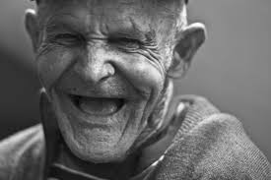
Happy if only vs. Happy in spite of
“I’ll be happy if only…”
-Younger people
“I’ll be happy in spite of…”
-Older people
Carl Pillemer of Cornell
Notes:
Carl Pillemer is a gerontologist. He studies older people and he saw a difference in the way that older people looked at life versus younger people. Older people had the life experience to know that things happen in life and they are not always good things. They tend to develop the ability to be happy even though things are not perfect. They CHOOSE to be “happy in spite of.” While younger people tend to be hold off their happiness and want to pin it on some future accomplishment or attainment. “I’ll be happy when I get that raise.” “I’ll be happy when I finish that test.” So what is our “to-do” now? We can choose to be happy NOW and not wait for something to happen in the future. We can CHOOSE to be happy now, even though things might not be perfect in our lives at the moment.

Slide 25
Preserve Mental Health
Kill the ANTs
Automatic Negative Thoughts
4 Questions
“Is it true?”
“Can I absolutely know it’s true with 100% certainty?”
“How do I feel when I believe the thought?”
“Who would I be or how would I feel if I didn’t have the thought?”
“Don’t believe every stupid thought you have.”
Dr Daniel Amen, Amen Clinics

Slide 26
Be Stress-Free
Notes:
Your next thing to do…Be Stress-Free! This really translates into “stop your worrying!”
Stress causes the brain to age faster and leads to a decline in brain growth factors. The key is not getting rid of things that could possibly stress you because there will always be things that could. The key is changing the way you respond to those things.
I love this quote by Mark Twain: “I have been through some terrible things in my life, some of which actually happened.”
We spend so much time in the future – and that’s what worry is – it’s fear of something happening in the future. And most of the time it never happens. That takes a terrible toll of both the physical body and our mental states. He also said, “Worrying is like paying a debt you don’t owe.”
So what do we do? Only deal with the PRESENT. Remember, worry is future-based. If there are things you are concerned about, take action on them. Look at what the FACTS are – not your fears or worries. Then take a look at what RESOURCES you have to help you.

Slide 27
“If you have fear of some pain or suffering, you should examine whether there is anything you can do about it.
If you can, there is no need to worry about it. If you cannot do anything, then there is also no need to worry about it.”
-Dalai Lama
Notes:
The Dalai Lama says, “If you have fear of some pain or suffering, you should examine whether there is anything you can do about it. If you can, there is no need to worry about it. If you cannot do anything, then there is also no need to worry about it.”
So there is really no need –ever- to worry. Worry only produces negative effects on the mind and body.
Other things that help decrease stress: meditation (20 mins), yoga (20 mins), physical activity (30 mins), 8 hrs of sleep, and relaxation techniques, especially those that focus on breathing.
Let’s take a look at the next thing.

Slide 28
Relaxed Breathing
Headache Relief Guide
https://www.youtube.com/watch?v=YKxV07cisPA&feature=youtu.be
Notes:
https://www.youtube.com/watch?v=YKxV07cisPA&feature=youtu.be

Slide 29
Find Purpose & Joy
Notes:
Our next to-do is to find purpose and joy. Both are important. Both are good for brain health. Purpose without joy can eventually lose it’s sense of purposefulness and joy without purpose loses it’s joy. You don’t have to get both out of the same thing, but you need both in your life. For example, for me, working in an oncology unit, may give me a tremendous sense of purpose, but I don’t know if I would find joy there. On the other hand, working in brain trauma gave me a tremendous sense of purpose and joy. Other people would say to me, “I don’t know how you work there, it must be so sad.” But for me, I always saw the hope and I was fascinated by the brain and all that it did. And I loved being able to use my knowledge and experience to help make a difference in people’s lives.

Slide 30
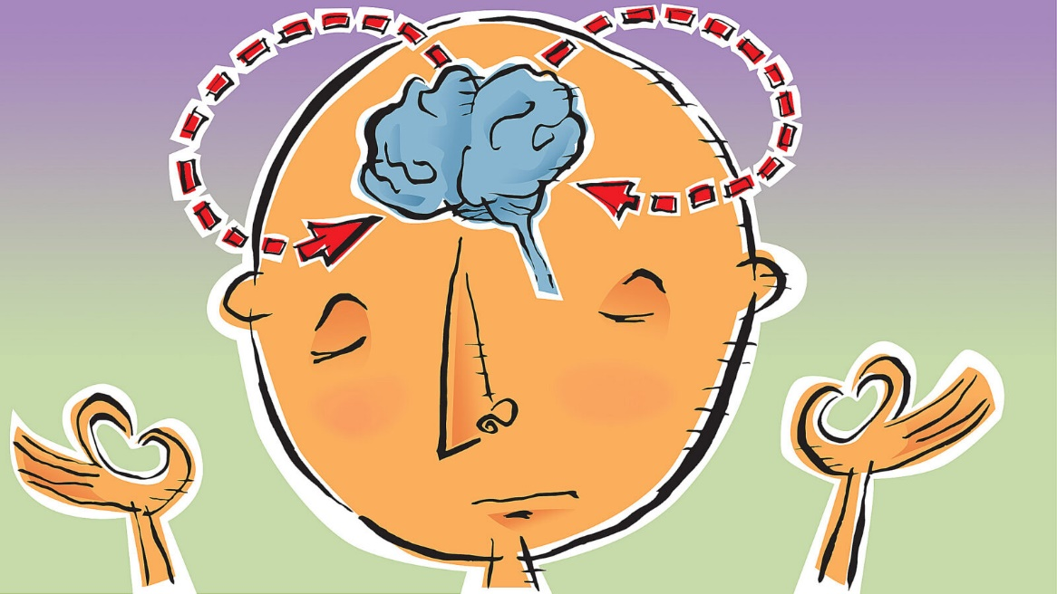
Meditation
Effective for
Depression
Chronic Pain
Anxiety
Attention
Addiction…
Changes in the Brain
More grey matter volume
Quiets down Default Mode Network (DMN)
Increase in Hippocampus
Decreases in Amygdala
Image: The Harvard Gazette
Notes:
More grey matter is important especially with aging – preserves the amount of brain we have
Default Mode Network is where all the chatter happens, our rambling thoughts, often called the “Monkey Mind” – quiet in this area is associated with more happiness.
Increases in the hippocampus – responsible for memory and learning
Decreases in amygdala – amygdala is responsible for fear, anxiety and stress. – people also reported feeling less anxious.

Slide 31
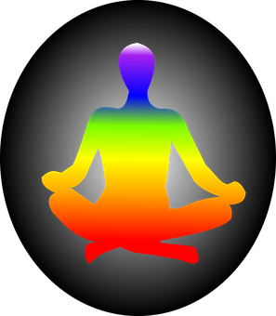
Different Ways to Meditate
Quiet, stilling the mind
Mantra
Guided
Mindfulness…

Slide 32
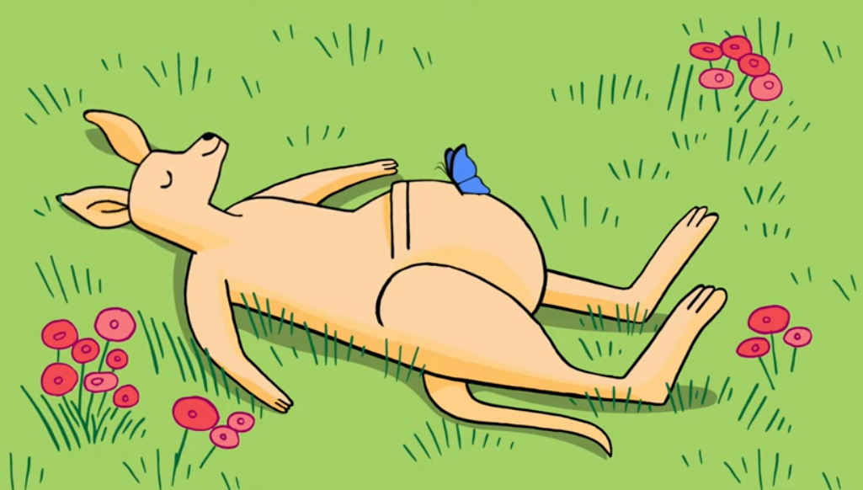
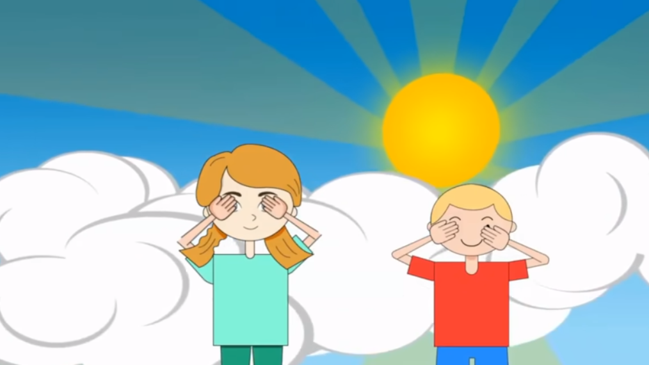
YouTube Meditations for Children and Teens
Butterfly Body Scan
Tree Guided Meditation for Children & Classrooms
Notes:
Butterfly: https://www.youtube.com/watch?v=56_8aK3cLEA
Tree: https://www.youtube.com/watch?v=iplZGpP2VO0

Slide 33
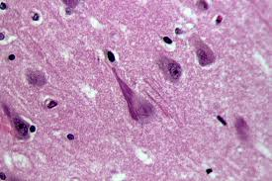
Purpose & Alzheimer’s Disease
Having a sense of purpose determined whether symptoms of Alzheimer’s Disease showed up or not
THE PURPOSE OF A LIFE IS
A LIFE OF PURPOSE.
ROBERT BYRNE
Commons.Wikimedia.org
Notes:
Researchers have long seen that people who have a sense of purpose live longer, fuller and healthier lives than those who don’t. Ex: Toby
Patricia Boyle and her team took an interesting look into the relationship between a sense of purpose and Alzheimer’s disease. They knew from previous studies that people who had a sense of purpose had less memory loss. So they took a look at the brains of people who died. They were looking for the plaques and neurofibrillary tangles that are an indicator of Alzheimer’s disease. What they found was that (from 246 brains) purpose didn’t stop these plaques and tangles from developing in the brain, but it did stop whether they showed symptoms of the disease or not. Their memories were much better. They showed little or no decline.
Boyles interpretation of this was that “having a purpose creates a reserve that enables some brains to form other pathways to transmit signals and nutrients and remain functional. The stronger the purpose, the more protective it is.” (MJ Ryan, Happiness is a Choice you make.)

Slide 34
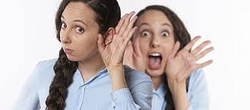
Be Social
Relationships
Decrease risk of dementia
Improve physical health (helps the immune system)
Increase capillary formation and new neuronal growth in the brain
Decrease depression and
Decrease stress
Get Hearing Aids when needed!
(We know who you are)

Slide 35
Learn
Notes:
Having extra cognitive reserve helps us to age well. Learning at any point in our lives helps us build cognitive reserve.
There was a study where older adults were given 10 hours of cognitive training. TEN YEARS later, their memory testing was better and their self-reports of functioning were better. A variety of studies have shown that memory and overall cognition can be improved with cognitive training, even in older adults with MCI (mild cognitive impairment).
No matter what your age, this is important. We used to think that brains only declined with age and only young people could grow new neurons or have what we call plasticity, but improved fMRI scanning has shown that brains continue to develop new neurons throughout our lives and that with “brain exercise” we can continue to increase the number of brain cells.
So we need to keep learning and doing NEW things. This doesn’t just mean be busy. For example, if you’ve knit your whole life and it’s simple for you, it won’t grow new cells, because your brain doesn’t need them to knit. That doesn’t mean give up knitting, but also start something new.

Slide 36
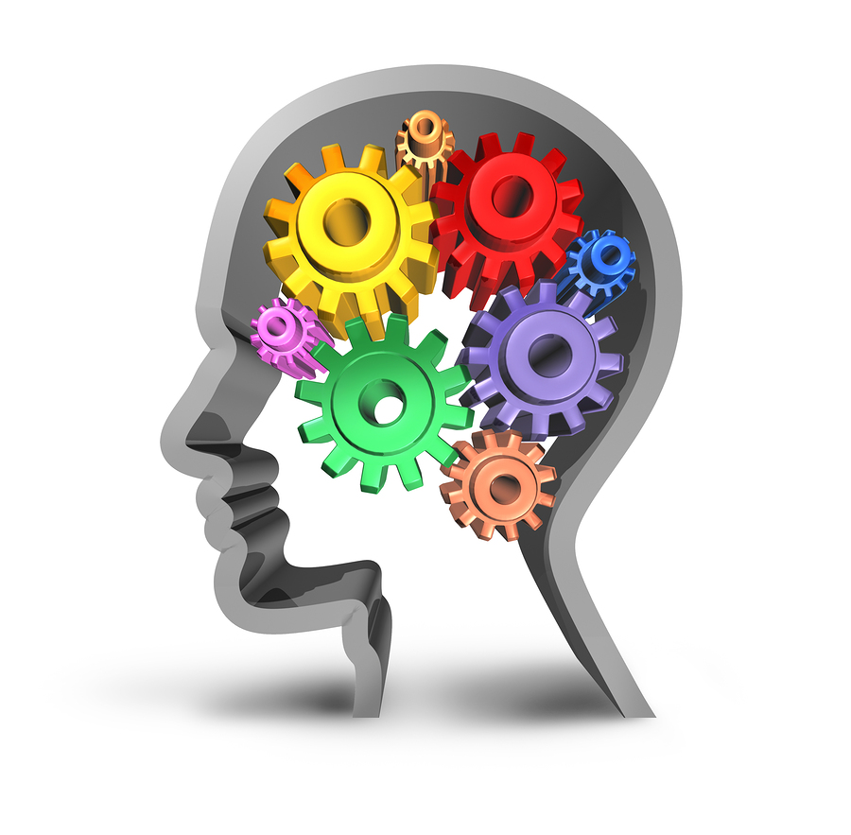
Building Cognitive Reserve

Slide 37
Exercise!

Slide 38
Exercise
Helps depression
Helps with focus
Decreases stress
Lowers blood pressure
Helps control blood sugar levels
Helps maintain healthy weight
Boosts immunity
…and more
Notes:
Exercise also alleviates depression – and there is some evidence to suggest that folks with BI have more depression, as we said, as they age, so we always want to do anything that will help with that.
Exercise elevates mood, helps with sleep, decreases stress and is good for the heart…and the brain!

Slide 39
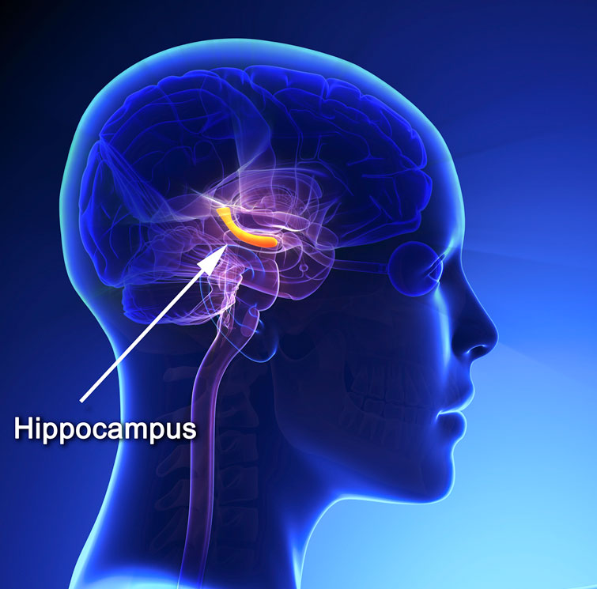
Exercise & Memory
Notes:
The hippocampus is the part of the brain that is very much involved with memory. Long term, mild exercise enhances the hippocampus and protects it against disease processes. The exercise has to be somewhat aerobic (stretching and weight training don’t do it). Aerobic exercise actually REVERSES age-related shrinkage in the memory centers of the brain.
And a lack of exercise negatively impacts the brain.

Slide 40
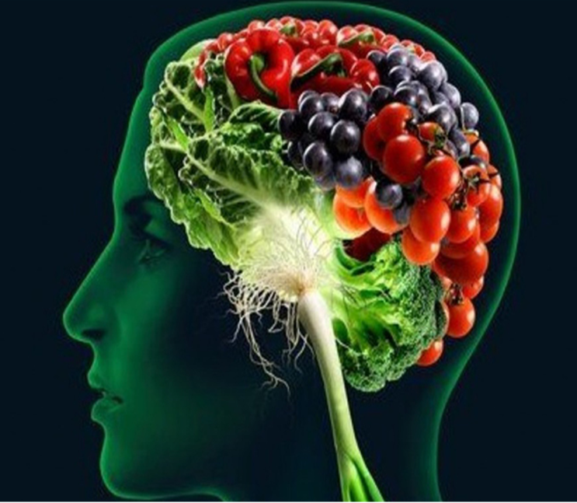
Eat Well
Eat Well.
Start Now.
Notes:
Eating well can reverse heart disease & diabetes.

Slide 41
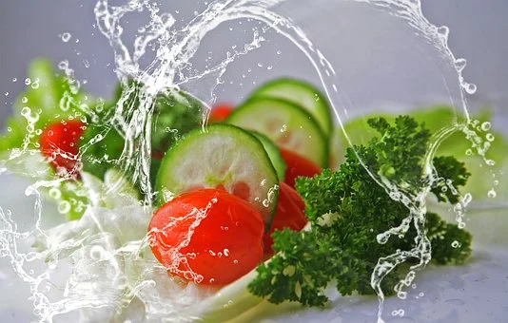
Eat Well
Eating to ward off Alzheimer’s
Currently thought to be incurable, but preventable
Through dietary and lifestyle changes
Guidelines for the Prevention of Alzheimer’s Disease
“Vegetables, legumes (beans, peas, lentils), fruits, and whole grains should replace meats and dairy products as primary staples of the diet.” - J. of Neurobiology of Aging, 2014

Slide 42
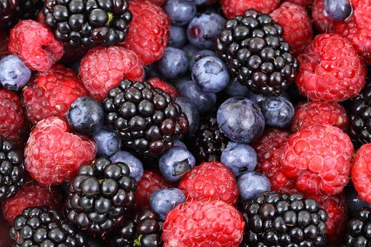
Eating to Ward off Stroke
Fiber
Soluble: beans, oats, nuts, berries
Insoluble: whole grains (brown rice, whole wheat)
Potassium
Best sources: greens, beans, sweet potatoes
Citrus
Decreases blood pressure, increases blood flow
Antioxidants
Plant foods 64Xs more antioxidants than animal foods
Notes:
Some specific things to ward off stroke:
Fiber: 97% of us don’t get enough! It doesn’t take much of an improvement to get positive results and reduce the risk of stroke. So start eating more fiber rich foods like beans, oats, nuts, berries and whole grains.
Potassium: Less than 2% of us get enough! We all think bananas when we think of potassium, but they actually come out # 1,622 on a list of potassium-rich foods, right below Reeses Pieces! Better sources are greens, beans and sweet potatoes.
Citrus: Contains hesperidin which increases blood flow throughout the body – including the brain. It also decreases blood pressure.
Antioxidants: Slow the aging of cells and repairs damage caused by free radicals. We are beginning to see that antioxidant supplements don’t help. We need to get them from food. On average, plant foods contain 64 times more antioxidants than animal foods. Spices come up high, so eat a lot of them as well. Antioxidants also help to prevent damage to the sensitive cell walls of the small blood vessels in the brain, they decrease artery stiffness, prevent clots from forming, decrease blood pressure and decrease inflammation.

Slide 43
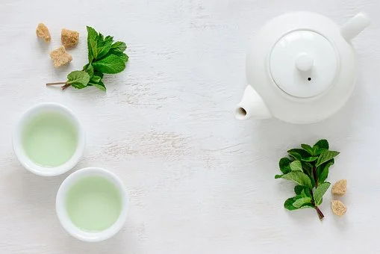
Green Tea Fun Fact:
Neuroprotective
Neurorestorative
Notes:
Not only will green tea help to heal the brain once it is damaged, but it is also neuroprotective. If you have green tea in your system when you are injured, it will help to protect the brain from damage.

Slide 44
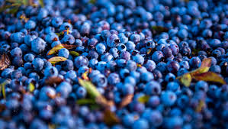
Fun Fact:
Wild Maine Blueberries
Good for
Health of Blood Vessels
Blood Vessel Regeneration
Reducing Inflammation
Lowering Blood Pressure
Enhancing Mood
Notes:
two polyphenol fractions found in wild blueberries, anthocyanins and phenolic acids
Get ORGANIC if not getting the wild Maine ones – non-organic blueberries contain the highest levels of pesticides. Easy to find frozen. Great in smoothies, healthy baked goods, etc.

Slide 45
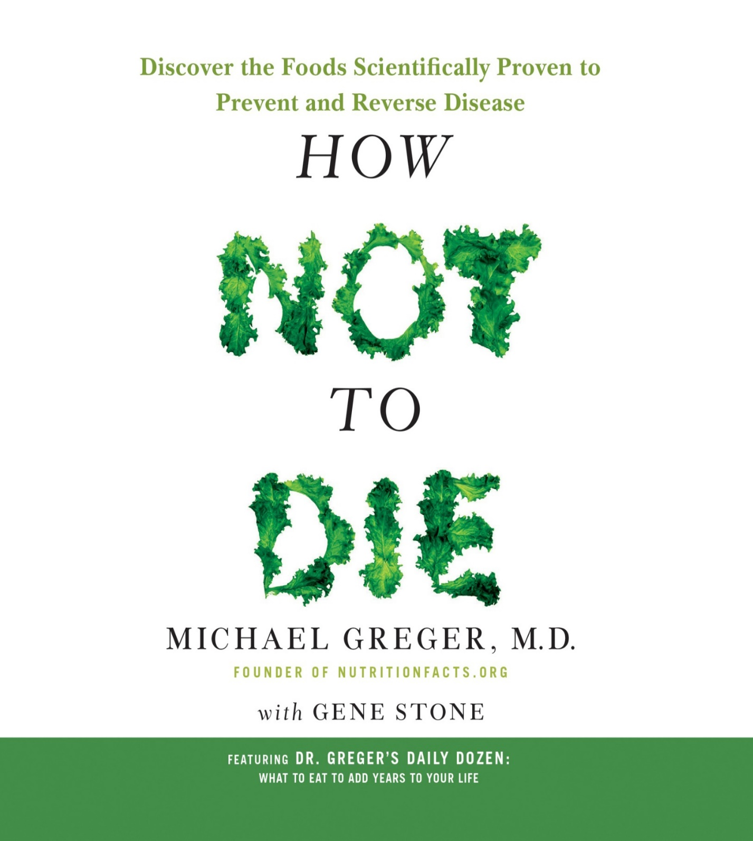
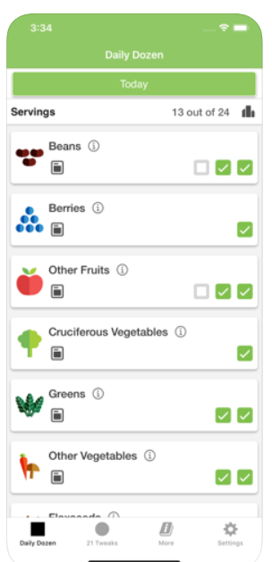
Notes:
In fact, if you want to read more, there’s a great book called How Not to Die by Dr. Michael Greger. In it, he covers all the evidence out there about nutrition and how it helps us to “not die” from the 15 leading things that kill Americans, like heart disease, diabetes and high blood pressure. Lucky for us, he also covers Brain Diseases which comes up #3 on the list.
The bottom line for ALL of the categories is whole foods, plant-based. Be careful, because a lot of the diets out there pick and choose their studies, don’t use studies at all, or focus on what they think Americans can do food-wise and not what they should. And many are aimed at short term weight loss, and don’t look at long term effects on the body. One example of this is high protein and low carbs.
Studies have shown that some foods impact certain cognitive domains, and others impact others, so it’s important to get a variety of plant foods.

Slide 46
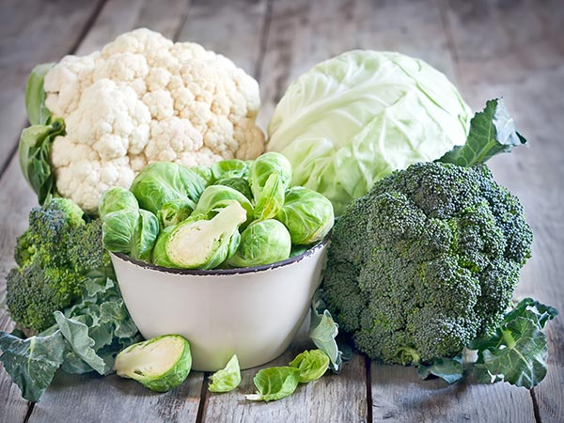
Cruciferous Fun Fact
Enzyme Sulforaphane
Protects brain, eye sight
Protects from free radical damage
Helps detoxification
Helps prevent and treat cancer
But almost NO sulforaphane in cooked
What to do
“Hack and Hold”: chop, wait 40 mins, then cook – enzyme is now there. So broccoli soup – blend first, then cook
For frozen (no enzyme) or cooked cruciferous: Add little bit of mustard powder or horseradish. Or add some fresh greens to your cooked greens
https://nutritionfacts.org/video/second-strategy-to-cooking-broccoli/

Slide 47
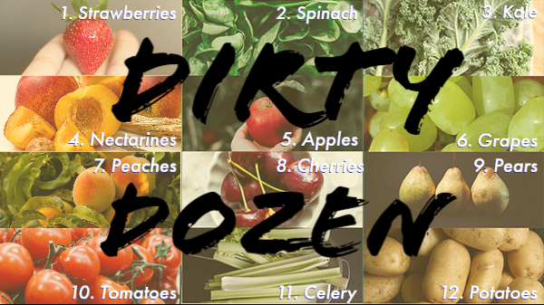
Remove Toxins
Food
Go organic
Grow your own
Reduce alcohol
Drink filtered water
Don’t eat processed foods
Watch artificial colors and sweeteners
Go vegetarian or vegan
Image: producebluebook.com List: ewg.org
Notes:
This could have gone under the last section on food, but I thought I’d further highlight the toxins in food.

Slide 48
Remove Toxins
Products
housecleaning
personal hygiene - www.safecosmetics.org, Think Dirty App
Environment
mold, smoke, paint fumes
Notes:
The dietary part of the 2014 “Dietary and Lifestyle Guidelines for the Prevention of Alzheimer’s Disease” that were published in the Journal of Neurobiology of Aging was “Vegetables, legumes (beans, peas, lentils), fruits, and whole grains should replace meats and dairy products as primary staples of the diet.”

Slide 49
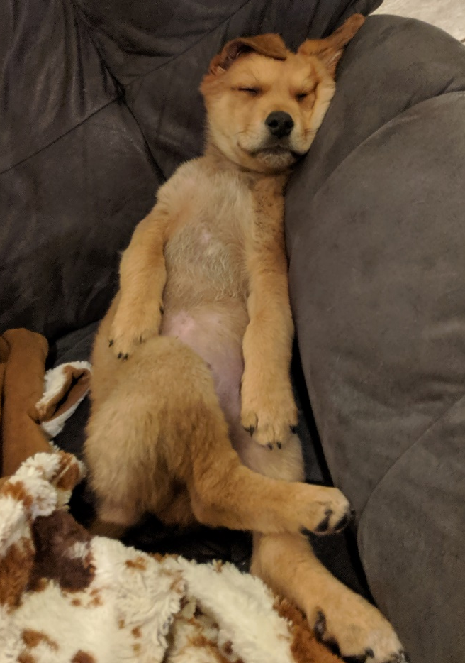
Sleep
For children’s needs at each age:
webmd.com/parenting/guide/sleep-children#1
Your brain cleans itself of toxins and plaques during the night.
If not cleaned, it causes brain fog, memory issues and can lead to dementia.
Strategies
Treat sleep apnea
Get 7-8 hours of sleep a night
Reduce/manage stress
Reduce use of electronic devices at night
Stick to a regular schedule
Reduce caffeine, especially at night
Drink chamomile tea
Kill the ANTs
Fix what keeps YOU up at night
Notes:
One theory about why people with dementia sleep so much is because their brain is trying to clean all of the plaques and other gunk.
Chronic insomnia leads to many other things like stroke, pain, cardiovascular disease, anxiety, cancer, death from any cause.
Sleep Apnea: “Untreated sleep apnea triples your risk of dementia and depression makes it hard to lose weight. It looks like Alzheimer’s disease on SPECT sans, with decreased blood flow to the parietal and temporal lobes.” Amen, Memory Rescue p245
Fix what keeps you up at night. You probably have an idea of what it is. Take care of it. Try some things or seek help. For me, for an overactive mind, it’s often enough to say, “don’t worry, it’ll be there in the morning.” For chronic pain and related restless leg, nightly stretching has been a life-saver or should I say sleep saver and has had many benefits that flow over to the daytime.

Slide 50
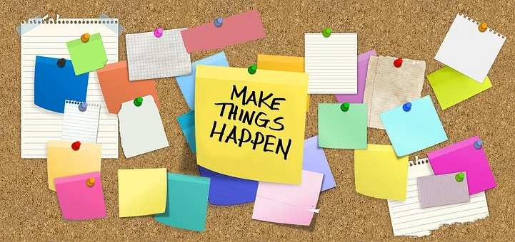
Post in the chat the Change YOU will make

Slide 51
Brain Health
How to Have a Healthy Brain Throughout Life
Evidence-based information on
Eating Well
Exercise
Being Social
Learning
Mental Health
Gratitude
How to Make Change
Free Resources
Resilience
Purpose and Joy
Brain Injury Prevention
Avoiding Toxicity
Sleep
tndisability.org/brain

Slide 52
Making Change
Best way to change others is to change yourself first.
Approaches
1. One small change at a time
Example: this month no diet soda, next month no red meat
2. Clean up one area at a time
Example: clean up my food - switch to veganism
3. Tackle everything at once
Example: Become a vegetarian, walk 1 mile everyday…
My example:
Decide who you can be accountable to

Slide 53
Daily Check-off
Resilience | Gratitude | Preserve Mental Health | Reduce Stress
Find Purpose & Joy | Be Social | Learn | Exercise
Eat Well | Remove Toxins | Sleep | Monitor Health*

Slide 54
Daily Check-off
Write 2 things I’m grateful for
Killed the ANTs!
Meditate 10 minutes
Brisk walk 20 minutes
10,000 steps daily
Call a friend (3 times a week)
Fill in Gregor App
4 Vegetarian Days a week
Sleep 7 hours
Blood pressure ___________
Blood sugar __________
Monthly: 1 new book read, 1 new thing tried

Slide 55
What will your approach be?
Notes:
Green check!!! Change image

Slide 56
Thank you!
www.tndisability.org/brain
*** More web-based training available https://bit.ly/2W5GCIK
Brain Links is supported by the Administration for Community Living (ACL) of the U.S. Department of Health and Human Services under Grant No. 90TBSG0024-01-00 and in part by the TN Department of Health, Traumatic Brain Injury Program.
Tennessee Disability Coalition
955 Woodland Street | Nashville | TN |37206 | 615-383-9442 www.tndisability.org/brain
Notes:
https://www.youtube.com/channel/UC5NeDDc1pzWyt0YKDHx015A/videos
https://www.facebook.com/BrainLinksTN/

